Slide 1




Responding to Emergencies in Humanitarian Context
Day
10

Slide 2
Learning outcome
Participants will be able to explain the impact and consequences of rapid and protracted crisis in a Humanitarian context.
Participants will relate and interpret the role of the communities, organizations and governments to address crises in a holistic approach.
Participants will be able to explain and compare among different emergency global responses
Participants will be able to explain about the Rapid Need Assessment approach in crisis settings and able to assess the critical needs, prioritize resources, and respond effectively using the approach.

Slide 3
Let’s test ourselves before we start
What is a sudden-onset crisis?
Which of the following is a primary
goal of a Rapid Needs Assessment (RNA)?
A. A crisis that develops over a long period
A. To delay the response planning process
B. A crisis that occurs abruptly with significant immediate impact
B. To identify the basic needs of the population for prioritizing assistance
C. A crisis caused by prolonged drought
C. To provide long-term recovery plans
D. A crisis without any immediate impact
D. To exclude government authorities from the response process

Slide 4
The Correct Answers
What is a sudden-onset crisis?
Which of the following is a primary
goal of a Rapid Needs Assessment (RNA)?
A. A crisis that develops over a long period
A. To delay the response planning process
B. A crisis that occurs abruptly with significant immediate impact
B. To identify the basic needs of the population for prioritizing assistance
C. A crisis caused by prolonged drought
C. To provide long-term recovery plans
D. A crisis without any immediate impact
D. To exclude government authorities from the response process

Slide 5

Let’s test ourselves before we start
True or False
Emergencies can disrupt access to basic needs such as food, water, shelter, and healthcare, leading to increased vulnerability and potential long-term adverse effects on affected populations.

Slide 6
Correct Answer
True

Slide 7
Sudden-onset crises, such as natural disasters or conflicts, significantly exacerbate existing humanitarian crises by increasing complexity and straining resources. These events can worsen health inequities and challenge the financial sustainability of relief efforts, as immediate needs divert resources from ongoing projects. Effective response requires rapid adaptation and coordinated efforts, adhering to humanitarian principles to balance immediate and long-term needs. Evaluating and improving policies is crucial for managing these compounded crises, as highlighted in various studies and reports, including those from UNHCR and CERF, which stress the importance of principled and sustainable humanitarian action.
Effect of Crisis

Slide 8
Protracted crises, characterized by prolonged conflicts, displacement, and disruptions to livelihoods, significantly exacerbate existing humanitarian situations by compounding vulnerabilities and straining resources. These crises lead to multidimensional challenges, requiring humanitarian actors to extend their roles and resources to address prolonged displacement and fill social safety net gaps. The economic and social impacts are profound, affecting health, livelihoods, and social stability. New emergencies, such as the COVID-19 pandemic, can amplify these existing crises, highlighting the need for adaptive and sustained humanitarian interventions. Building resilience is crucial for managing these prolonged emergencies and supporting long-term recovery efforts
Effect of Crisis

Slide 9
Consequences of emergencies
Emergencies in humanitarian settings can have severe and varied consequences, including:
Death and Physical Injuries
Sexual and Gender-Based Violence
Mental Health Issues and Emotional Distress
Children in Armed Conflicts
High mortality rates and injuries among the affected population.
Increased risks of SGBV due to the breakdown of social structures.
High prevalence of mental health issues such as trauma, depression, distress and anxiety.
Recruitment of children by armed groups.
Missing and Separated Children
Crimes
Displacement
Poor Health and Nutrition
Higher incidents of missing, unaccompanied, and separated children.
Increased risk of child trafficking, kidnapping, theft.
Mass displacement of populations.
Deterioration in health and nutritional status.

Slide 10
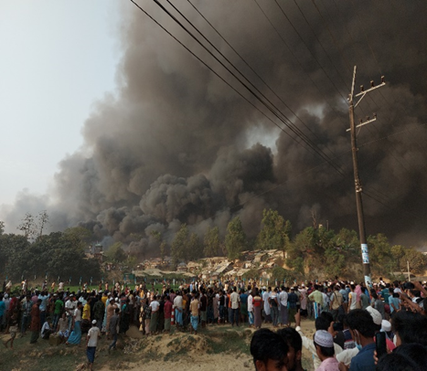
Case Study from Rohingya Crisis
(camps 8E, 8W, 9 & camp-10 at Ukhiya) in the afternoon on March 22, 2021. The fire ignited from camp 8E and it soon spread to Camps 8W, 9 and 10 leaving over 10,000 infrastructures including houses, child friendly space (CFS), community centers, temporary learning center (TLC) and many other offices fully or partly affected. The incident triggered a mass relocation of people, including children, who were taking shelter in other camps. Many Rohingya people were psychologically affected and compared the disaster to their forced migration from Myanmar on 25th august, 2017. The fire destroyed homes and spaces of the Rohingya community, leaving families and children feeling lost, confused and isolated.
Photo source: BRAC IED photo archives

Slide 11
Participants will write their reflections on the following questions in a padlet
1
2
3
What would the next steps be to ensure wellbeing and play-based learning for children, despite damage to the centers?
What, in your opinion, are the urgent requirements of the afflicted communities that need to be addressed?
What would the next steps be to ensure wellbeing and play-based learning for children, despite damage to the centers?

Slide 12

Emergency Response and Management in Humanitarian Context
**Assess the Situation**
**Activate Emergency Plans**
**Establish Communication Channels**
**Ensure Safety and Security**
**Provide Immediate Relief**
**Address Health and Medical Needs**
**Support Mental Health and Psychosocial Well-being**
**Coordinate with Other Organizations**
**Plan for Recovery and Rehabilitation**
**Maintain and Restore Education**
**Monitor and Evaluate**
**Document and Learn**

Slide 13
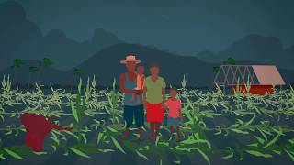

Needs Assessment in Emergencies

Slide 14
Rapid Needs Assessment during Emergency
RNA is a critical tool used in the first three days of a disaster to collect and analyze information about the affected populations' needs. It involves government authorities and various humanitarian actors to establish a common understanding of the situation, prioritize assistance, and plan for subsequent actions.
Purpose
To identify the immediate needs of the population and prioritize assistance.
Timing
Conducted within the first three days of a disaster.
Participants
Administered by government authorities with involvement from various humanitarian actors.
Outcome
The findings inform the strategic plan for emergency response.
It’s important to note that while RNA provides a broad assessment of needs, it can be complemented by in-depth sectoral assessments that can be carried out in the months following a disaster or in a slow onset emergency.
Learn more here.

Slide 15

In humanitarian contexts, various sectors play critical roles during emergencies to ensure the well-being and safety of affected populations. Let’s delve into these sectors:
Roles of Different Sectors
1
Food Security: Ensuring access to food during emergencies is crucial. Humanitarian agencies distribute food aid, promote agricultural recovery, and address malnutrition. They collaborate with local farmers, markets, and food suppliers.
2
Water, Sanitation, and Hygiene (WASH): WASH interventions prevent the spread of diseases. Organizations provide clean water, sanitation facilities, and hygiene education. Proper sanitation prevents outbreaks and promotes health.
3
Health: Health services are vital during crises. Medical teams treat injuries, illnesses, and provide preventive care. They also manage disease outbreaks and immunization campaigns.
4
Livelihoods: Livelihoods programs focus on helping people regain their means of earning a living. This might involve cash assistance, vocational training, or support for small businesses. By restoring livelihoods, communities become more resilient and self-reliant.
5
Shelter: Providing safe shelter protects people from the elements and ensures their privacy and dignity. This includes distributing tents, repairing homes, and establishing temporary settlements.

Slide 16
Roles of Different Sectors
6
Protection: Protection actors work to prevent and respond to violence, exploitation, and abuse. They safeguard vulnerable groups, such as women, children, and refugees. This sector also addresses legal rights and psychosocial support.
7
Education: Education is essential even in crisis situations. It provides stability, a sense of normalcy, and helps children and youth continue learning. Humanitarian organizations work to establish safe learning spaces, provide educational materials, and support teachers.
8
Nutrition: Malnutrition is a common issue in emergencies. Nutrition programs focus on treating malnourished individuals, especially children, and pregnant or lactating women.
Notes:
Resource Source: announcement_mhpss-preparedness-event-ankara-2024_final_.pdf

Slide 17
Response Levels: Community, Organization and Government
In many cases, community members are the first responders during emergencies. Their immediate actions can save lives and provide essential support. Communities possess local knowledge about their environment, resources, and vulnerabilities. They can quickly mobilize resources, share information, and support each other.
Community Level
Importance
Communities are the first line of defense during crises, leveraging local knowledge and networks.
Roles
Communities organize evacuation, resource distribution, and communication channels.
They collect and distribute relief supplies efficiently.
Communities mitigate isolation by providing emotional support.
They disseminate real-time updates and collaborate with responders, contributing to community resilience.
Additionally, first responders—trained professionals who arrive promptly at the scene—play critical roles in assessment, life-saving interventions, stabilization, coordination, and communication during crises. Together, communities and first responders create effective crisis responses, safeguarding lives and minimizing damage.

Slide 18
Response Levels: Community, Organization and Government
Organization Level
Government Level
Humanitarian organizations play a critical role in emergency response by:
Collaborate with other agencies, NGOs, and community groups to ensure a unified response.
Allocate resources efficiently (e.g., personnel, supplies, funds) to address immediate needs.
Disseminate accurate information to the public, stakeholders, and affected communities.
Provide essential services (medical care, shelter, food) promptly.
Involve local communities in decision-making and response efforts.
The government administer overall emergency response efforts, including:
Set clear policies, guidelines, and priorities for crisis response.
Activate emergency protocols and mobilize resources.
Ensure critical infrastructure (transport, utilities) remains functional.
Enforce regulations and facilitate inter-agency coordination.
Protect citizens, maintain order, and manage evacuation if necessary.

Slide 19
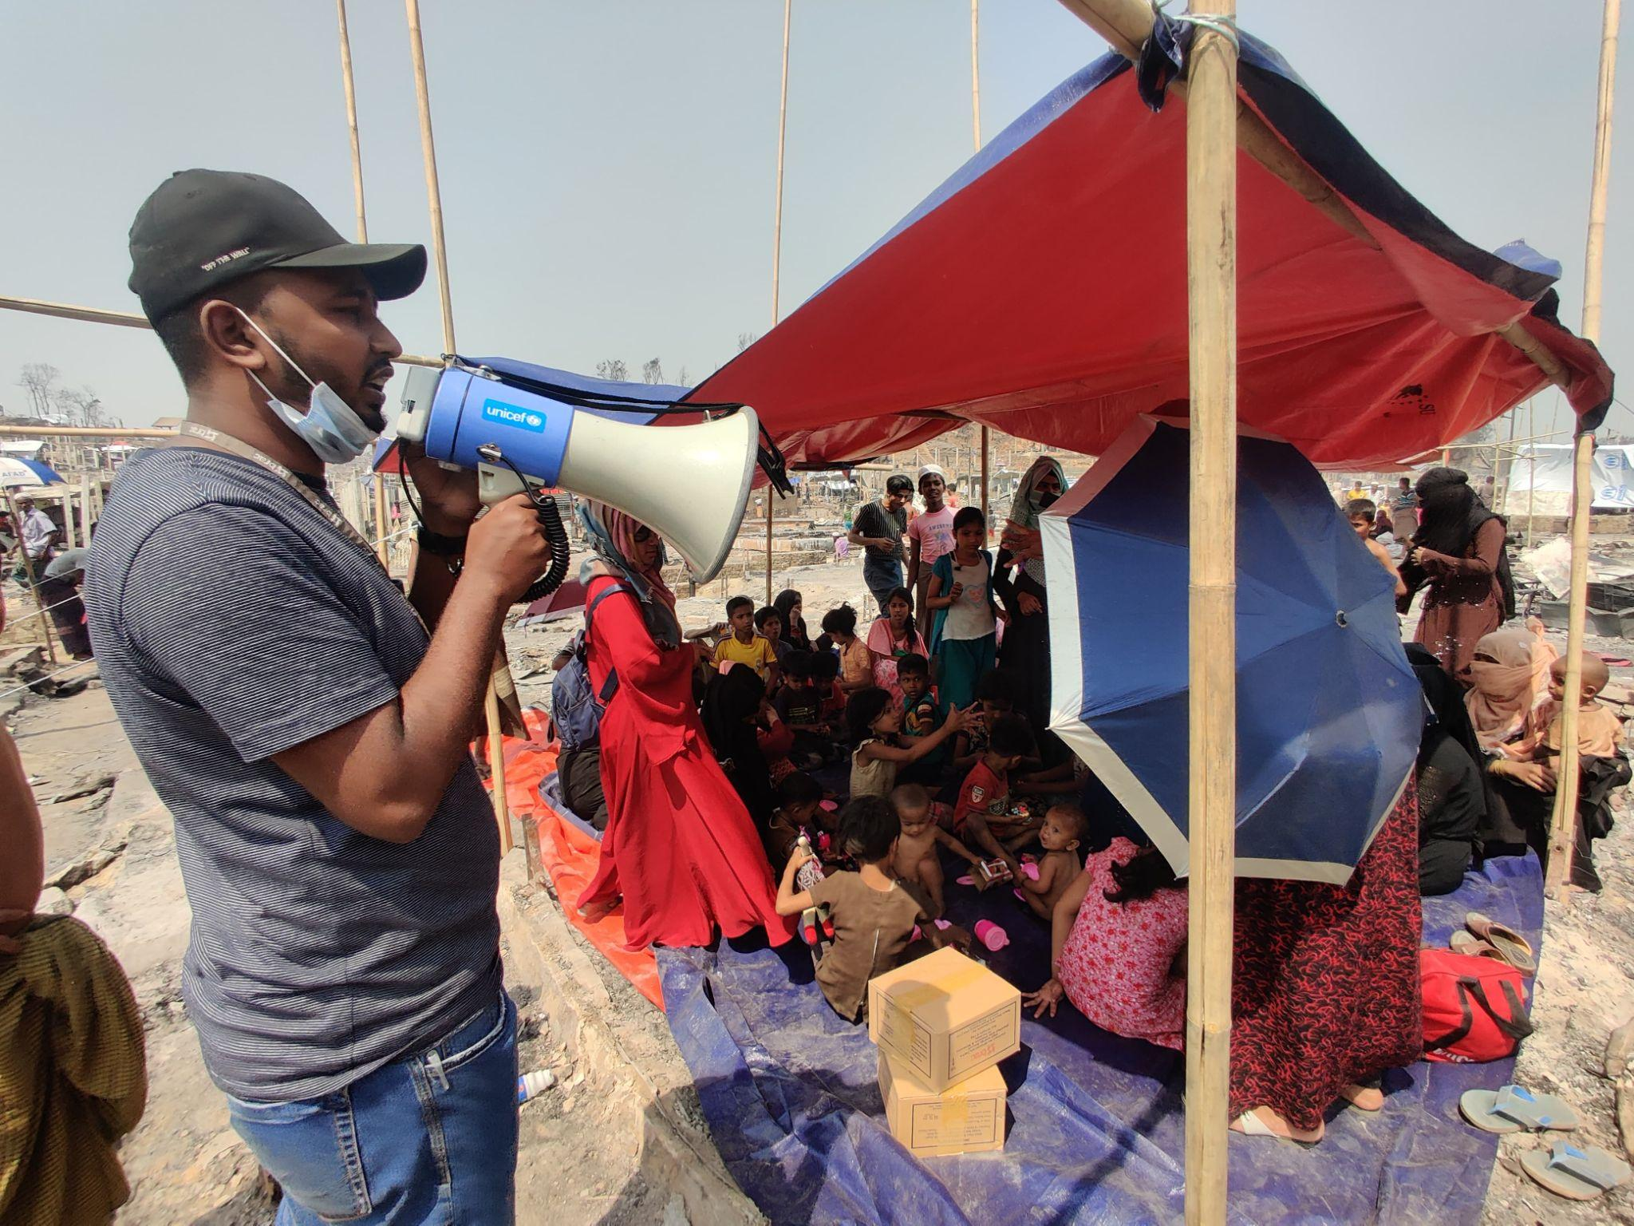
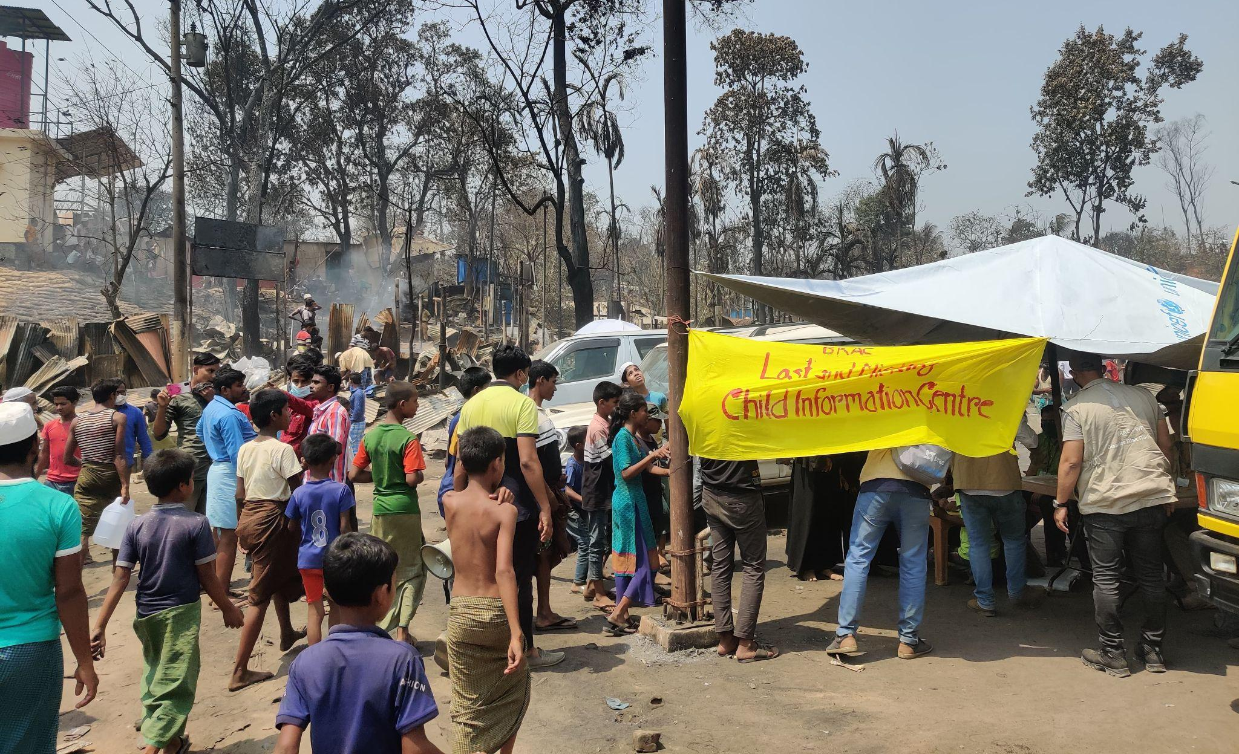
BRAC Response in March 2021 Fire Incident
BRAC Child Protection was actively operating in the camps where the fire incident occurred on 22 March 2021. After the fire broke out, around 3PM, the staff from BRAC Child Protection promptly established lost and found booths at the three designated exit routes of these camps.
In anticipation of such emergencies, BRAC had previously stored emergency response kits in large cargo containers situated just outside the camps. These kits were equipped with items such as megaphones and small tents. The megaphones were used to call out to lost children, while the tents served as safe spaces for them.
This proactive measure was taken to ensure the protection of children who were separated from their families during the chaos, providing them a secure environment until they could be safely reunited with their families.
What action did BRAC take to promptly respond to the fire?

Slide 20
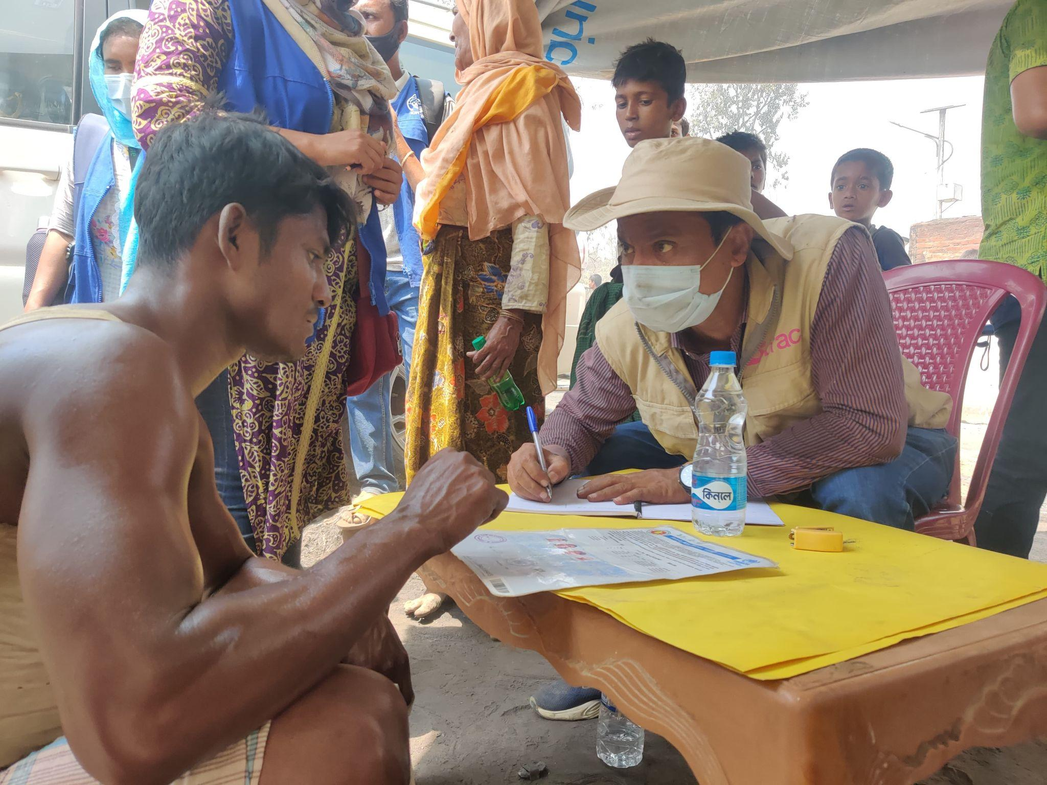
Case Continued
By around 10PM, more than 150 children had been registered at these lost and found booths. While many were successfully reunited with their families, a handful, including children as young as 3 years old, needed to be cared for overnight.
Previously, BRAC had trained community members to serve as emergency caregivers. The children who were not reunited with their families by nightfall were entrusted to these caregivers.
In the following days, BRAC made efforts to locate the families of these children. This was done by circulating messages within the affected community and coordinating with service providers. However, throughout this process, BRAC exercised utmost caution to maintain the privacy and confidentiality of the children's information. This was to prevent any potential perpetrators from exploiting the situation to their advantage.
How did BRAC engage community members during the response?
Photo source: BRAC IED photo archives

Slide 21
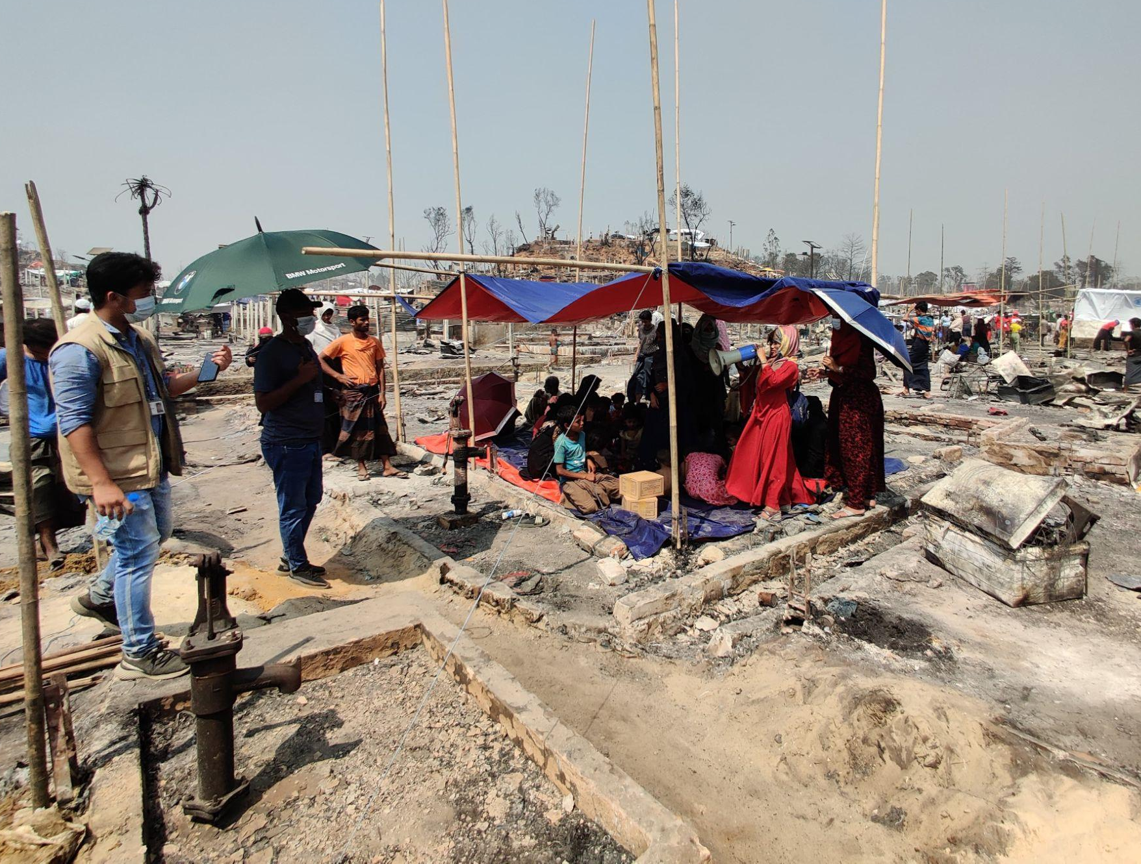
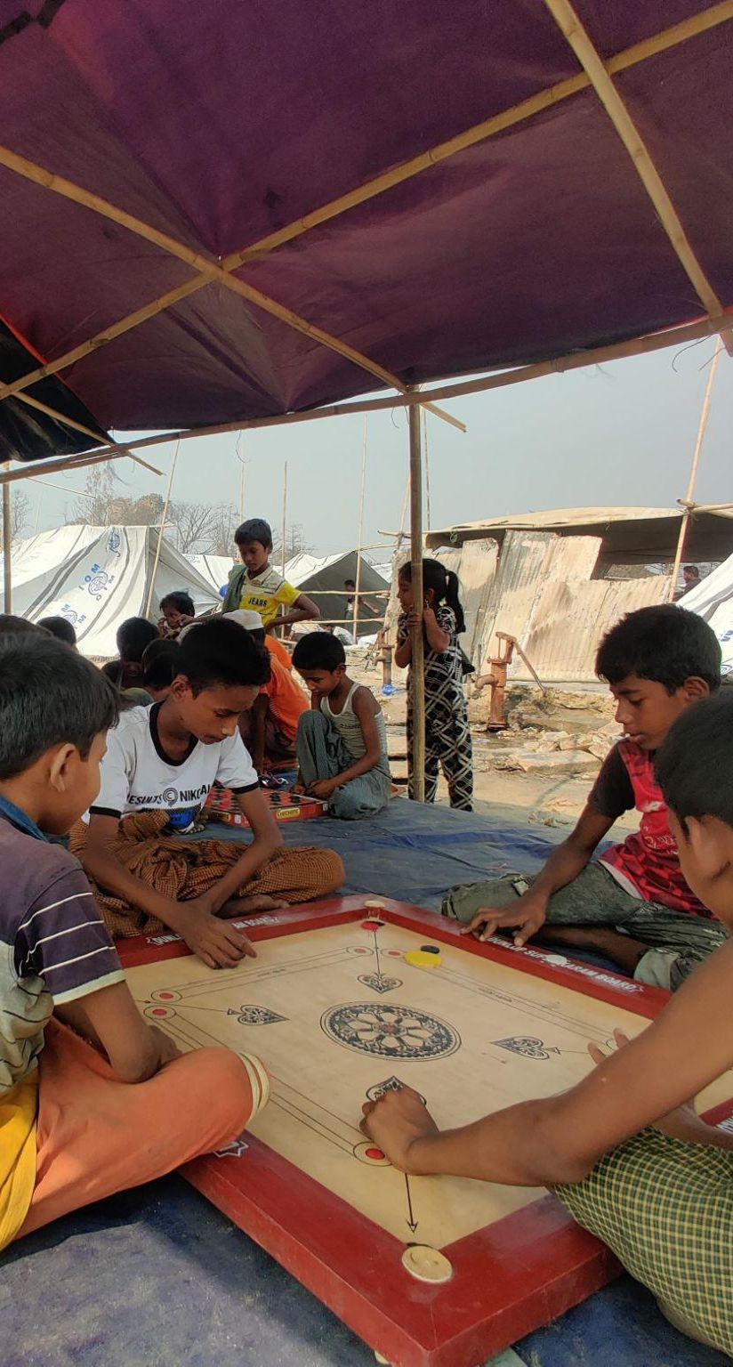
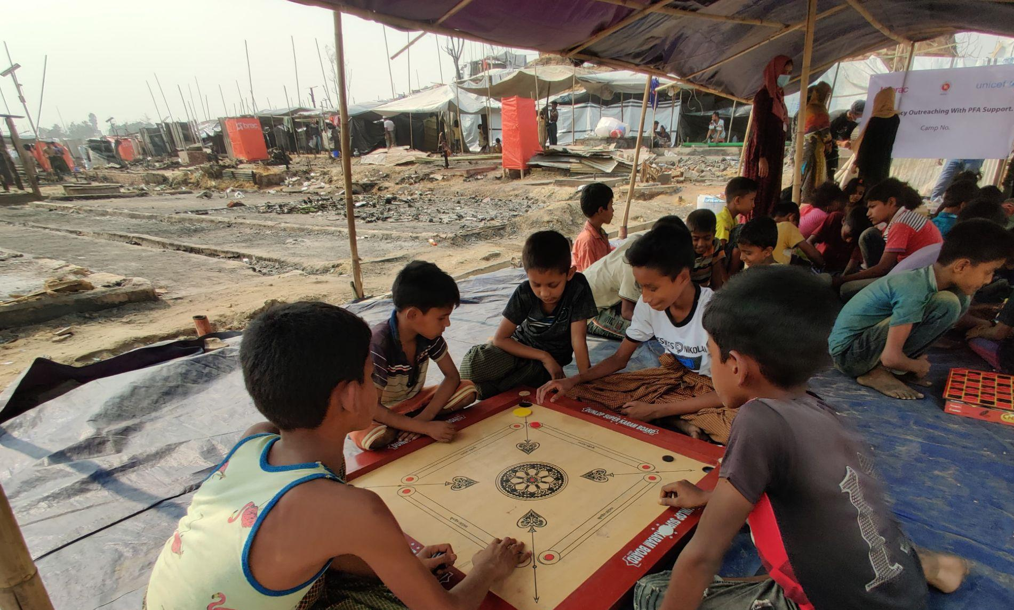
Case Continued
As BRAC endeavored to reunite the children in the ensuing days, the Child Protection team established mobile Child Friendly Spaces (CFSs) within the camp areas assigned to them by the Camp-in-charge (a Government Official). These CFSs served as safe havens for children affected by the fire.
The camps were fraught with hazards due to the aftermath of the fire, including broken glass and charred debris, posing a risk to young children who might wander unsupervised. Recognizing this, parents found solace in these spaces, considering them safe for their children while they were preoccupied with receiving aid items to rebuild their damaged shelters.
In addition to providing a safe physical space, expert psychologists and para-counsellors offered Psychological First Aid and Psychosocial Support to the affected children and their families, helping them cope with the distress caused by the fire. These essential services were maintained until the camps were restored to their previous functioning state.
What was the role of government in this particular case?
Photo source: BRAC IED photo archives

Slide 22
Think….
Look
Listen
Link
What kind of action principles that a PFA provider can follow in this fire incident

Slide 23
Emergency response program during Protracted Crisis
Emergency Remote learning (ERL) is the unplanned and sudden shift from the traditional form of education into a remote one following the state of emergency in diﬀerent countries due to the outbreak of COVID-19. Various measures have been taken in different countries of the world to respond to slow onset crises like Covid. Eg: Various online based learning programs were launched to continue the education program. Activities have been continued by adopting different modalities without stopping any developmental activities. Some examples of these are:
Radio learning program that worked during the Ebola crisis in sierra leone
Nigeria had audio learning guides, self-study activity packets, among other mobile-learning resources.
Radio learning program and Radio Play Labs in Uganda
Radio and TV Learning program in Kenya
BRAC
Pashe Achhi Model etc.

Slide 24
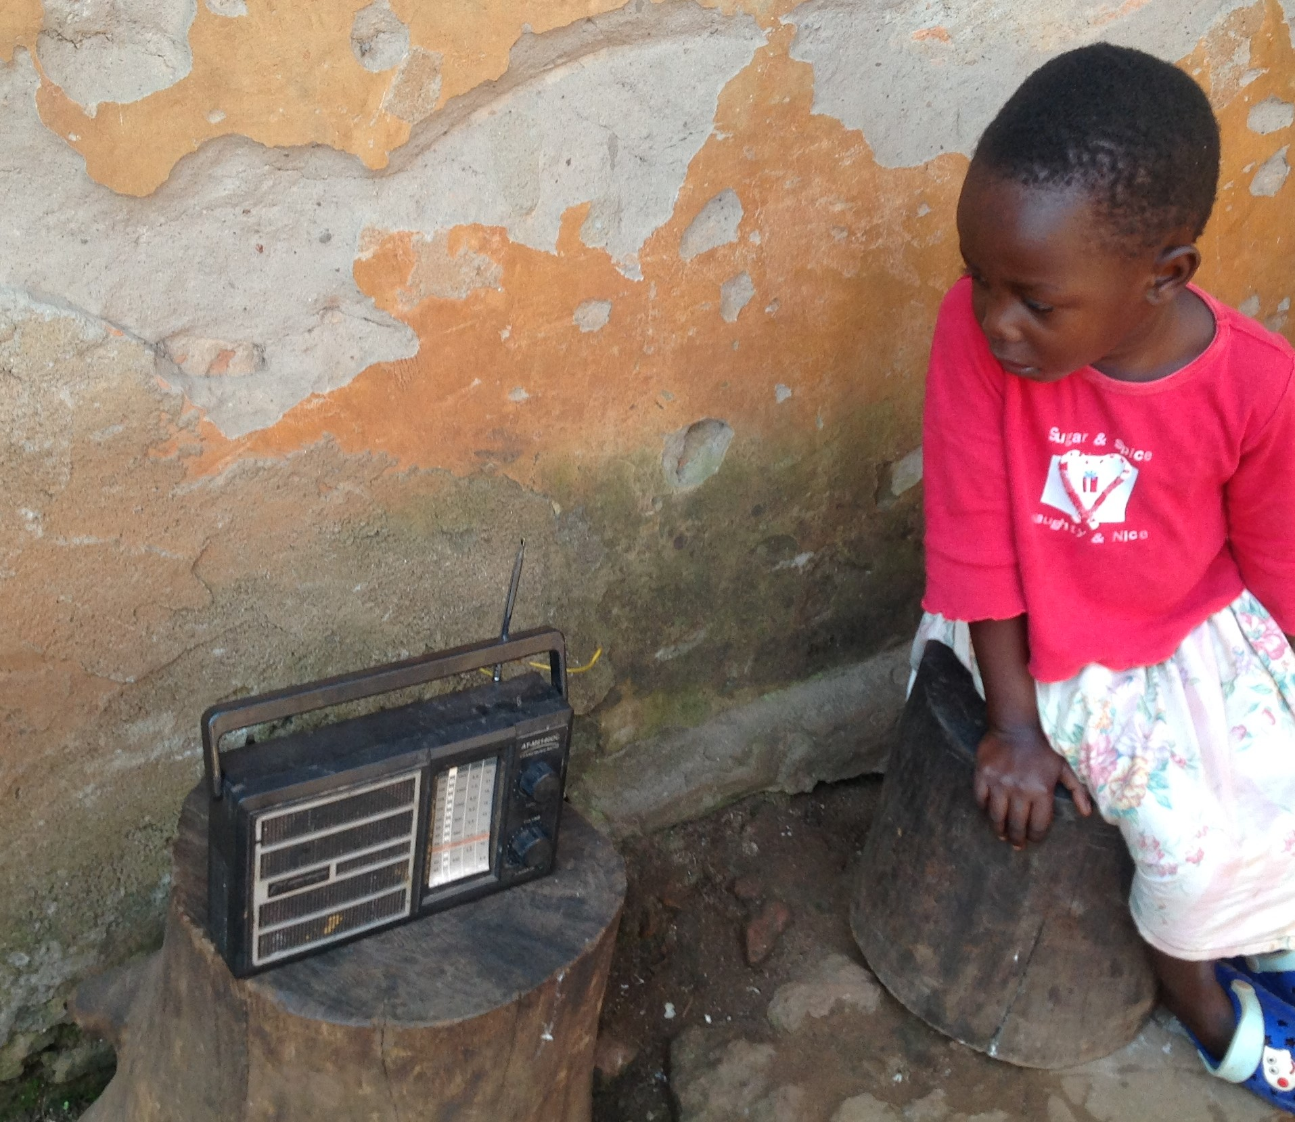
Radio-based learning programme
Radio is far more readily available to citizens in rural areas of Uganda than the Internet, so this offers a way for many more pupils in rural areas to access education.
The broadcasts are enabled children to continue accessing quality teaching whilst at home throughout the pandemic, with the support of parents, siblings and caregivers.
Important health messages were also included within the content.
Radio-based sessions for children had been identified as a priority by the Ministry of Education and Sports. These sessions were also received by teachers and, as they exemplified good educational practice, provided some professional development
Photo source: Brac international
Notes:
Resouce Source: https://www.researchgate.net/publication/353136653_Community_radio-based_blended_learning_model_A_promising_learning_model_in_remote_area_during_pandemic_era

Slide 25
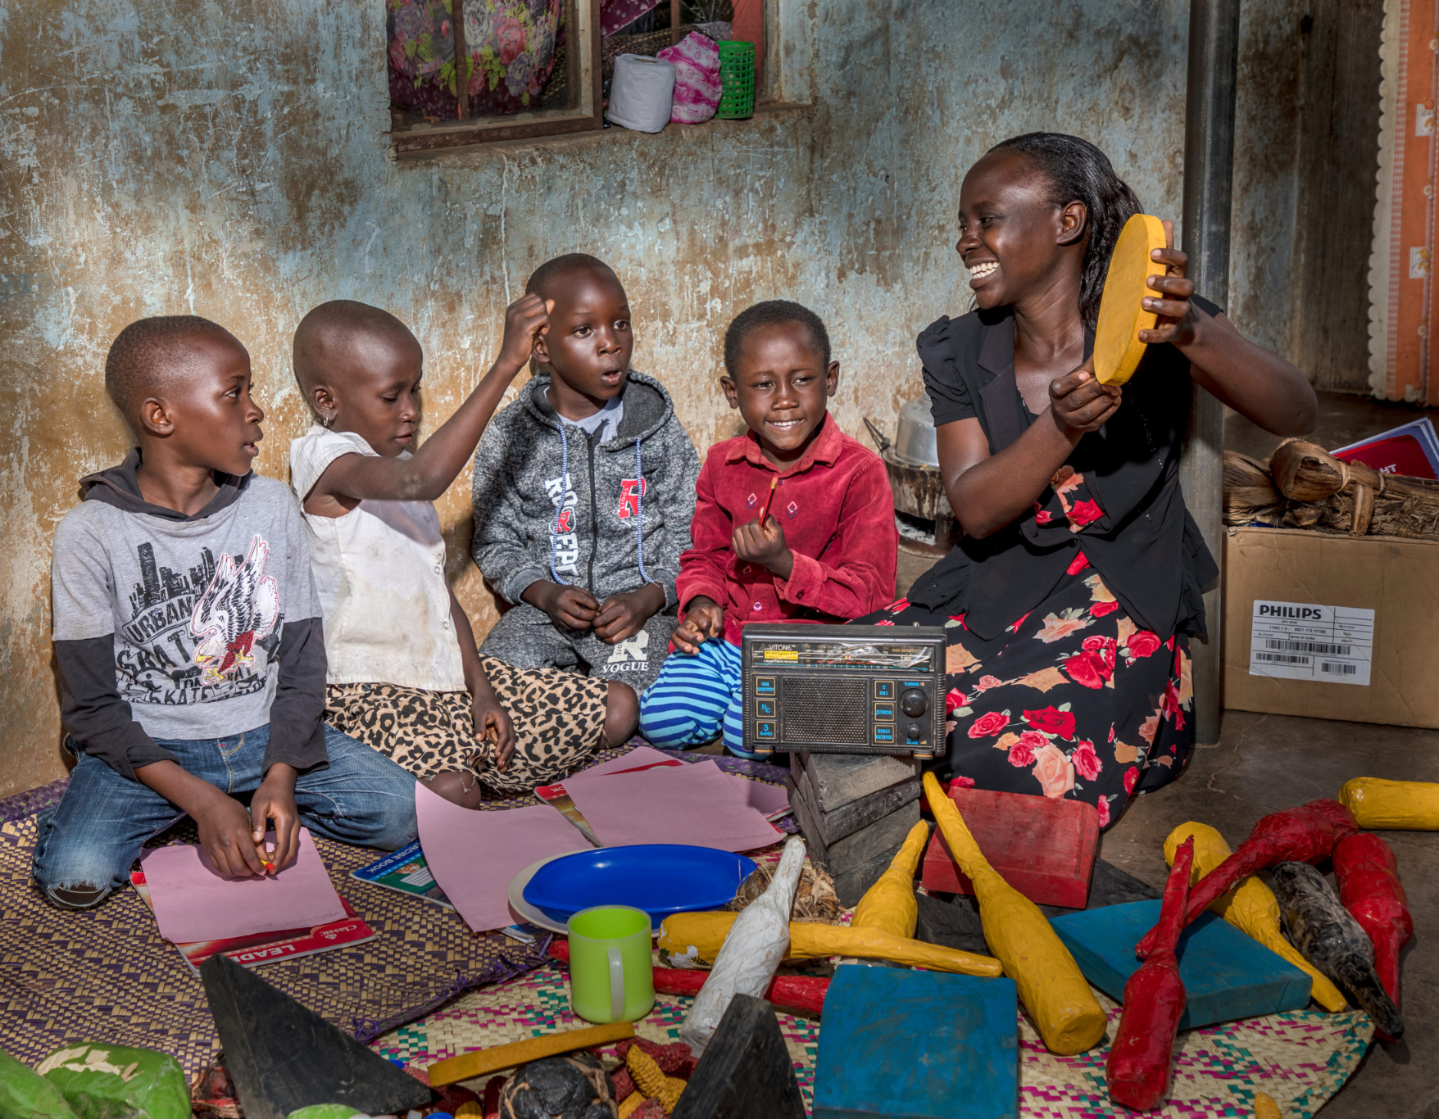
Radio Play Labs
During Covid-19 BRAC developed the BRAC Radio Programme, which aired for 30 minutes every Saturday.
During radio sessions, teachers led interactive, playful activities for literacy and numeracy, held storytelling sessions, and shared messages on child development, positive parenting, nutrition, stimulation, safety, and well-being.
Parents and older siblings were actively encouraged to participate and help create a child-friendly and playful environment at home.
Photo source: Brac international
Notes:
Resource Source: https://bracinternational.org/see-the-latest/radio-play-labs-delivering-remote-playful-learning-experiences-for-children-in-uganda/

Slide 26
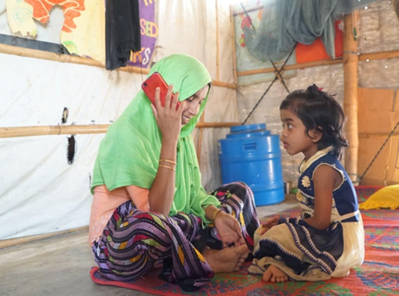
Pashe Achi Telecommunication Model
The Bangladesh government closed facilities and educational institutes due to COVID-19, limiting non-essential activities and halting face-to-face activities.
BRAC IED suspended face-to-face activities to contain the virus. To provide children with opportunities to learn at home, the 'Pashe Achhi' Telecommunication Model was developed, integrating psychosocial support and playful approaches while prioritizing safety.
Pashe Achhi means “Beside You” in Bangla. It is a phone-based remote learning model developed in response to the COVID-19 pandemic.
Photo source: BRAC IED photo archives
Notes:
Resource Source: https://bracjpgsph.org/assets/front/pdf/research/reports/Final%20Report_Pashe%20Achi%20Caregivers%20Engagement.pdf

Slide 27
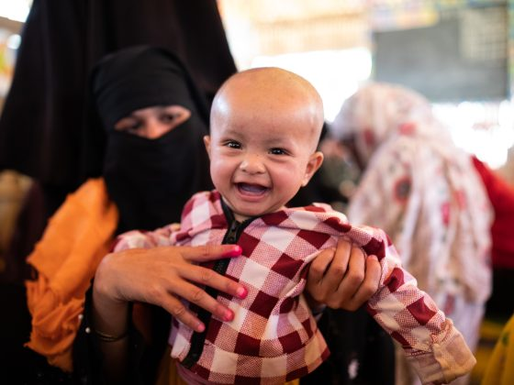
The Pashe Achhi Telecommunications Model aims to:
Supporting caregivers in adopting playful learning approaches to engage positively with their children.P
Provide information on COVID-19.
Support children’s learning and development during the pandemic.
Address the well-being of mothers and their children.
Develop the skills of Play Leaders and Mother Volunteers.
Ensure that staff, facilitators and front-line service providers feel heard, respected, and valued for their contributions in supporting families during this crisis.
Notes:
Resource Source: https://sesameworkshop.org/play-to-learn-program/pashe-achhi-telecommunication-model/

Slide 28




Pashe Achhi Telecommunication Model
Worked with Where It’s invented How the Content delivered Frequency
Caregivers of children age 0–6 Bangladesh
Remote Facilitators follow scripted sessions to support caregiver wellbeing and lead caregivers and their children through playful activities
Scheduled
Participants received one 20-minute call each week for 10 months

Slide 29
Challenges
Managing a crisis in a humanitarian context can be challenging due to some factors:
Global Challenges
Operational Environment
Caseloads
Coordination
Humanitarian stakeholders are increasingly concerned about the impacts of current or emerging global challenges, such as climate change, food and financial crises, extreme poverty, urbanization, water scarcity, energy security, migration, and population growth.
The environments in which international humanitarian actors operate can be impacted by these global challenges. This includes access to resources, security issues, and the ability to deliver aid effectively.
Global challenges can impact emerging humanitarian needs. This includes the number of people in need of assistance and the types of assistance they require.
Coordinating the response to a humanitarian crisis can be challenging, especially when multiple organizations and agencies are involved in local, national and global levels.
Notes:
Resource Source: Global Challenges and their Impact on International Humanitarian Action | OCHA (unocha.org)
Five humanitarian challenges facing the world in 2021 - GOAL Global

Slide 30
Living Conditions: The impacts are moderated through their continuous movement or worse living circumstances limiting access to food, shelter, water, and health services, a greater environmental exposure (e.g., overcrowded camps), more challenging security issues, unclear international mandates, and the disruption of normalcy creating excessive stress
Conflict: Whole systems and communities are weakened when fighting occurs in densely populated areas and suffer from the cumulative impacts of unrestricted warfare, violence, poverty, pandemics, sanctions, and bad governance.
Challenges

Slide 31
The need for flexibility, adaptability, and a comprehensive approach
Complex and Dynamic Nature of Crises: Humanitarian crises are often complex and dynamic, with changing needs and contexts. Flexibility allows humanitarian actors to adapt their strategies and interventions as the situation evolves.
Diverse Needs: Affected populations have diverse needs. A comprehensive approach ensures that all aspects of these needs are addressed, from immediate relief to long-term recovery.
Building Resilience: Addressing immediate needs is crucial, but it’s also important to help communities build resilience to future crises. This involves strengthening local capacities, supporting sustainable livelihoods, and promoting risk reduction measures.
Global Challenges: Humanitarian stakeholders are increasingly concerned about the impacts of current or emerging global challenges, such as climate change, food and financial crises, extreme poverty, urbanization, water scarcity, energy security, migration, and population growth. These challenges require adaptable and comprehensive solutions.
Collaborative Partnerships: The scale of humanitarian crises often requires the concerted action of a number of agencies and organizations. A flexible and adaptable approach can facilitate better coordination and collaboration.
Notes:
Resource Source: Global Challenges and their Impact on International Humanitarian Action | OCHA (unocha.org)

Slide 32
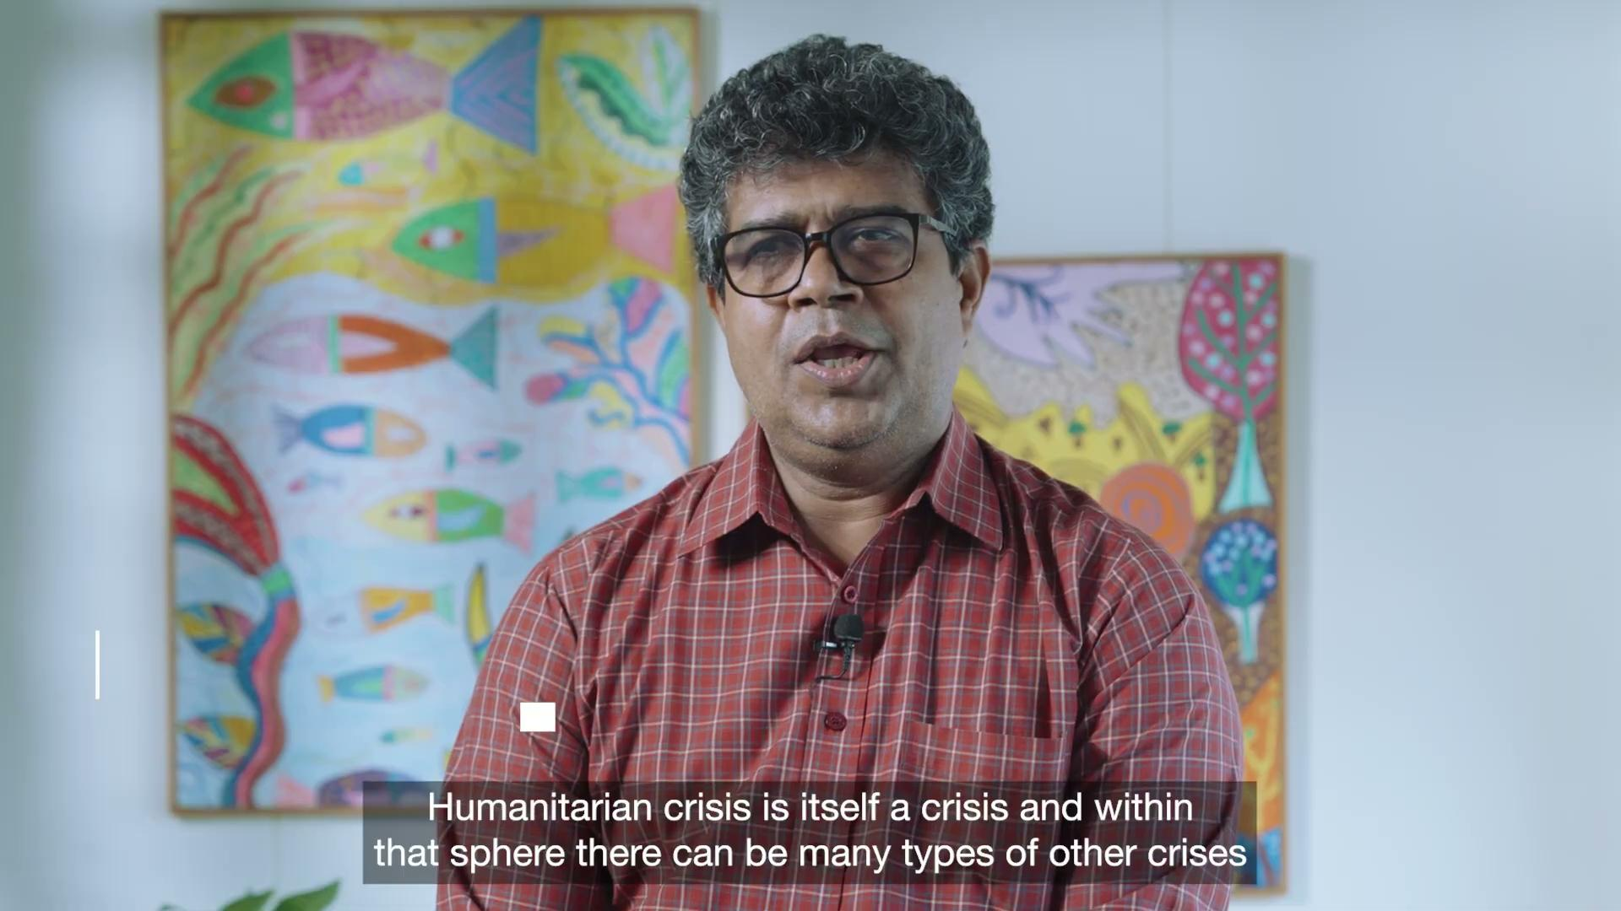

Slide 33
Final Reflections:
Participants will write on a padlet -
1
2
Reflect on the importance of adaptability and flexibility in emergency response. How can organizations improve these traits?
Discuss the challenges faced by caregivers during emergencies. How can their wellbeing be ensured?

Slide 34
https://www.humanitarianlibrary.org/sites/default/files/2014/10/Global_Challenges_Policy_Brief_Jan10.pdf
Managing environmental health risks in emergencies. (2024, July 5). https://www.who.int/activities/managing-environmental-health-risks-in-emergency
Radio based learning programme - Redearth Education. (n.d.). https://www.redeartheducation.org/programmes/radio-based-learning-programme/
Voigt, S., Schneiderhan, T., Twele, A., Gähler, M., Stein, E., & Mehl, H. (2011). Rapid Damage Assessment and Situation Mapping: Learning from the 2010 Haiti Earthquake. Photogrammetric Engineering and Remote Sensing, 77(9), 923–931. https://doi.org/10.14358/pers.77.9.923
World Health Organization: WHO. (2022, March 16). Mental health in emergencies. https://www.who.int/news-room/fact-sheets/detail/mental-health-in-emergencies
Humanitarian architecture. (n.d.). https://higuide.elrha.org/humanitarian-parameters/humanitarian-architecture/
Khudadad, S. (n.d.). Basics of emergency preparedness in humanitarian settings. Jobs in United Nations, NGO, European Union. https://www.impactpool.org/articles/basics-of-emergency-preparedness-in-humanitarian-settings
Khudadad, S. (2023, August 25). Writing a humanitarian contingency plan. https://www.linkedin.com/pulse/writing-humanitarian-contingency-plan-salar-khudadad/
References

Slide 35
Complex Humanitarian Emergencies - Center for Disaster Philanthropy. (2023, November 14). Center for Disaster Philanthropy. https://disasterphilanthropy.org/resources/complex-humanitarian-emergencies/#:~:text=In%202023%2C%20364.6%20million%20people,Humanitarian%20emergencies%20are%20consistently%20underfunded.
Handbook, U. E. (2023, November 27). Humanitarian programme cycle (IASC). UNHCR. https://emergency.unhcr.org/coordination-and-communication/interagency/humanitarian-programme-cycle-iasc
Kohrt, B. A., Mistry, A. S., Anand, N., Beecroft, B., & Nuwayhid, I. (2019). Health research in humanitarian crises: an urgent global imperative. BMJ Global Health, 4(6), e001870. https://doi.org/10.1136/bmjgh-2019-001870
Rapid Response | CERF. (n.d.). https://cerf.un.org/apply-for-a-grant/rapid-response
IOM’s Humanitarian Policy – Principles for Humanitarian Action - World. (2016, April 6). ReliefWeb. https://reliefweb.int/report/world/iom-s-humanitarian-policy-principles-humanitarian-action
Australian Agency for International Development. (2011). Humanitarian Action Policy. Retrieved from http://www.ausaid.gov.au/publications
References

Slide 36
Peters, K., & Bih, K. B. (2024, March 16). Turning multidimensional crisis into an opportunity to address compounding disaster-conflict risks. World Bank Blogs. https://blogs.worldbank.org/en/sustainablecities/turning-multidimensional-crisis-opportunity-address-compounding-disaster-conflict
United Nations System Chief Executives Board for Coordination. (n.d.). Shared Framework for Action: United Nations System-wide Support to the Implementation of the 2030 Agenda for Sustainable Development. Retrieved from http://www.unsceb.org
Herrick, C., Kelly, A. H., & Soulard, J. (2022). Humanitarian inversions: COVID‐19 as crisis. Transactions of the Institute of British Geographers/Transactions - Institute of British Geographers, 47(4), 850–865. https://doi.org/10.1111/tran.12544
Resilience in Protracted Crises | Policy Support and Governance Gateway | Food and Agriculture Organization of the United Nations | Policy Support and Governance | Food and Agriculture Organization of the United Nations. (n.d.). https://www.fao.org/policy-support/policy-themes/resilience-protracted-crises/en/
IFRC. (2018, September 27). IFRC approach for Emergency Needs Assessments [Video]. YouTube. https://www.youtube.com/watch?v=VpDejNMWPOU
Humanitarian Needs Assessment – The Good Enough Guide - World. (2015, January 28). ReliefWeb. https://reliefweb.int/report/world/humanitarian-needs-assessment-good-enough-guide-0
ACAPS. (2016). Questionnaire design: How to design a questionnaire for needs assessments in humanitarian emergencies. ACAPS.
References

