Slide 1
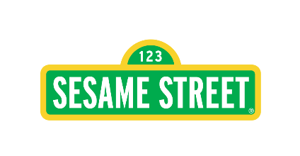


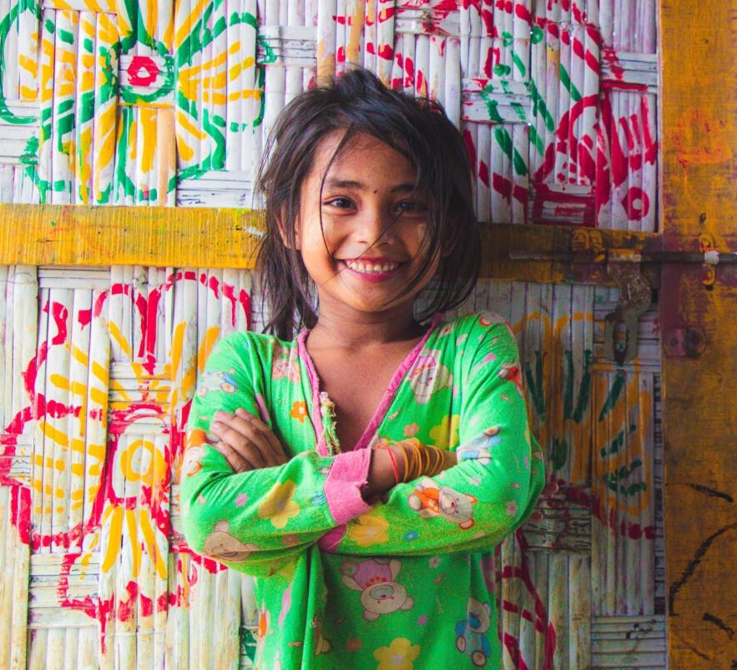

Learning Outcomes
Day 9: Co-designing Culturally Appropriate Spaces in Humanitarian Settings
Demonstrate an understanding of the spatial context and need for culturally appropriate space design in humanitarian settings.
Identify and apply appropriate community engagement tools to gather insights and incorporate cultural considerations into space design.
Notes:
Welcome to the class, Co-designing Culturally Appropriate Spaces in Humanitarian Settings!
In this class, you'll learn the importance of culturally appropriate space design in humanitarian settings and see real-life examples of how to respect and reflect cultural contexts.
You'll use community engagement tools to understand and incorporate cultural needs into space design. Learn how to effectively engage with communities to understand their needs, values, and preferences.
Finally, you'll closely look at a case of space design and follow through it’s process of engaging the community to co-design child friendly spaces that are culturally appropriate.

Slide 2
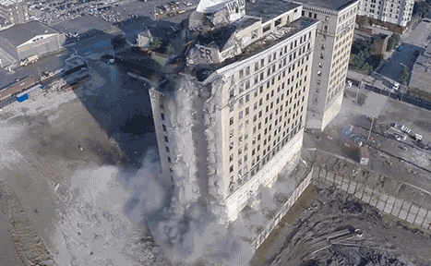
A Situation-based case
Imagine you won a lottery and went out of the country on a vacation with your family. You came back from the vacation and saw there has been an earthquake in the country and many houses and other facilities are demolished. Your house has also collapsed and your bank account is frozen.
Notes:
Let’s start with a scenario based case-
Imagine you won a lottery and went out of the country on a vacation with your family. You came back from the vacation and saw there has been an earthquake in the country and many houses and other facilities are demolished. Your house has also collapsed and your bank account is frozen

Slide 3
In such a situation, which of the following will you choose immediately?
A
B
C
You get a basic shelter, immediately that you are not familiar with or is not to your liking.
You do not get a shelter immediately, but external assistance would come and create a house according to your preferences and needs. It would take a long time and you wouldn’t have any immediate shelter to stay in.
You get a temporary shelter immediately, and in time as you settle down, external assistance helps you rebuild your own house as per your preferences.
Notes:
In such a situation, which of the following will you choose immediately?
You get a basic shelter, immediately that you are not familiar with or is not to your liking.
You do not get a shelter immediately, but external assistance would come and create a house according to your preferences and needs. It would take a long time and you wouldn’t have any immediate shelter to stay in.
You get a temporary shelter immediately, and in time as you settle down, external assistance helps you rebuild your own house as per your preferences.

Slide 4




What is a SHELTER?
Safety & Security
Climate protection
Health
Human Dignity
A shelter is defined as a habitable covered living space providing a secure and healthy living environment
with privacy and dignity. Refugees and others of concern to UNHCR have the right to adequate shelter in
order to benefit from protection from the elements, space to live and store belongings as well as privacy,
comfort and emotional support.
Notes:
We asked you about your house or shelter, let’s look at what is a shelter in a Humanitarian Context?
Shelter is a critical factor affecting survival in the initial stages of a disaster. Beyond survival, shelter is necessary to provide security, personal safety and protection from the climate and to promote resistance to ill health and disease. It is also important for human dignity, to sustain family and community life and
to enable affected populations to recover from the impact of disaster.
A shelter is defined as a habitable covered living space providing a secure and healthy living environment with privacy and dignity. Refugees and others of concern to UNHCR have the right to adequate shelter in order to benefit from protection from the elements, space to live and store belongings as well as privacy,
comfort and emotional support.
Shelter should be adapted according to the geographical context, the climate, the cultural practice and habits, the local availability of skills as well as accessibility to adequate construction materials in any given country.

Slide 5
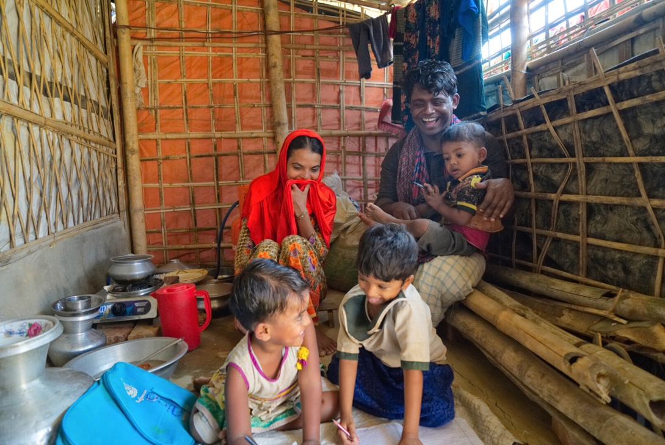




Why are we talking about SHELTER or SPACE DESIGN?
Well-being
Enhance Sleep
Quality
Reduce Stress
Overall Health
Image:A typical housing at Rohingya Camp in Cox’s Bazar, Bangladesh. BRAC IED. (2020)
Notes:
Why exactly are we talking about shelter or space design in this course ?
Because the built environment greatly affects people's well-being.
Environmental psychology shows that well-designed spaces can reduce stress and improve health.
For instance, temporary shelters with natural light, good ventilation, and privacy can enhance residents' stress levels, sleep quality, and overall well-being. This is crucial in humanitarian contexts where people are already under significant stress.

Slide 6
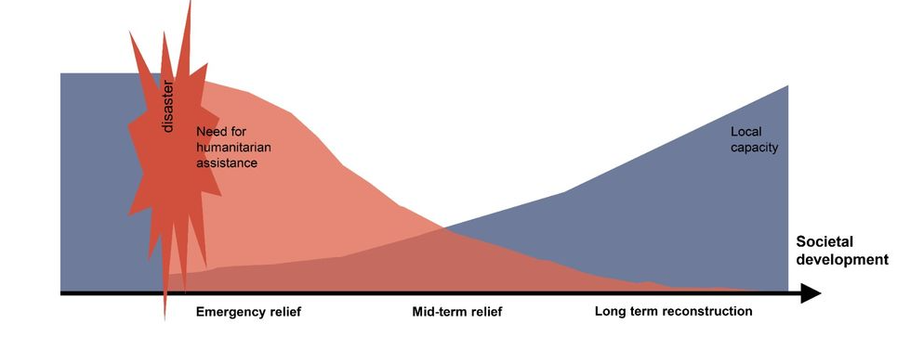
TIMELINE for Humanitarian Construction
Emergency relief is the immediate response to life-threatening conditions. It requires urgent actions: emergency shelters ensure protection from weather, prevent further deaths and secure the survival of the victims.
Mid-term relief includes the transitional shelter, which offers standard solutions to housing needs, while still not being an ideal solution.
Reconstruction is when the permanent habitat and infrastructure are set in place.
Source: https://www.aalto.fi/en/wit-programme/humanitarian-architecture-what-does-it-mean
Notes:
Now Let’s relate your context with the timeline for humanitarian construction again
When the earthquake destroys your house and you come back to find yourself without a shelter is when emergency relief comes. Emergency relief is the immediate response to life-threatening conditions. It requires urgent actions: emergency shelters ensure protection from weather, prevent further deaths and secure the survival of the victims.
When over time you settle down, is the time for mid-term relief includes the transitional shelter, which offers standard solutions to housing needs, while still not being an ideal solution. This is when we previously suggest external help would come and help you rebuild your own house as per your preferences. This is the stage where co-creation or co-designing of spaces starts in Humanitarian Setting
Finally comes the Reconstruction phase when the permanent habitat and infrastructure are set in place.

Slide 7
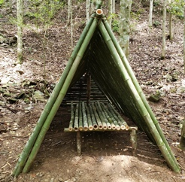
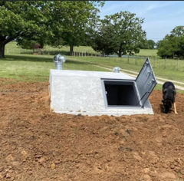
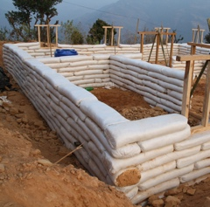
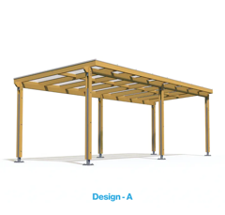
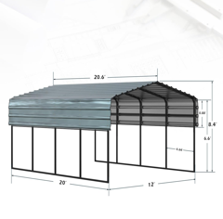
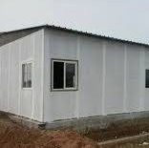
Durable MATERIALS throughout different TIMELINES
Withstand harsh weather conditions
Readily available
Reusable or Recyclable
BAMBOO
CONCRETE
EARTHBAGS
TIMBER
METAL
RECYCLED MATERIALS
Notes:
Durable construction materials play a crucial role in humanitarian shelter design, ensuring the safety, resilience, and longevity of temporary housing for displaced populations. These materials need to withstand harsh weather conditions, be readily available, and often be reusable or recyclable to minimize environmental impact.
Some Common Durable Materials for humanitarian shelter designs include:
Bamboo: Lightweight, strong, and fast-growing, bamboo is a sustainable option for shelter frames, walls, and roofing. With proper treatment, it resists rot and pests.
Timber: Wood is a traditional and versatile building material. Engineered wood products like plywood and oriented strand board (OSB) offer strength and durability.
Concrete: While heavier, concrete provides excellent durability and fire resistance. It's often used for foundations and floors.
Metal: Corrugated metal sheets are lightweight, durable, and easy to transport, making them suitable for roofing and siding.
Earthbags: Filled with soil, these bags create sturdy walls with good thermal mass and insulation properties.
Recycled materials: Reusing materials like shipping containers, pallets, and tires reduces waste and lowers costs.

Slide 8
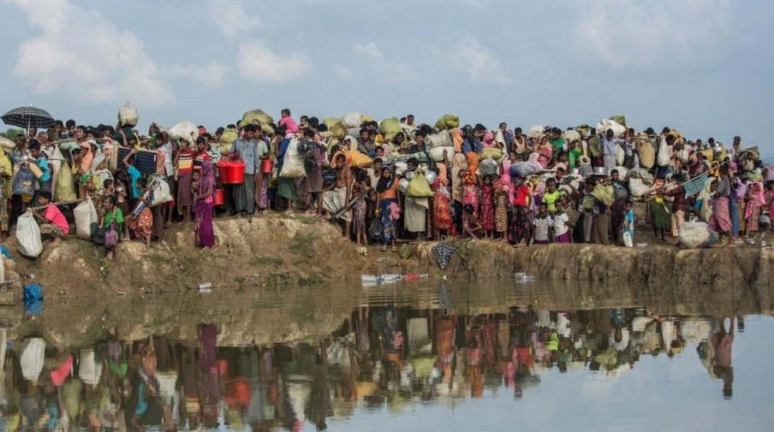
What do you observe in this picture?
Answer
A Heavy flow of People
Local capacity suddenly collapses.
Need for humanitarian assistance is high
Notes:
Let's look at common scenarios after a HUMANITARIAN CRISIS occur
This a common scenario in the beginning of a crisis… What do you observe here?
.
.
.
.
.
There is a heavy flow of people, local capacity suddenly collapses, and the need for humanitarian assistance is high.
https://doctorsoftheworld.org/blog/rohingya-refugees-in-bangladesh/

Slide 9
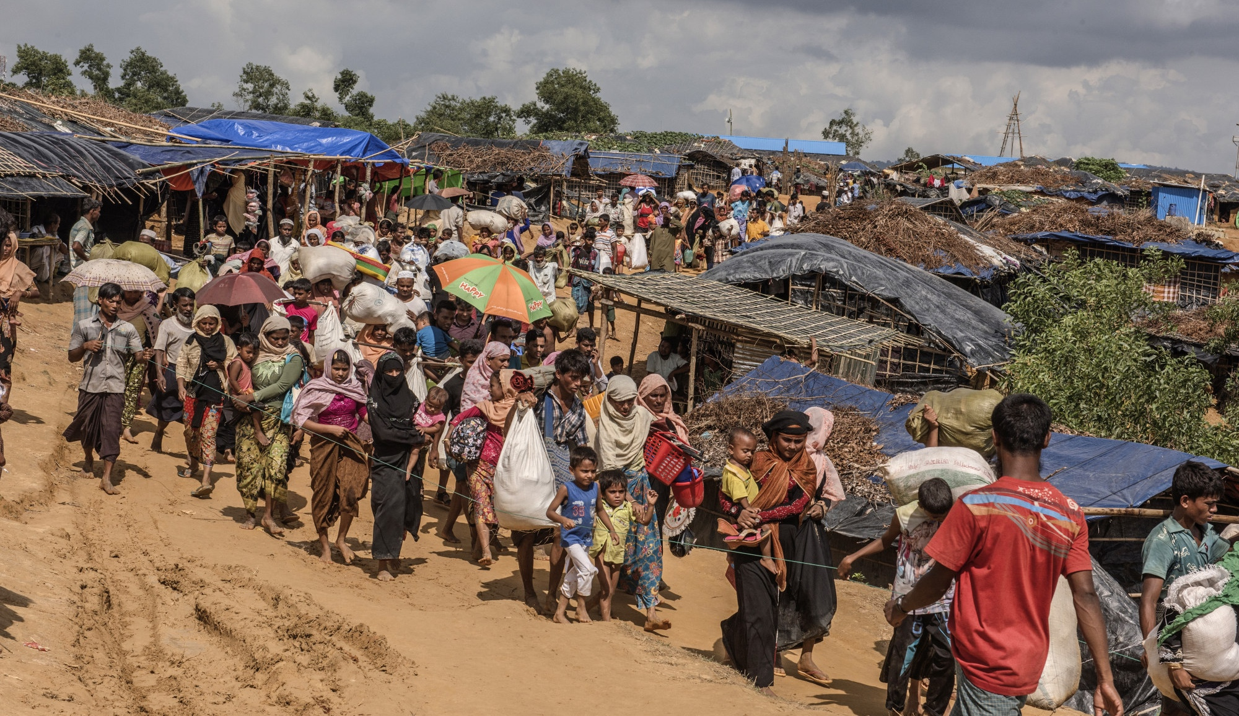
What do you observe in the space shown in this picture?
Emergency support provided: Temporary housing, Food and Medical care , Sanitation
(some basic facilities)
Answer
Notes:
What do you observe in the space shown in this picture?
.
.
.
.
.
Here it is visible that emergency support is provided. This includes temporary housing, perhaps food and medical care facilities, and basic sanitation services.

Slide 10
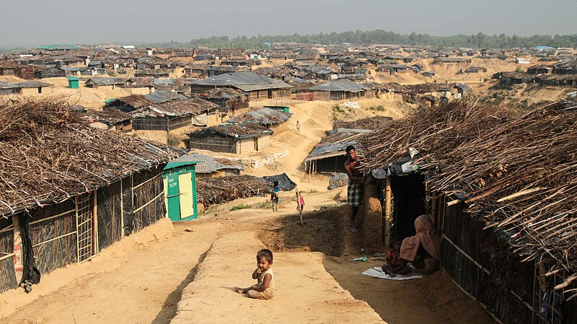
What do you observe about the settlement through this picture?
Answer
________________________
Answer
Space constraint, dense housing but lack of roads and other systematic infrastructure
Notes:
What do you observe about the settlement through this picture?
.
.
.
.
.
Space constraint with dense housing is evident here. It still lacks roads and other systematic infrastructure.

Slide 11
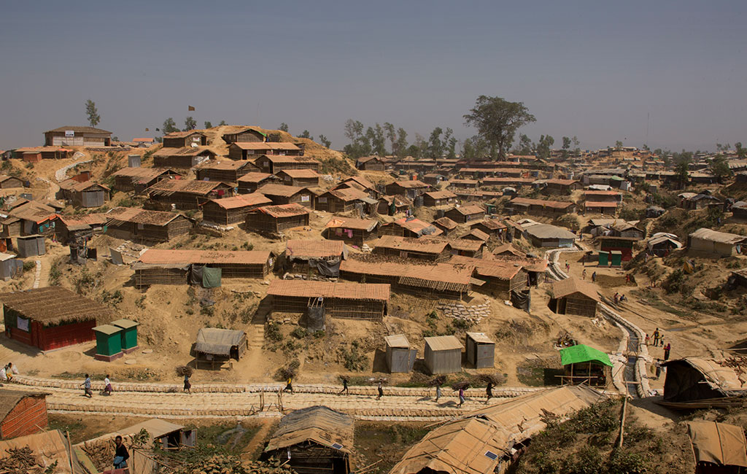
What do you observe in the space provided here?
Answer
Infrastructure: road, sewerage system
Notes:
So What do you observe in the space provided here?.
.
.
.
.
.
The settlement is moving towards Mid-term relief. It has infrastructures including community facilities, structure, proper sewerage system and roads.

Slide 12
What do you think is still missing?
Answer
Cultural appropriation, Personalization and Comfort.
Notes:
However, What do you think is still missing?
.
.
.
.
.
The settlement still hasn’t developed for the community a sense of ownership, cultural appropriation, personalization and comfort.

Slide 13
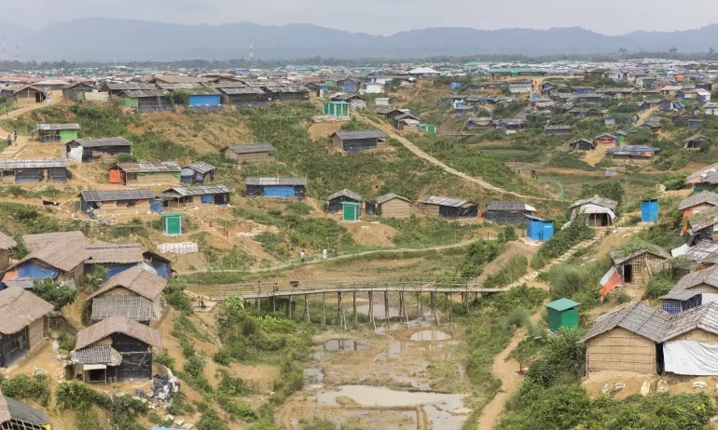
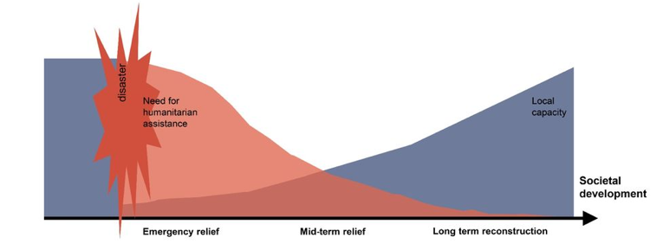
In the next stage Cultural incorporation starts in full swing
Notes:
In this stage, the development of the settlement has reached mid-relief, here comes cultural appropriation starts in full-swing and along with it comes comfort and personalization for each family.

Slide 14

CULTURAL APPROPRIATENESS
Designing solutions that respect and align with the cultural norms, values, and practices of the affected community.
Let’s look at the case of AL-ZATAARI CAMP
Prioritizing Efficiency and Standardization
ISOLATION
AND FRUSTRATION
Notes:
Cultural appropriateness is the practice of designing solutions that respect and align with the cultural norms, values, and practices of the affected community.
How can CULTURAL APPROPRIATENESS be incorporated into space?
Let’s look at the case of AL-ZATAARI CAMP
Initially, during emergency relief , in Al-Zaatari camp, UNHCR housed refugess in prefabricated containers, which lacked privacy, ventilation, and cultural familiarity this was mostly done to prioritize efficiency and standardization.
These regulations failed to account for the refugees' experiences and cultural norms- the lack of private courtyards, essential for social gatherings in Syrian culture, led to feelings of isolation and frustration.

Slide 15

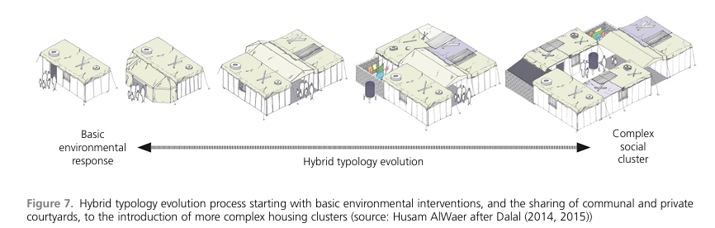
Notes:
In response to these inadequacies, refugees began to subvert UNHCR regulations. They repurposed shipping containers as communal spaces, creating makeshift mosques, schools, and shops. They adjusted and dismantled structures to create more private and communal areas within the containers. By merging different spaces, they created a more cohesive and vibrant urban environment.
Thus UNHCR made modifications, incorporating feedback from residents, introduced communal spaces and adjusted shelter layouts, significantly improving community well-being.

Slide 16



What does the SPATIAL CONTEXT in a Humanitarian Crisis consist of?
Physical characteristics
Social
Dynamics
Security considerations
Notes:
Understanding the Spatial Context would require understanding of the following
Physical characteristics:
Topography, climate, available infrastructure, and potential hazards.
Social dynamics:
Population demographics, cultural practices, community structures, and power relations.
Security considerations:
Conflict zones, access restrictions, and potential for violence.

Slide 17
Humanitarian intervention is primarily MULTI-SECTORAL.
It involves addressing various needs simultaneously
Food
Security
Shelter
Water, Sanitation and hygiene
Health
Nutrition
Protection
Education
Livelihoods
Notes:
Humanitarian intervention is primarily multi-sectoral. It involves addressing various needs simultaneously, such as providing temporary housing, food, medical care, sanitation etc, to ensure comprehensive support for affected populations.

Slide 18
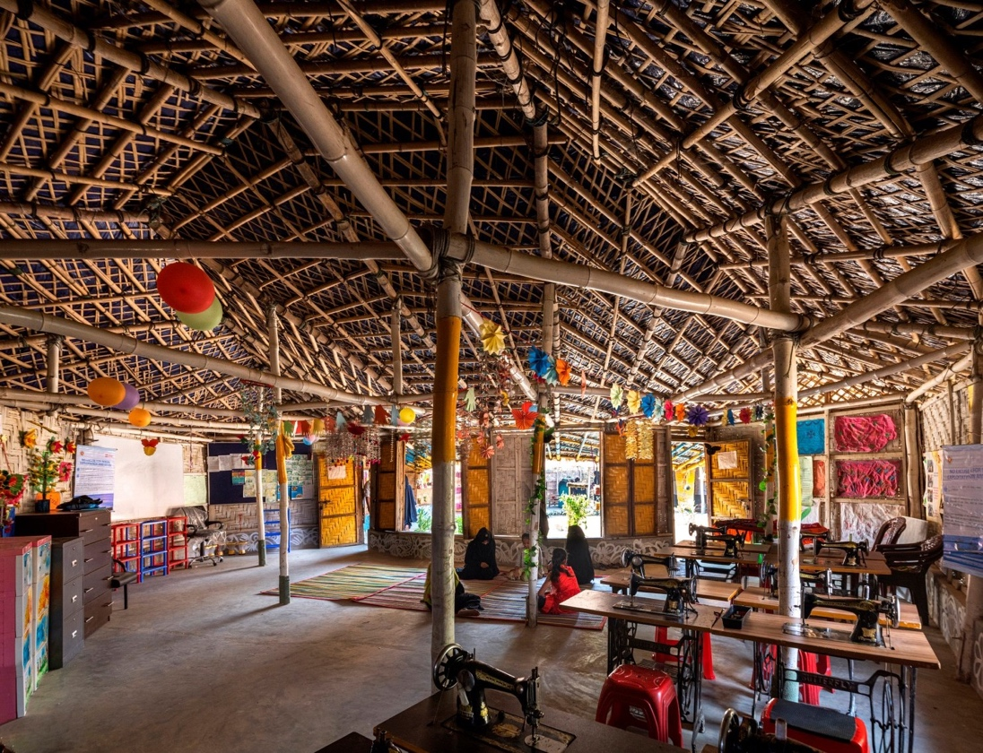




MULTI-Purpose Spaces
Space
Optimization
Adaptive
Furniture
Flexible Infrastructure
Community driven Planning
Image:Aga Khan Award winning safe space for women and children in Rohingya Camp, Cox’s Bazar, Bangladesh.Aga Khan Trust for Culture/Asif Salman (November, 2022)
Notes:
Humanitarian settings, whether refugee camps, disaster zones, or conflict areas, present unique challenges in terms of space utilization and understanding the spatial context. Optimizing limited space while catering to the diverse needs of affected populations is crucial for effective humanitarian response.
In this context, the concept of multi-use emerges as a vital tool for maximizing efficiency and promoting well-being.
Multi-use refers to the design and implementation of spaces that can serve multiple functions, adapting to different needs at different times.
This can be achieved through flexible infrastructure, adaptable furniture, and community-driven planning which can provide a sense of normalcy and routine, contributing to the mental and emotional well-being of affected populations.
On the right is a photograph of Aga Khan Award winning Safe space for women and children in the Rohingya camp, Cox’s Bazar, BAngladesh This space have grown to comprise programmes for skill development, such as facilities to create and showcase handmade products; community-based protection (CBP) activities; psychosocial support activities; children’s play spaces; and breastfeeding areas.
Ref: https://www.futurarc.com/project/architecture-of-refuge-rohingya/
https://www.asifsalman.com/single-post/community-spaces-in-rohingya-refugee-response-aga-khan-award-for-architecture-2022

Slide 19
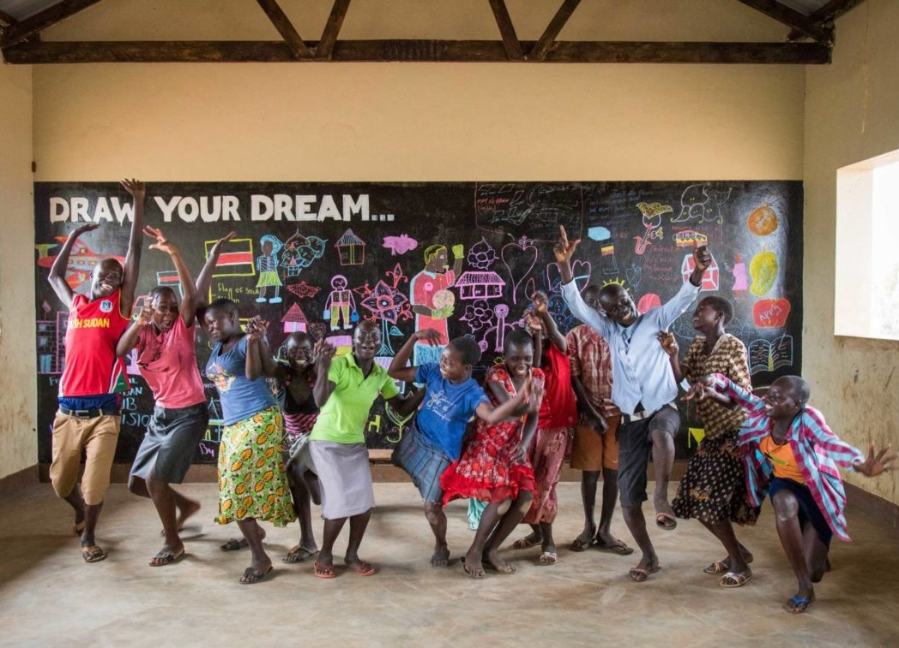




CO-DESIGN: A Path to Cultural Appropriateness
The PROCESS of Co-designing Spaces
1. Engagement
2. Ideation
3. Prototyping
4. Evaluation
Image:South Sudanese children from World Vision’s Child-Friendly Space in the Bidi Bidi refugee settlement acting silly after drawing their dreams inside the classroom. Oscar Durand for World Vision (2017)
Notes:
Now, that you understand the importance of cultural appropriateness let’s take a look at how it can be achievement.
Cultural appropriateness can achieved through co-design by actively involving community members in the design process, ensuring their cultural norms and practices are respected and integrated. Co-design emphasizes the active participation of beneficiaries throughout the design process.
The process of co-designing spaces can be divided into four main steps:
First is Engagement: This step involves engaging with the community to understand their needs and aspirations. This can be done through methods, such as interviews, focus groups, and workshops.
Second is Ideation: This involves generating ideas for the design of the space. This can be done through a variety of methods, such as brainstorming, sketching, and prototyping.
Third is Prototyping which involves creating a prototype of the space. This can be done through building a physical model or creating a virtual model.
Finally Evaluation: This step involves evaluating the prototype with the community to get feedback. This feedback can be used to improve the design of the space.

Slide 20
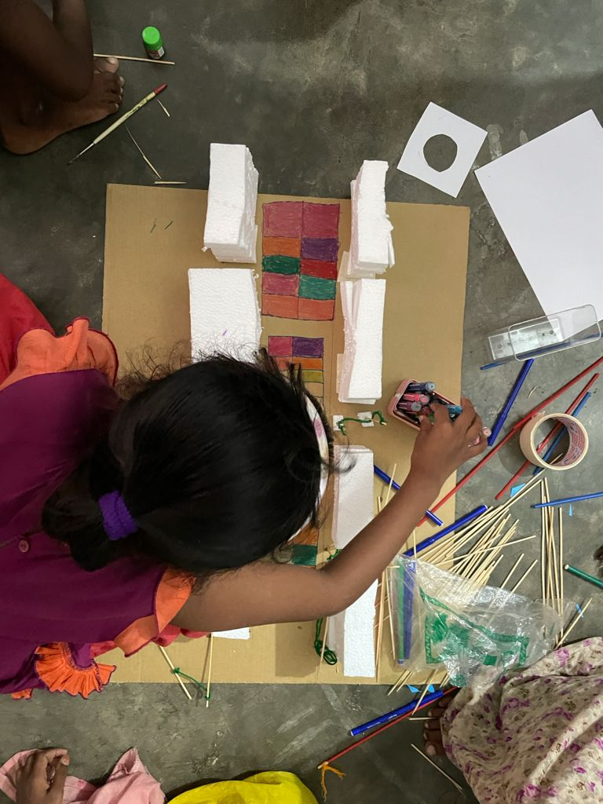
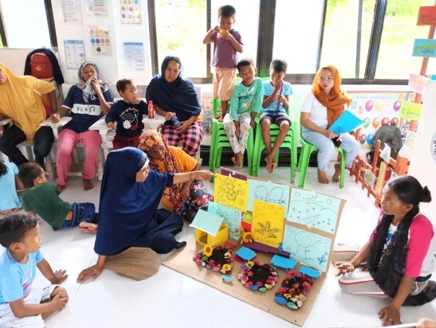
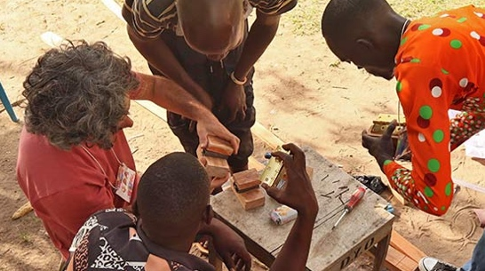
Methods for COMMUNITY ENGAGEMENT
Informal Focus Group Discussions and Interviews
Empathy Mapping
Community Mapping
Model Making
Drawing and Storytelling
Image: Community planning their garden, BARMM, Philippines. BRAC IED (2023)
Image:Children designing their preferred playspace in the informal settlement, Korail, Dhaka, Bangladesh. BRAC IED (2021)
Image: Design Workshop with the community in Rhino Camp, Uganda. MIT D-Lab (2022)
Notes:
Community engagement is crucial for co-designing because they ensure that the needs, preferences, and cultural practices of the community are understood and incorporated into the design, leading to more effective, accepted, and sustainable solutions.
Some effective community engagement tools consist of-
Focus Group Discussion and Interview
Empathy Mapping
Community Mapping
Model Making
Drawing and Storytelling
Now let’s take a closer look at these tools.
References
* [Co-designing Humanitarian Spaces: A Guide for Practitioners](https://www.humanitarianresponse.info/en/operations/co-designing-humanitarian-spaces-guide-practitioners)
* [The Role of Co-Design in Humanitarian Shelter Design](https://www.researchgate.net/publication/331536833_The_Role_of_Co-Design_in_Humanitarian_Shelter_Design)
* [Co-designing Humanitarian Spaces: A Case Study from Kenya](https://www.sheltercentre.org/sites/default/files/resources/Co-designing%20Humanitarian%20Spaces%20A%20Case%20Study%20from%20Kenya.pdf)

Slide 21
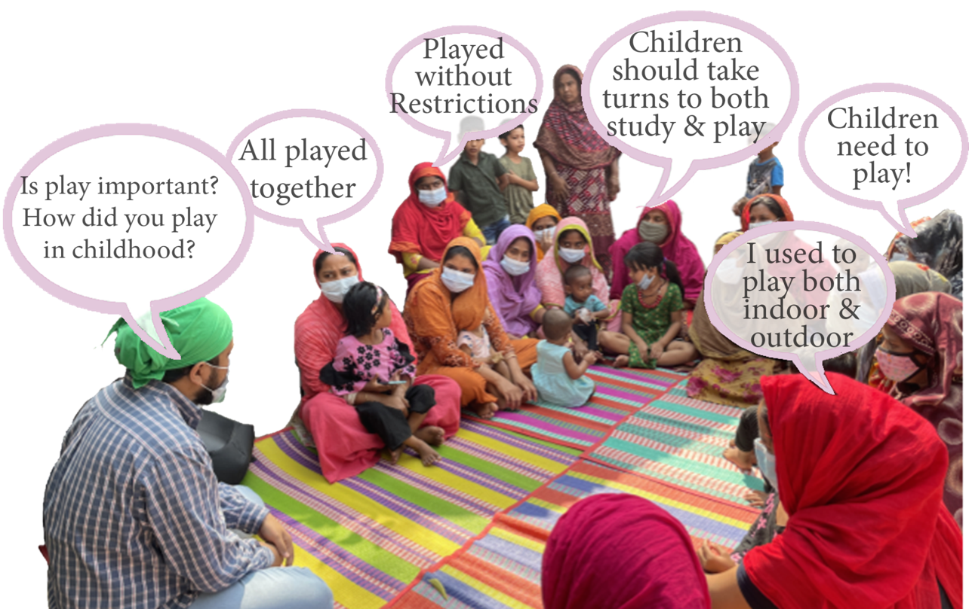
Informal Focus Group Discussion and Interview
It’s An Organic Process
Essentials:
Rapport Building, Trust, Humility, Active Listening,
Observations and Collaboration
PURPOSE
To gather detailed insights from those directly affected by the crisis.
To understand specific needs and cultural norms to inform the design of shelters, communal spaces, and services.
Image:Focus Group Discussions with Mothers about play in Bhashantek, Dhaka, Bangladesh. BRAC IED.(2021)
Notes:
Focus Group Discussion and Interview
Focus Group Discussions are where Small groups of displaced community members or refugees gather to discuss specific issues related to their living conditions, safety, and cultural needs. Facilitators guide the conversation to gather diverse perspectives. For example the facilitator is having a conversation about play to understand its need in the community.
Similarly, Interviews are One-on-one conversations with community members to explore individual experiences, needs, and preferences in-depth, particularly focusing on the impact of displacement and cultural considerations.
These methods are usually done to-
To gather detailed insights from those directly affected by the crisis and To understand specific needs and cultural norms to inform the design of shelters, communal spaces, and services.

Slide 22
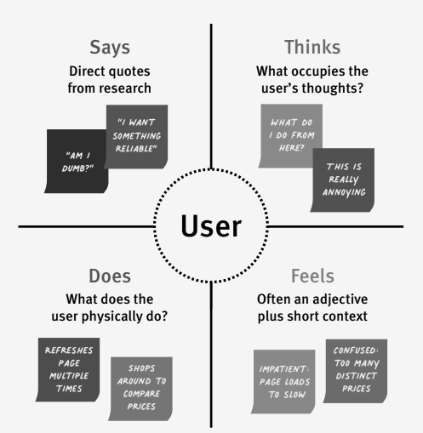
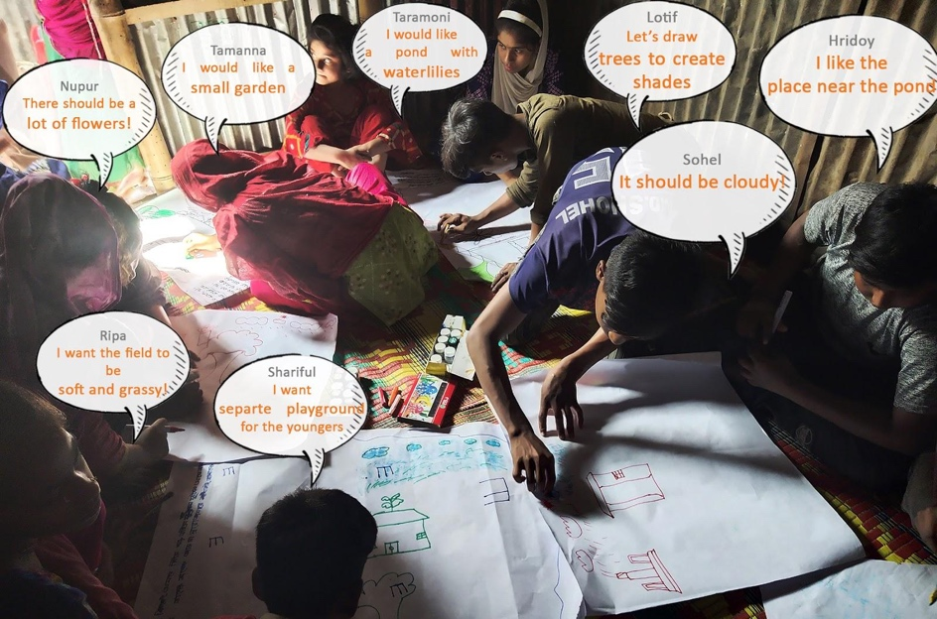
Empathy Mapping
PURPOSE
To build a deep understanding of the psychological and emotional impact of displacement.
To ensure that the design process meets the real needs, as opposed to perceived needs, of the user.
Image:Mapping with Adolescent Children in Kallyanpur, Dhaka,Bangladesh. BRAC IED.(2021)
Notes:
Next is Empathy Mapping.
Empathy Mapping is a visual tool that helps designers understand and empathize with the daily experiences, challenges, and emotions of displaced individuals. It involves mapping out what community members say, think, feel, and do in their current environment.
Empathy mapping can be used to build a deep understanding of the psychological and emotional impact of displacement.
And to ensure that the design process meets the real needs, as opposed to perceived needs, of the user thus addresses not only physical needs but also emotional and psychological well-being.
file:///C:/Users/BRAC%20IED/Downloads/DEFSA2015_Conference_Proceedings1.pdf
https://www.researchgate.net/figure/Double-Diamond-adapted-with-focus-on-empathy-development_fig3_307932419

Slide 23
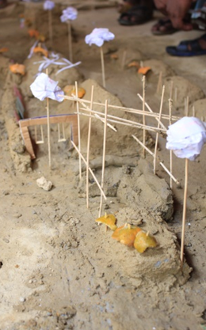
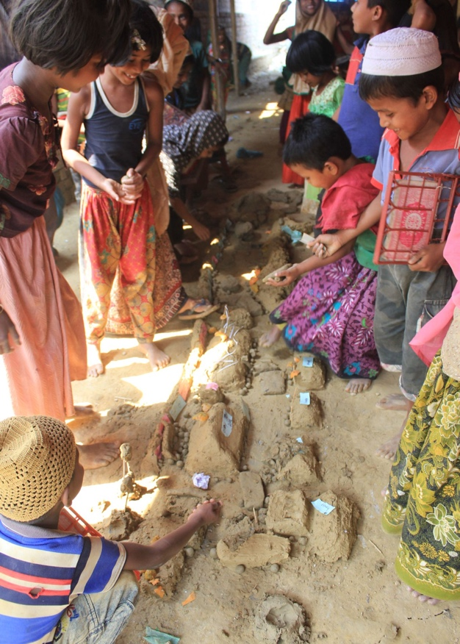

Community Mapping
PURPOSE
To identify essential resources and areas that need improvement.
To utilize local knowledge for better planning and design of shelters and communal spaces that are safe, accessible, and culturally appropriate.
SOME ELEMENTS TO MAP
Existing Physical Elements:Trees, Canals, Open Space, House plots, Streets, Infrastructure, Community spaces and Community boundaries
Problems: Disaster risks, poor infrastructure (road, sewage, electricity, sanitation), Unclear Tenure, Poor planning
Opportunity potential: People’s idea, Active people/Group, Cultural and natural heritage
Existing Social Groups: Saving group, Religious group, Youth group, Kinship/ clan, Local organization (Religious . official)
Image:Mapping spaces with Rohingya Children in the Rohingya Camp, Cox’s Bazar, Bangladesh. BRAC IED (2019)
Source:
Notes:
Community Mapping is a participatory activity where displaced community members create a visual map of their current living environment. This includes identifying critical resources, areas of safety, social spaces, and locations of concern or cultural significance.
Some key factors that can be mapped are Existing Physical Elements , Problems, Opportunity potential, Existing Social Groups
By mapping these it is possible To identify essential resources and areas that need improvement and To utilize local knowledge for better planning and design of shelters and communal spaces that are safe, accessible, and culturally appropriate.

Slide 24
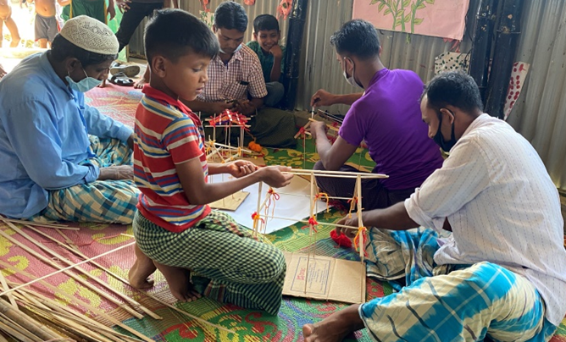
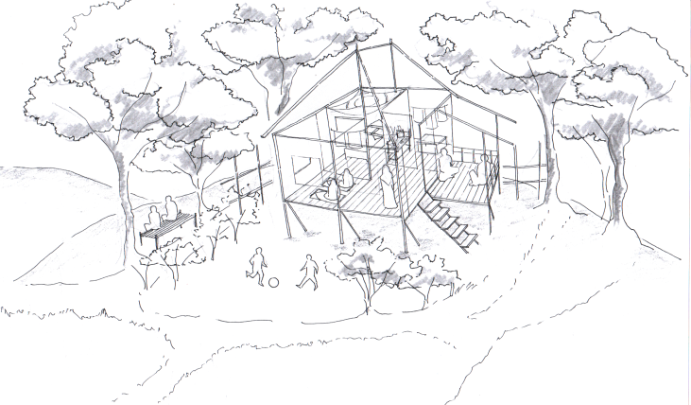
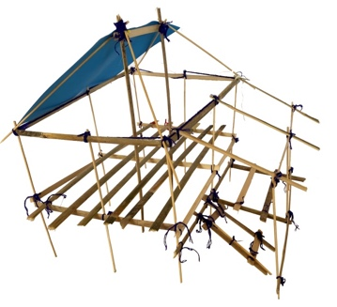
Model Making
“I had a large area back in Burma. It was surrounded by lemon, mango, blackberry and coconut trees. I grew them myself. In the evening, I enjoyed sitting and chatting with friends and family. There was a wooden staircase connected to the living room upstairs The kitchen was downstairs. Kids room was right beside the living room. We lived in the corner room. There’s was a prayer room where my daughters used to pray. I used to take rest on the balcony which was uplifted from the ground.”
PURPOSE
To visualize ideas and concepts in a tangible form, making it easier for community members to communicate their needs and preferences.
To facilitate innovative thinking and collaborative problem-solving for better-designed humanitarian spaces.
Image:Model making with Rohingya Father in the Rohingya Camp, Cox’s Bazar, Bangladesh. BRAC IED (2020)
Notes:
Model Making is a hands-on activity where community members, including children, construct physical models of their ideal shelters or communal spaces using available materials. This encourages creativity and practical problem-solving.
Hence model making can be used to visualize ideas and concepts in a tangible form, making it easier for community members to communicate their needs and preferences. And also to facilitate innovative thinking and collaborative problem-solving for better-designed humanitarian spaces.
As you can see in the photo that in a workshop with Rohingya Fathers in the Rohingya Refugee Camp, in Cox’s Bazaar, Bangladesh, fathers and children together made a model of the house they used it to describe their house, its surround- giving a glimpse of their lifestyles.
One of the fathers described their model as he said, “I had a large area back in Burma. It was surrounded by lemon, mango, blackberry and coconut trees. I grew them myself. In the evening, I enjoyed sitting and chatting with friends and family. There was a wooden staircase connected to the living room upstairs The kitchen was downstairs. Kids room was right beside the living room. We lived in the corner room. There’s was a prayer room where my daughters used to pray. I used to take rest on the balcony which was uplifted from the ground.”
From this description and model a visualization of a typical Rohingya family’s housing preferences were derived.

Slide 25
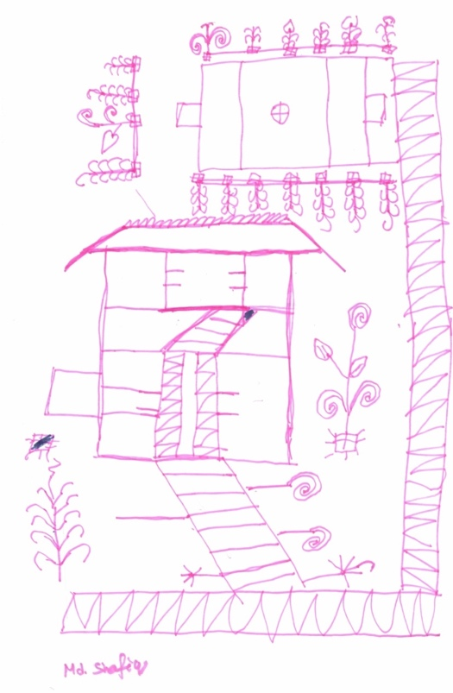
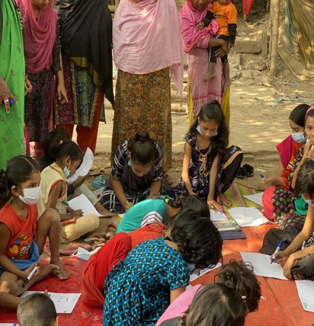
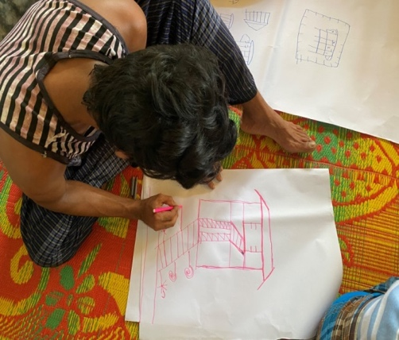
Drawing and Storytelling
“I had a two storied house in Burma. The pillars on the side were made of bricks. It was surrounded with wooden fences, and the roof was made with straw. The stairs were made by wooden plank. Most of the houses were made with bamboo in Burma. We were not allowed to make permanent structures in there even though we could afford to build one because of fear.
For decorating the house, we used coffee sachets and triangular shaped color tracing paper. We had to be questioned if we decorate our house too beautifully. This model house is like a temporary house, but we could’ve build stronger houses using tree logs. A house could be easily stable if it stands on wooden logs. I used white wooden logs for supporting column for my house.”
PURPOSE
To capture a wide range of ideas and perspectives in a creative and accessible way, particularly from those who may be less comfortable with verbal communication.
To uncover underlying values, traditions, and personal experiences that should be considered in the design to create spaces that feel safe and familiar.
Image:Drawing session with Children in Rohingya Camp, Cox’s Bazar, Bangladesh. BRAC IED (2020)
Image:Drawing session with Children in Bhashantek, Dhaka, Bangladesh. BRAC IED (2021)
Notes:
In drawing and storytelling session, community members, specially children, use drawings to express their needs, fears, and hopes regarding their living conditions and the design of their environment. Often during drawing and later in presentations sharings about personal stories and experiences related to displacement, daily life in the camp, and interactions with humanitarian services take place.
Through these sessions, separately with mothers, fathers and specially children it is possible to capture a wide range of ideas and perspectives in a creative and accessible way, particularly from those who may be less comfortable with verbal communication. Additionally these could also uncover underlying values, traditions, and personal experiences that should be considered in the design to create spaces that feel safe and familiar.
Such a drawing and storytelling session was conducted in the Rohingya can where a child drew a two-storied house and described, “I had a two storied house in Burma. The pillars on the side were made of bricks. It was surrounded with wooden fences, and the roof was made with straw. The stairs were made by wooden plank. Most of the houses were made with bamboo in Burma. We were not allowed to make permanent structures in there even though we could afford to build one because of fear.
For decorating the house, we used coffee sachets and triangular shaped color tracing paper. We had to be questioned if we decorate our house too beautifully. This model house is like a temporary house, but we could’ve build stronger houses using tree logs. A house could be easily stable if it stands on wooden logs. I used white wooden logs for supporting column for my house.””

Slide 26



The Theory of PLACE ATTACHMENT
NOSTALGIA
the longing for
cultural heritage and familiar experiences
Emotional bonds people form with their physical environment
Crucial for their well-being and sense of identity.
Memories
+ Cultural Practices
Into the Spaces
| Fosters a strong sense of OWNERSHIP & PRIDE
| Spaces become MEANINGFUL & RESPECTED
| Enhances SUSTAINABILITY & RESILIENCE
Notes:
The theory of place attachment highlights the emotional bonds people form with their physical environment, which are crucial for their well-being and sense of identity.
The Community engagement methods discussed are vital in humanitarian settings as they connect these emotional bonds to the design process.
By using these methods, you can harness nostalgia—the longing for cultural heritage and familiar experiences—by incorporating community members' memories and cultural practices into the spaces.
This involvement not only ensures that the spaces are culturally appropriate but also fosters a strong sense of ownership and pride. When communities actively participate in designing their environments, these spaces become meaningful and respected, enhancing their sustainability and the community's resilience.
Participatory Mapping:Ref:
Brown, B., & Altman, I. (2004). *Place attachment.* New York: Springer.
Bell, P. A. (2009). Place attachment and displacement: A study of the forced relocation of indigenous peoples. *Journal of Environmental Psychology,* *29*(2), 115-124.

Slide 27
Some key KEY FACTORS to understand Cultural Nuances in Humanitarian Setting
1.
Privacy and Gender Considerations
2.
Religious and Spiritual Practices
3.
Social Structures and Community Dynamics
4.
Traditional Building Practices and Materials
Notes:
Some key factors to understand Cultural Nuances in Humanitarian Settings are-
One, Privacy and Gender Considerations:
Cultures have varying norms regarding privacy, interaction between genders, and family structures. Ignoring these can lead to discomfort and safety concerns.
Two, Religious and Spiritual Practices:
Spaces for prayer, meditation, or other religious activities are crucial for maintaining mental and spiritual well-being in times of crisis.
Three, Social Structures and Community Dynamics:
Understanding existing social hierarchies and community organization is key to designing spaces that facilitate social interaction and support
Four, Traditional Building Practices and Materials:
Incorporating local building techniques and materials can offer several benefits, including sustainability, cost-effectiveness, and cultural familiarity.
Ignoring the cultural nuances of affected communities can lead to spaces that are not only underutilized but can even heighten existing vulnerabilities. Let’s see an example-

Slide 28
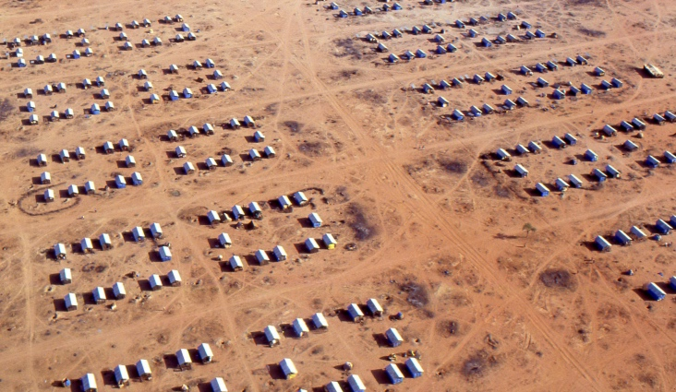
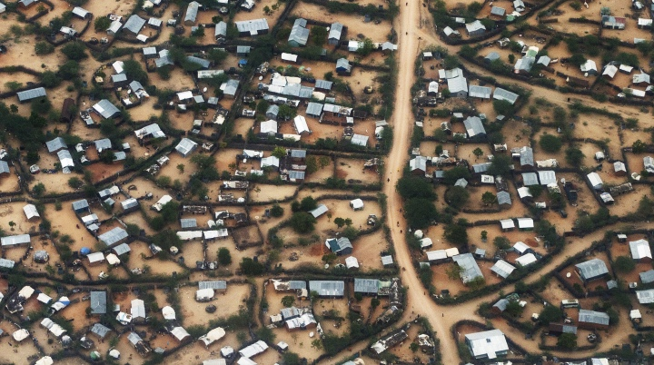
RELIGIOUS & SPIRITUAL PRACTICES
Dadaab Refugee Camp in Kenya
Problem:
In the early days of the Dadaab Refugee Camp in Kenya, which primarily hosts Somali refugees, there were insufficient spaces dedicated to religious and spiritual activities. This oversight affected the mental and spiritual well-being of the refugees, who were unable to practice their religion freely and regularly, leading to increased stress and a sense of cultural loss.
Solution:
To remedy this, the camp management established mosques and designated prayer areas within the camp. These spaces allowed refugees to continue their religious practices, providing a sense of normalcy and community cohesion. The inclusion of these facilities was crucial for maintaining the refugees' spiritual well-being and overall morale (UNHCR, 2023).
Image: Refugee Settlement, Kenya. UNHCR (1992)
References
UNHCR. (2023). Strategic Considerations in Shelter Responses. Retrieved from emergency.unhcr.org
Image: Refugee Settlement, Kenya. UNHCR (2020)
Notes:
In the early days of the Dadaab Refugee Camp in Kenya, which primarily hosts Somali refugees, there were insufficient spaces dedicated to religious and spiritual activities. This oversight affected the mental and spiritual well-being of the refugees, who were unable to practice their religion freely and regularly, leading to increased stress and a sense of cultural loss.
To remedy this, the camp management established mosques and designated prayer areas within the camp. These spaces allowed refugees to continue their religious practices, providing a sense of normalcy and community cohesion. The inclusion of these facilities was crucial for maintaining the refugees' spiritual well-being and overall morale

Slide 29
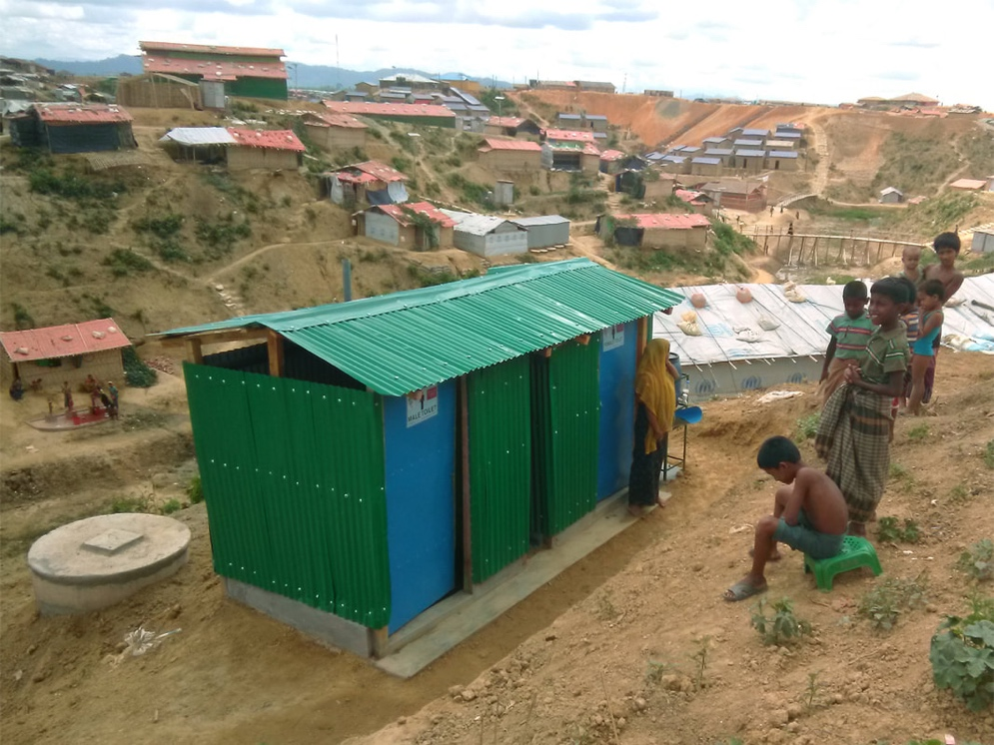
Privacy and Gender Considerations
Rohingya Camp, Cox’s Bazar, Bangladesh
In the Rohingya Refugee Camp in Bangladesh, the initial lack of consideration for privacy and gender norms led to significant discomfort and safety concerns among Rohingya refugees, particularly women.
The camp's design did not adequately separate facilities for men and women. Further, lights were installed to make it feel safe for everyone.
However, women ended up breaking the lights and go to the washroom in dark.
This was because the women felt safer without the lights, they thought without the lights they would not to be seen or identified going to the toilets at night hence they would avoid harassments.
Notes:
Most importantly you need to be MINDFUL AND DEEPLY ENQUIRE every event or incident that occur to fully understand the context of Humanitarian setting.
Let’s look at the Rohingya Refugee Camp, there the initial lack of consideration for privacy and gender norms led to significant discomfort and safety concerns among Rohingya refugees, particularly women.
The camp's design did not adequately separate facilities for men and women. Furthermore, lights were installed to make it feel safe for everyone.
However, women ended up breaking the lights and go to the washroom in dark.
This was because the women felt safer without the lights, they thought without the lights they would not to be seen or identified going to the toilets at night so they would avoid harassments.
Thus, In the Rohingya Refugee Camp, the initial oversight of these aspects resulted in significant discomfort and safety issues, particularly for women. The failure to separate facilities and the inappropriate use of lighting underscored the importance of designing spaces that respect and accommodate gender-specific privacy preferences to ensure safety, dignity, and cultural relevance.
https://thereader.mitpress.mit.edu/at-the-azraq-refugee-camp-restoring-humanity-through-art-and-design/

Slide 30
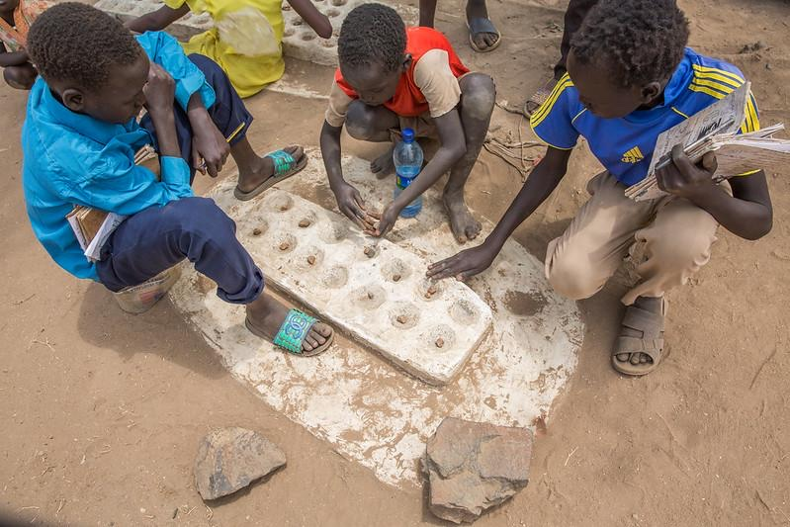




The BENEFITS of Culturally Appropriate Design
1. Increased Utilization
3. Improved Mental Health and Well-being
2. Enhanced Safety and Security
4.Community Ownership
Image: Children enjoy playing together at the Child Friendly Spaces (CFS) in Kule refugee camp, Gambella region (2017)
Notes:
There are numerous benefits of Culturally Appropriate Design
One, Increased Utilization:
When spaces are designed with cultural needs in mind, they are more likely to be used and accepted by the community. This leads to better utilization of resources and improved program effectiveness.
Two, Enhanced Safety and Security:
Addressing cultural sensitivities regarding gender, privacy, and social structures can reduce the risk of conflict and violence, creating a safer environment for everyone.
Three, Improved Mental Health and Well-being:
Spaces that cater to cultural and spiritual needs can provide comfort and a sense of normalcy, contributing to improved mental health and resilience in the face of adversity.
Four, Community Ownership:
Involving communities in the design process and utilizing local resources fosters a sense of ownership, leading to greater project sustainability and long-term success.

Slide 31
Situation-based TASK (Take your time and think carefully!)
In your neighbourhood, one of the big old buildings has been demolished and now a new school for the children will be built here. A group of architects from outside your community came in to design the school. The architects came to consult with you.
Choose from below what combination of community engagement methods would you suggest to the architects coming to work in your community and why?
Focus Groups Discussion and Interview
Model Making
Empathy Mapping
Drawing and Storytelling
Community Mapping
Write your answer here: https://padlet.com/hamidahashrafi/in-your-neighbourhood-one-of-the-big-old-buildings-has-been--s12oo7sz1oh0pate
Notes:
Time for a Situation-based TASK for you.
Suppose, In your neighbourhood, one of the big old buildings has been demolished and now a new school for the children will be built here. A group of architects from outside your community came in to design the school. The architects came to consult with you.
Choose from below what combination of community engagement methods would you suggest to the architects coming to work in your community and why?

Slide 32
Established PRINCIPLES by internationally renowned Organizations and Governing bodies
National legislation, policies & plans provide a framework for settlement design (UNHCR, 2019, p. 12)
Environmental considerations drive design (UNHCR, 2019, p. 15)
1. Participation and Community Engagement (The Sphere Handbook)
2. Safety and Security (UNHCR Guidelines)
3. Accessibility and Inclusivity (The Core Humanitarian Standard.)
4. Flexibility and Adaptability (IFRC Shelter and Settlements Guidelines)
5. Cultural Sensitivity and Dignity (The Sphere Handbook )
6. Child Friendly Spaces (A Handbook for Practitioners (UNICEF, 2016), The Child Protection Minimum Standards (CPMS) by the Child Protection Working Group (CPWG) )
Notes:
When it comes to space design in humanitarian settings, specific principles emerge from internationally recognized organizations and governing bodies. These principles focus on creating safe, functional, and dignified living environments for displaced populations. Here are key principles with references and specific examples:
1. Participation and Community Engagement:
- Principle: Engage affected communities in the design and planning process to ensure their needs and preferences are considered.
- Example: In the Kalobeyei integrated settlement in Kenya, community members were involved in designing shared spaces like market areas and community centers, fostering a sense of ownership and social cohesion.
2. Safety and Security:
- Principle: Prioritize safety and security in space design to protect inhabitants from risks and threats.
- Example: In the Cox's Bazar Rohingya refugee camps in Bangladesh, pathways and communal spaces are well-lit and designed to minimize risks, particularly for vulnerable groups like women and children.
3. Accessibility and Inclusivity:
- Principle: Ensure spaces are accessible to all individuals, including persons with disabilities and elderly populations.
- Example: In the Azraq refugee camp in Jordan, shelters and communal facilities are designed with accessible pathways, ramps, and adapted facilities to accommodate persons with disabilities.
4. Flexibility and Adaptability:
- Principle: Design spaces that can adapt to changing needs and demographics over time.
- Example: In the refugee settlements in Uganda hosting South Sudanese refugees, shelters are constructed using modular and expandable designs to accommodate growing families and changing needs.
5. Cultural Sensitivity and Dignity:
- Principle: Respect cultural norms and traditions in space design to preserve dignity and promote well-being.
- Example: In the Dzaleka refugee camp in Malawi, communal spaces are designed to reflect cultural preferences and practices, providing areas for social gatherings and religious activities.
Child Friendly Spaces:
Principle: Create designated spaces for children that provide a safe and supportive environment for play, learning, and protection
These principles guide the design and planning of spaces in humanitarian settings, ensuring that interventions are contextually appropriate, inclusive, and responsive to the needs and aspirations of displaced communities. Real-life examples from specific refugee camps demonstrate how these principles are implemented to create safe, functional, and dignified living environments for displaced populations.

Slide 33
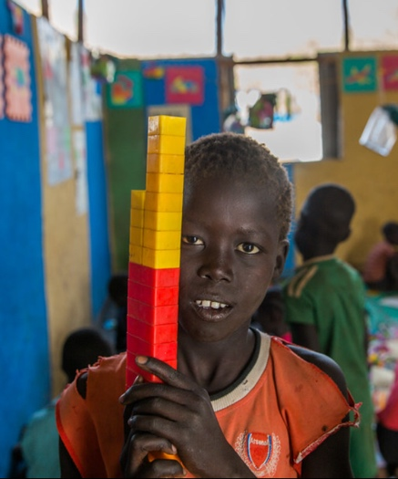
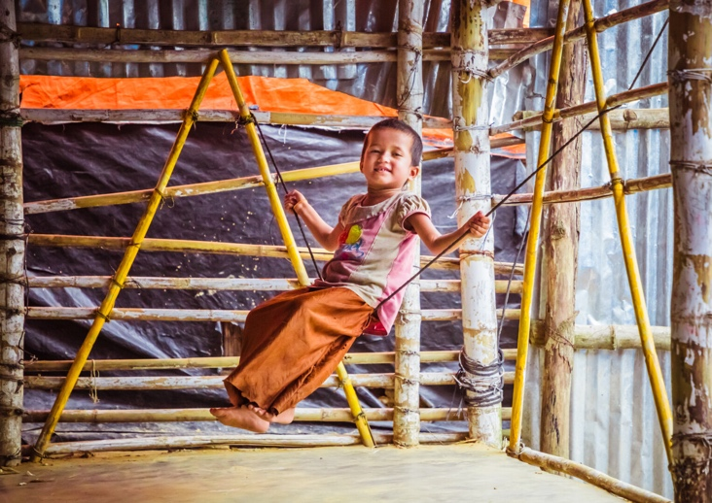
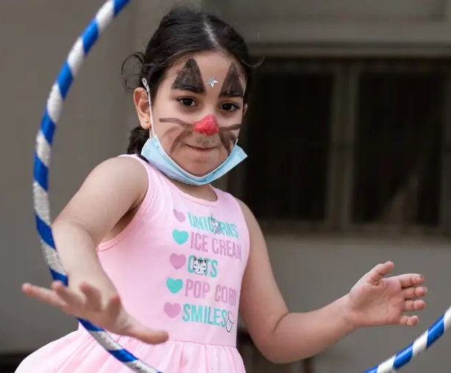
Now let’s talk about the MOST VULNERABLE group
The Children
Image: Child Friendly Spaces (CFS) in Kule refugee camp, Gambella region, UNICEF Ethiopia. (2017).
Image:Humanitarian Play Lab at the Rohingya Camp in Cox’s Bazar, Bangladesh, BRAC IED. (2019)
Image:Pop-up Child Friendly Space, Beirut, Lebanon, Save the Children. (2021)
Notes:
Now let’s talk about the MOST VULNERABLE group
The Children
In humanitarian emergencies, children are disproportionately affected and face unique challenges compared to adults.
Their vulnerability stems from a combination of factors related to their physical and emotional development, social conditions, and the specific nature of humanitarian crises.
Image: Unicef ethiopia

Slide 34
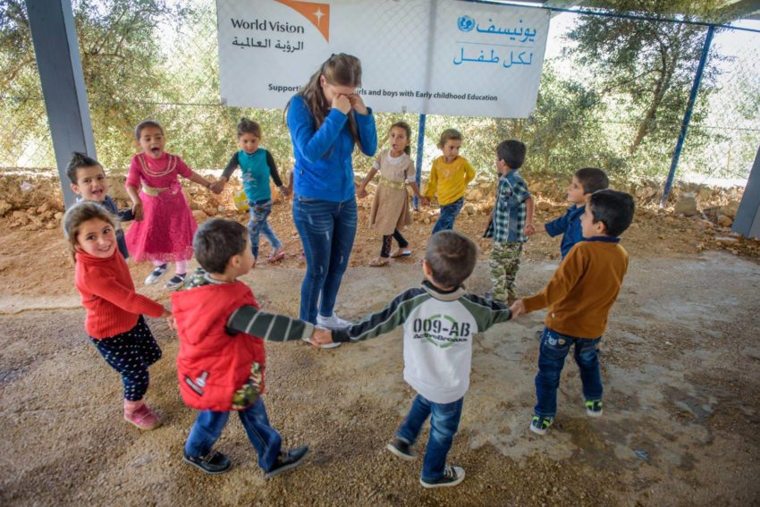



CHILD-FRIENDLY SPACES
Child-centered
Culturally sensitive
Stimulating environments
SENSE OF
SECURITY
PLAY AND
LEARN
SUPPORTIVE SOCIAL
ENVIRONMENT
Image: Teacher Rita Cholakian plays games with her young students at World Vision’s early childhood education center, Lebanon, UNICEF-funded and World Vision-started project. World Vision, (2017)
Notes:
Here, Child friend spaces aim to provide a temporary space where children can establish some degree of normalcy, engage in age-appropriate activities, and feel protected. It focuses on creating child-centered, culturally sensitive, and stimulating environments. Well-designed spaces can potentially contribute to children's psychosocial well-being by providing a sense of security, opportunities for play and learning, and a supportive social environment.

Slide 35
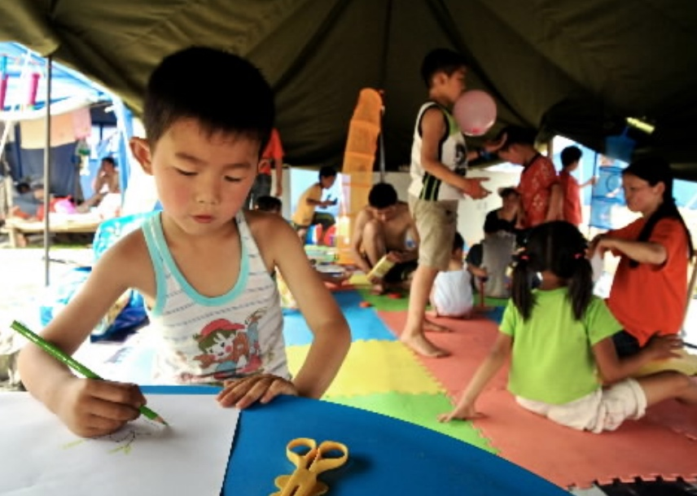
Simple GUIDELINES to create Child-Friendly Spaces:
Extra Reading Material:
Co-Designing Early Childhood Spaces in Humanitarian Contexts:
Insights from Play to Learn Practitioners
Know your PURPOSE
ASSESS the needs and risks
COORDINATE with other organizations
SELECT SITE that is safe and accessible
DESIGN SPACE AND LAYOUT
Ensure SAFETY
Provide AGE APPROPRIATE AND CULTURALLY RELEVANT materials
RECRUIT AND TRAIN staff
Provide structured and unstructured ACTIVITIES
MONITOR AND EVALUATE
Incorporate FEEDBACK
TRANSITION AND EXIT
Image:Child Friendly Space at the Mainzhu Stadium in China’s Sichuan Province in the aftermath of the devastating May 12, 2008 earthquake.
Notes:
A Child Friendly Space (CFS) is a safe haven for children affected by emergencies. Here's a simplified guide based on the handbook:
1. Purpose: Provide a protected space for children to play, learn, and heal.
2. Assessment: Understand the specific needs and risks children face in the emergency context.
3. Coordination: Collaborate with other organizations and local authorities to maximize resources and avoid duplication.
4. Site Selection: Choose a safe, accessible location with water and sanitation facilities, ideally near other services.
5. Space and Layout: Ensure enough space for various activities, both indoors and outdoors, and consider the needs of children with disabilities.
6. Safety: Prioritize safety by clearing hazards, establishing emergency procedures, and training staff in first aid.
7. Equipment and Materials: Provide age-appropriate, culturally relevant toys, games, and educational materials.
8. Staffing: Recruit and train staff who are caring, responsible, and understand child protection principles. Maintain appropriate child-to-staff ratios.
9. Activities: Offer a mix of structured and unstructured activities that promote play, learning, psychosocial well-being, and life skills.
10. Monitoring and Evaluation: Continuously assess the program's effectiveness and make necessary adjustments.
11. Feedback: Establish mechanisms for children, caregivers, and community members to provide feedback and raise concerns.
12. Transition and Exit: Plan for the eventual transition of the CFS into longer-term community-based initiatives or other programs.
Remember, the most important aspect is to create a safe and supportive environment where children can heal, learn, and thrive amidst the challenges of an emergency.
Ref: Metzler, J., Savage, K., Yamano, M., & Ager, A. (2015). Evaluation of child friendly spaces: An inter-agency series of impact evaluations in humanitarian emergencies. Columbia University Mailman School of Public Health and World Vision International.
Yang. (2008). Child friendly spaces in emergencies: A handbook for save the children staff. Save the Children

Slide 36
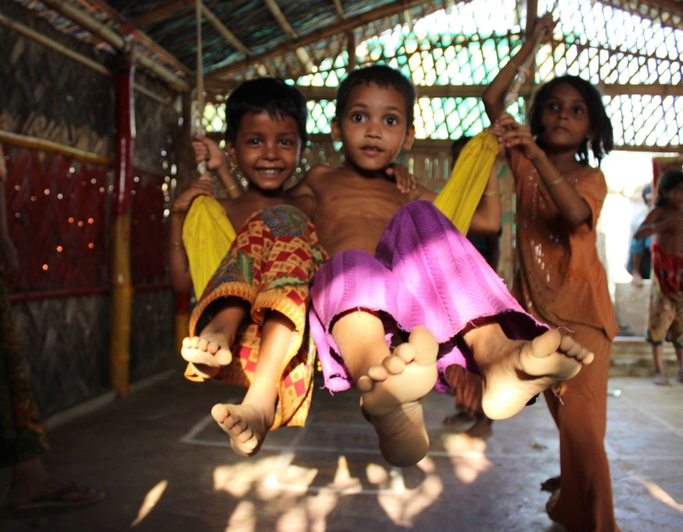
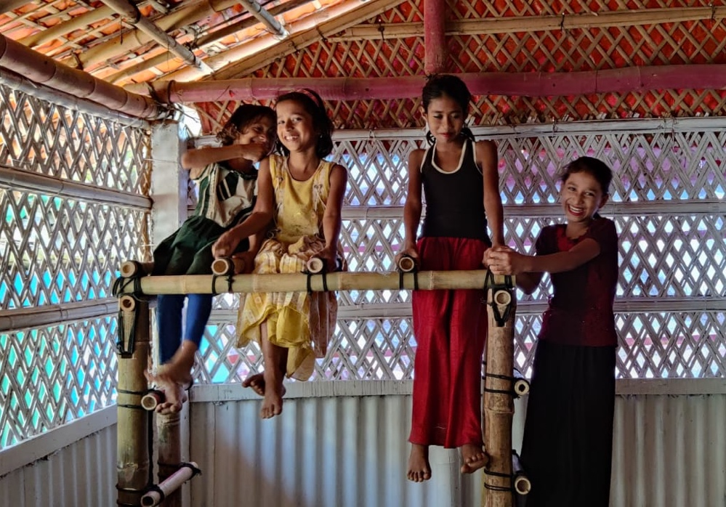
Case: Humanitarian Indoor Playground in Rohingya Refugee Camps
Images:Humanitarian Play Lab at the Rohingya Camp in Cox’s Bazar, Bangladesh, BRAC IED. (2019)
Notes:
Let’s look at the case of Humanitarian Play Labs as a child friendly space.
Humanitarian Play Labs are indoor play spaces that cater to children residing in the refugee camps of Cox’s Bazaar designed for healing and learning through play.
The design pays special attention for cultural retention, resource and space optimization while giving a relief from the scorching heat of the camps, it also celebrates and encourages Rohingyas children’s affinity towards nature and environment conservation through planning planting workshops etc.
The project also takes into account children’s interest towards creating and playing with natural material like clay, mud and bamboo.
If you wish to know more about the project’s process and development, feel free click on this slide’s title to take you to a few more slides elaborating on the process.

Slide 37
Key TAKEAWAYS
Prioritize Community
Engagement for space design
Understand the
Context
Design for Cultural Appropriateness
Adhere to Humanitarian Design Principle
Maintain Shelter Design Standards
Child-Friendly Spaces are crucial

Slide 38
References
Humanitarian architecture – what does it mean? | Aalto University. (2023, September 6). https://www.aalto.fi/en/wit-programme/humanitarian-architecture-what-does-it-mean
SHELTER DESIGN CATALOGUE SECTION: DIVISION OF PROGRAMME SUPPORT AND MANAGEMENT SHELTER AND SETTLEMENT (https://www.unhcr.org/). (2016). https://sheltercluster.org/compendium/documents/division-programme-support-and-management-shelter-and-settlement-section. https://emergency.unhcr.org/sites/default/files/2024-01/unhcr_shelter_design_catalogue_january_2016.pdf
AlWaer, H., Sibley, M., & Cooper, I. (2023). Design and use of space in refugee camps: a case study of a contested terrain. Proceedings of the Institution of Civil Engineers. Urban Design and Planning, 176(3), 123–141. https://doi.org/10.1680/jurdp.22.00068
Barnes, V., & Eriksson, V. (2015). Mapping empathy and ethics in the design process. ResearchGate. https://www.researchgate.net/publication/307932419_Mapping_Empathy_and_Ethics_in_the_Design_Process
UNHCR. (2023). Strategic Considerations in Shelter Responses. Retrieved from emergency.unhcr.org UN Women. (2021). Gender-Responsive Implementation in Humanitarian Settings. Retrieved from ppguide.unwomen.org
Inalhan, G., Yang, E., & Weber, C. (2021b). Place attachment theory. In Routledge eBooks (pp. 181–194). https://doi.org/10.1201/9781003128830-16
Save the Children [A Handbook for Save the Children Staff]. (2008). Child Friendly Spaces in Emergencies: A Handbook for Save the Children Staff. https://image.savethechildren.org/child-friendly-space-in-emergencies-ch11044514.pdf/7680i28h2bi56p3hf52lxt3uu8l68oc4.pdf

Slide 39

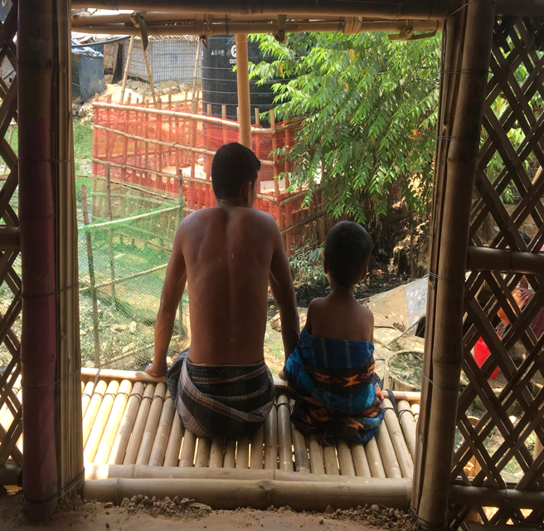


Thank you
Notes:
Thank you

