Slide 1
Day
Integration of Mental Health
and Psychosocial Support Approach
for Afflicted Communities
8

Slide 2
Learning Outcomes
Participants will be able to:
Compare and explain between Psychological First Aid and Psychosocial Support
Explain the importance of multi sectoral approach
Assess and explain the need of mental health integration in different sector
Can relate, compare and explain different global models of Mental Health and Psychosocial Support

Slide 3
Think
What is Psychosocial Support?
What is the Difference Between Psychological First Aid (PFA) and Psychosocial Support (PSS)?

Slide 4
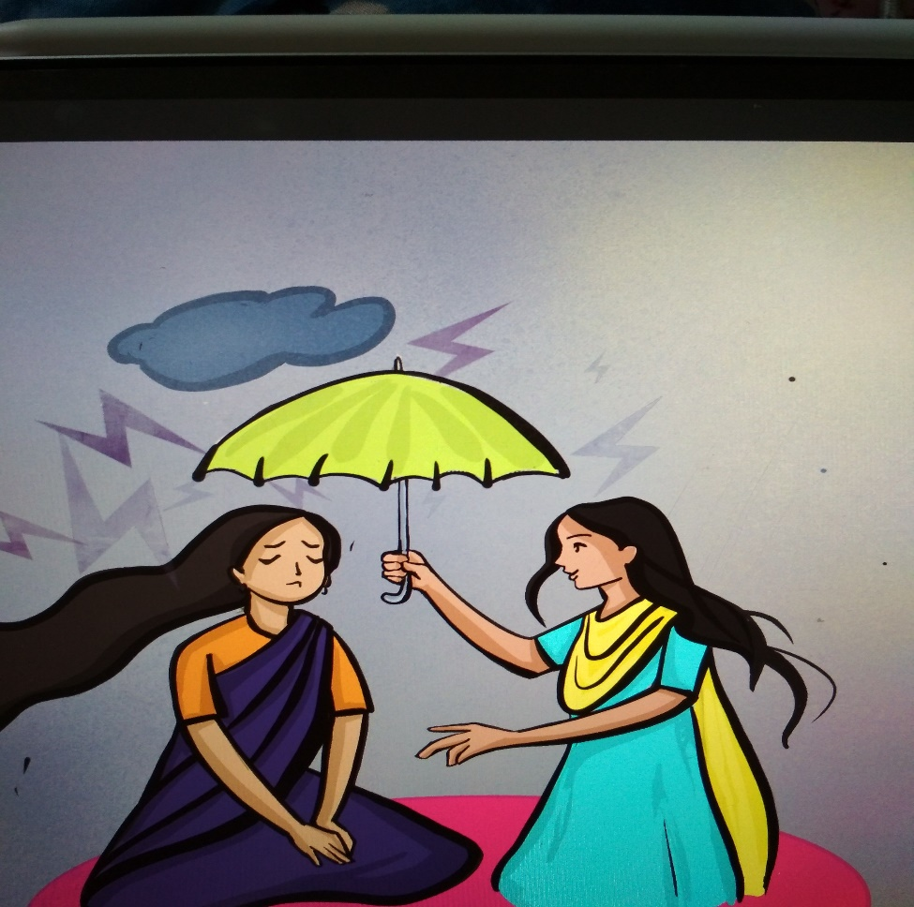
Psychosocial Support (PSS)
Psychosocial support is a continuum of programming that works at different layers of care, including with individuals, families, groups, and communities.
Interventions focus on coping and stress reduction; building interpersonal connections; and addressing psychological, social, and spiritual needs of individuals and communities through respectful and caring relationships.
Notes:
Resource Source: https://www.fhi360.org/wp-content/uploads/2023/11/resource-mhpss-8csmodel.pdf
Illustration Source: BRAC IED Archives

Slide 5
Onset
PFA
Immediate Support after the onset
PSS
Those who will be unable to manage day to day distress and being dysfunctional in daily living
Psychotherapy/Psychiatric Intervention
Those who has severe mental health issues

Slide 6
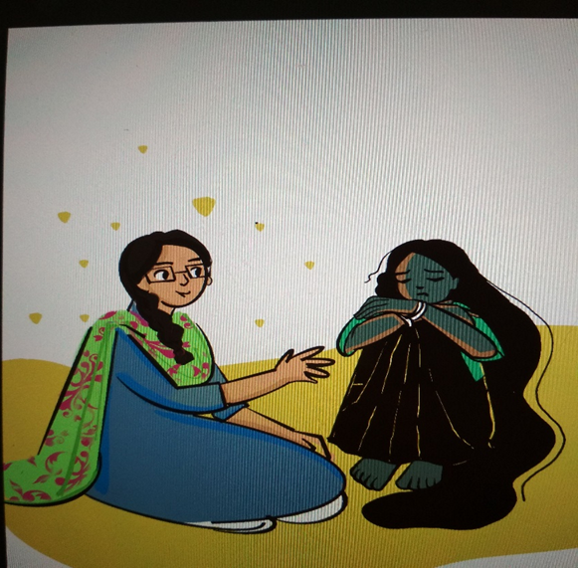
Mental Health and Psychosocial Support
Mental health and psychosocial support is used in this document to describe any type of local or outside support that aims to protect or promote psychosocial well-being and/or prevent or treat mental disorder. although the terms mental health and psychosocial support are closely related and overlap, for many aid workers they reflect different, yet complementary, approaches.
Notes:
Resource Source: https://emergency.unhcr.org/emergency-assistance/health-and-nutrition/mental-health-and-psychosocial-support-mhpss
Illustration Source: BRAC IED Archives

Slide 7
Multi Sectoral Approach
A multi-sectoral, integrated approach to mental health care means making mental health a priority in sectors beyond the mental health system – including the physical health system, and in education, employment, and societal settings and policies.
Notes:
Resource Source: https://www.oecd-ilibrary.org/social-issues-migration-health/a-new-benchmark-for-mental-health-systems_7486a219-en
Illstration Source: https://www.mhpssmsp.org/es

Slide 8
Why is Mental Health Integration needed?
Pursue a ‘mental health in all policies’ approach;
Ensure physical health needs are met;
Enable front line actors to connect individuals to appropriate services.
Involve social protection systems that promote recovery and encourage return to work or education;
Notes:
Resource Source: https://interagencystandingcommittee.org/sites/default/files/2024-01/IASC%20Guidance%20Integrating%20MHPSS%20and%20Peacebuilding%2C%20a%20Mapping%20and%20Recommendations%20for%20Practitioners..pdf

Slide 9
Global Models of MHPSS
There are some significant model of MHPSS that are followed globally in the humanitarian context. Some significant models are:
01
02
IASC Guidelines Multi layered Model
BRAC Paracounsellor Model

Slide 10
IASC Guidelines
The Inter-Agency Standing Committee (IASC) was established in 1992 in response to General Assembly Resolution 46/182, which called for strengthened coordination of humanitarian assistance. The Inter-Agency Standing Committee (IASC) issues these Guidelines to enable humanitarian actors to plan, establish and coordinate a set of minimum multi-sectoral responses to protect and improve people’s mental health and psychosocial well-being in the midst of an emergency.
Key Purposes:
To enable humanitarian actors and communities to plan, establish and coordinate
To protect and improve people’s mental health and psychosocial well-being in the midst of an emergency.
Implementing minimum responses, which are essential, high-priority responses that should be implemented as soon as possible in an emergency.
Notes:
Resource Source: https://interagencystandingcommittee.org/sites/default/files/migrated/2014-10/Checklist%20for%20field%20use%20IASC%20MHPSS.pdf

Slide 11
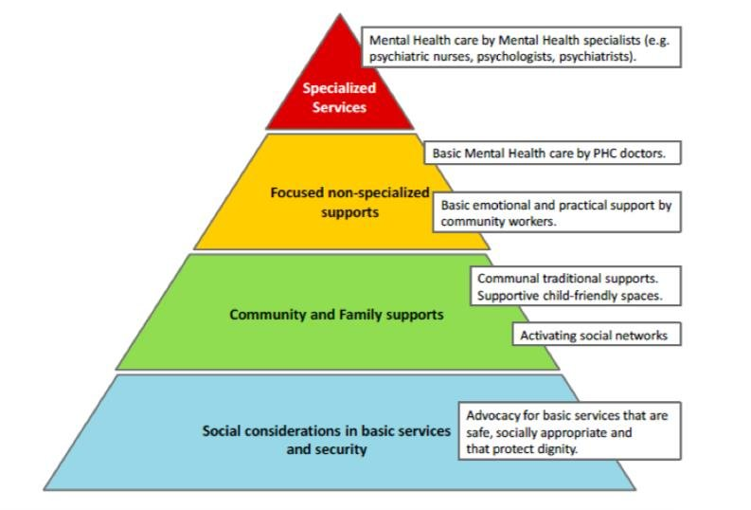
Intervention pyramid for mental health and psychosocial support in emergencies
Notes:
Resource Source: https://interagencystandingcommittee.org/sites/default/files/migrated/2014-10/Checklist%20for%20field%20use%20IASC%20MHPSS.pdf

Slide 12
Core principles IASC Guidelines
01
Human rights and equity
02
Participation
03
Do no harm
04
Building on available resources and capacities
05
Integrated support systems
06
Multi-layered supports
Notes:
Resource Source: https://interagencystandingcommittee.org/sites/default/files/migrated/2014-10/Checklist%20for%20field%20use%20IASC%20MHPSS.pdf

Slide 13
Reflection Question
Write one most interesting point from the discussion

Slide 14
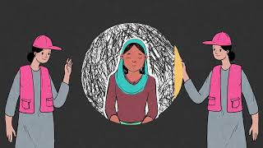

Slide 15
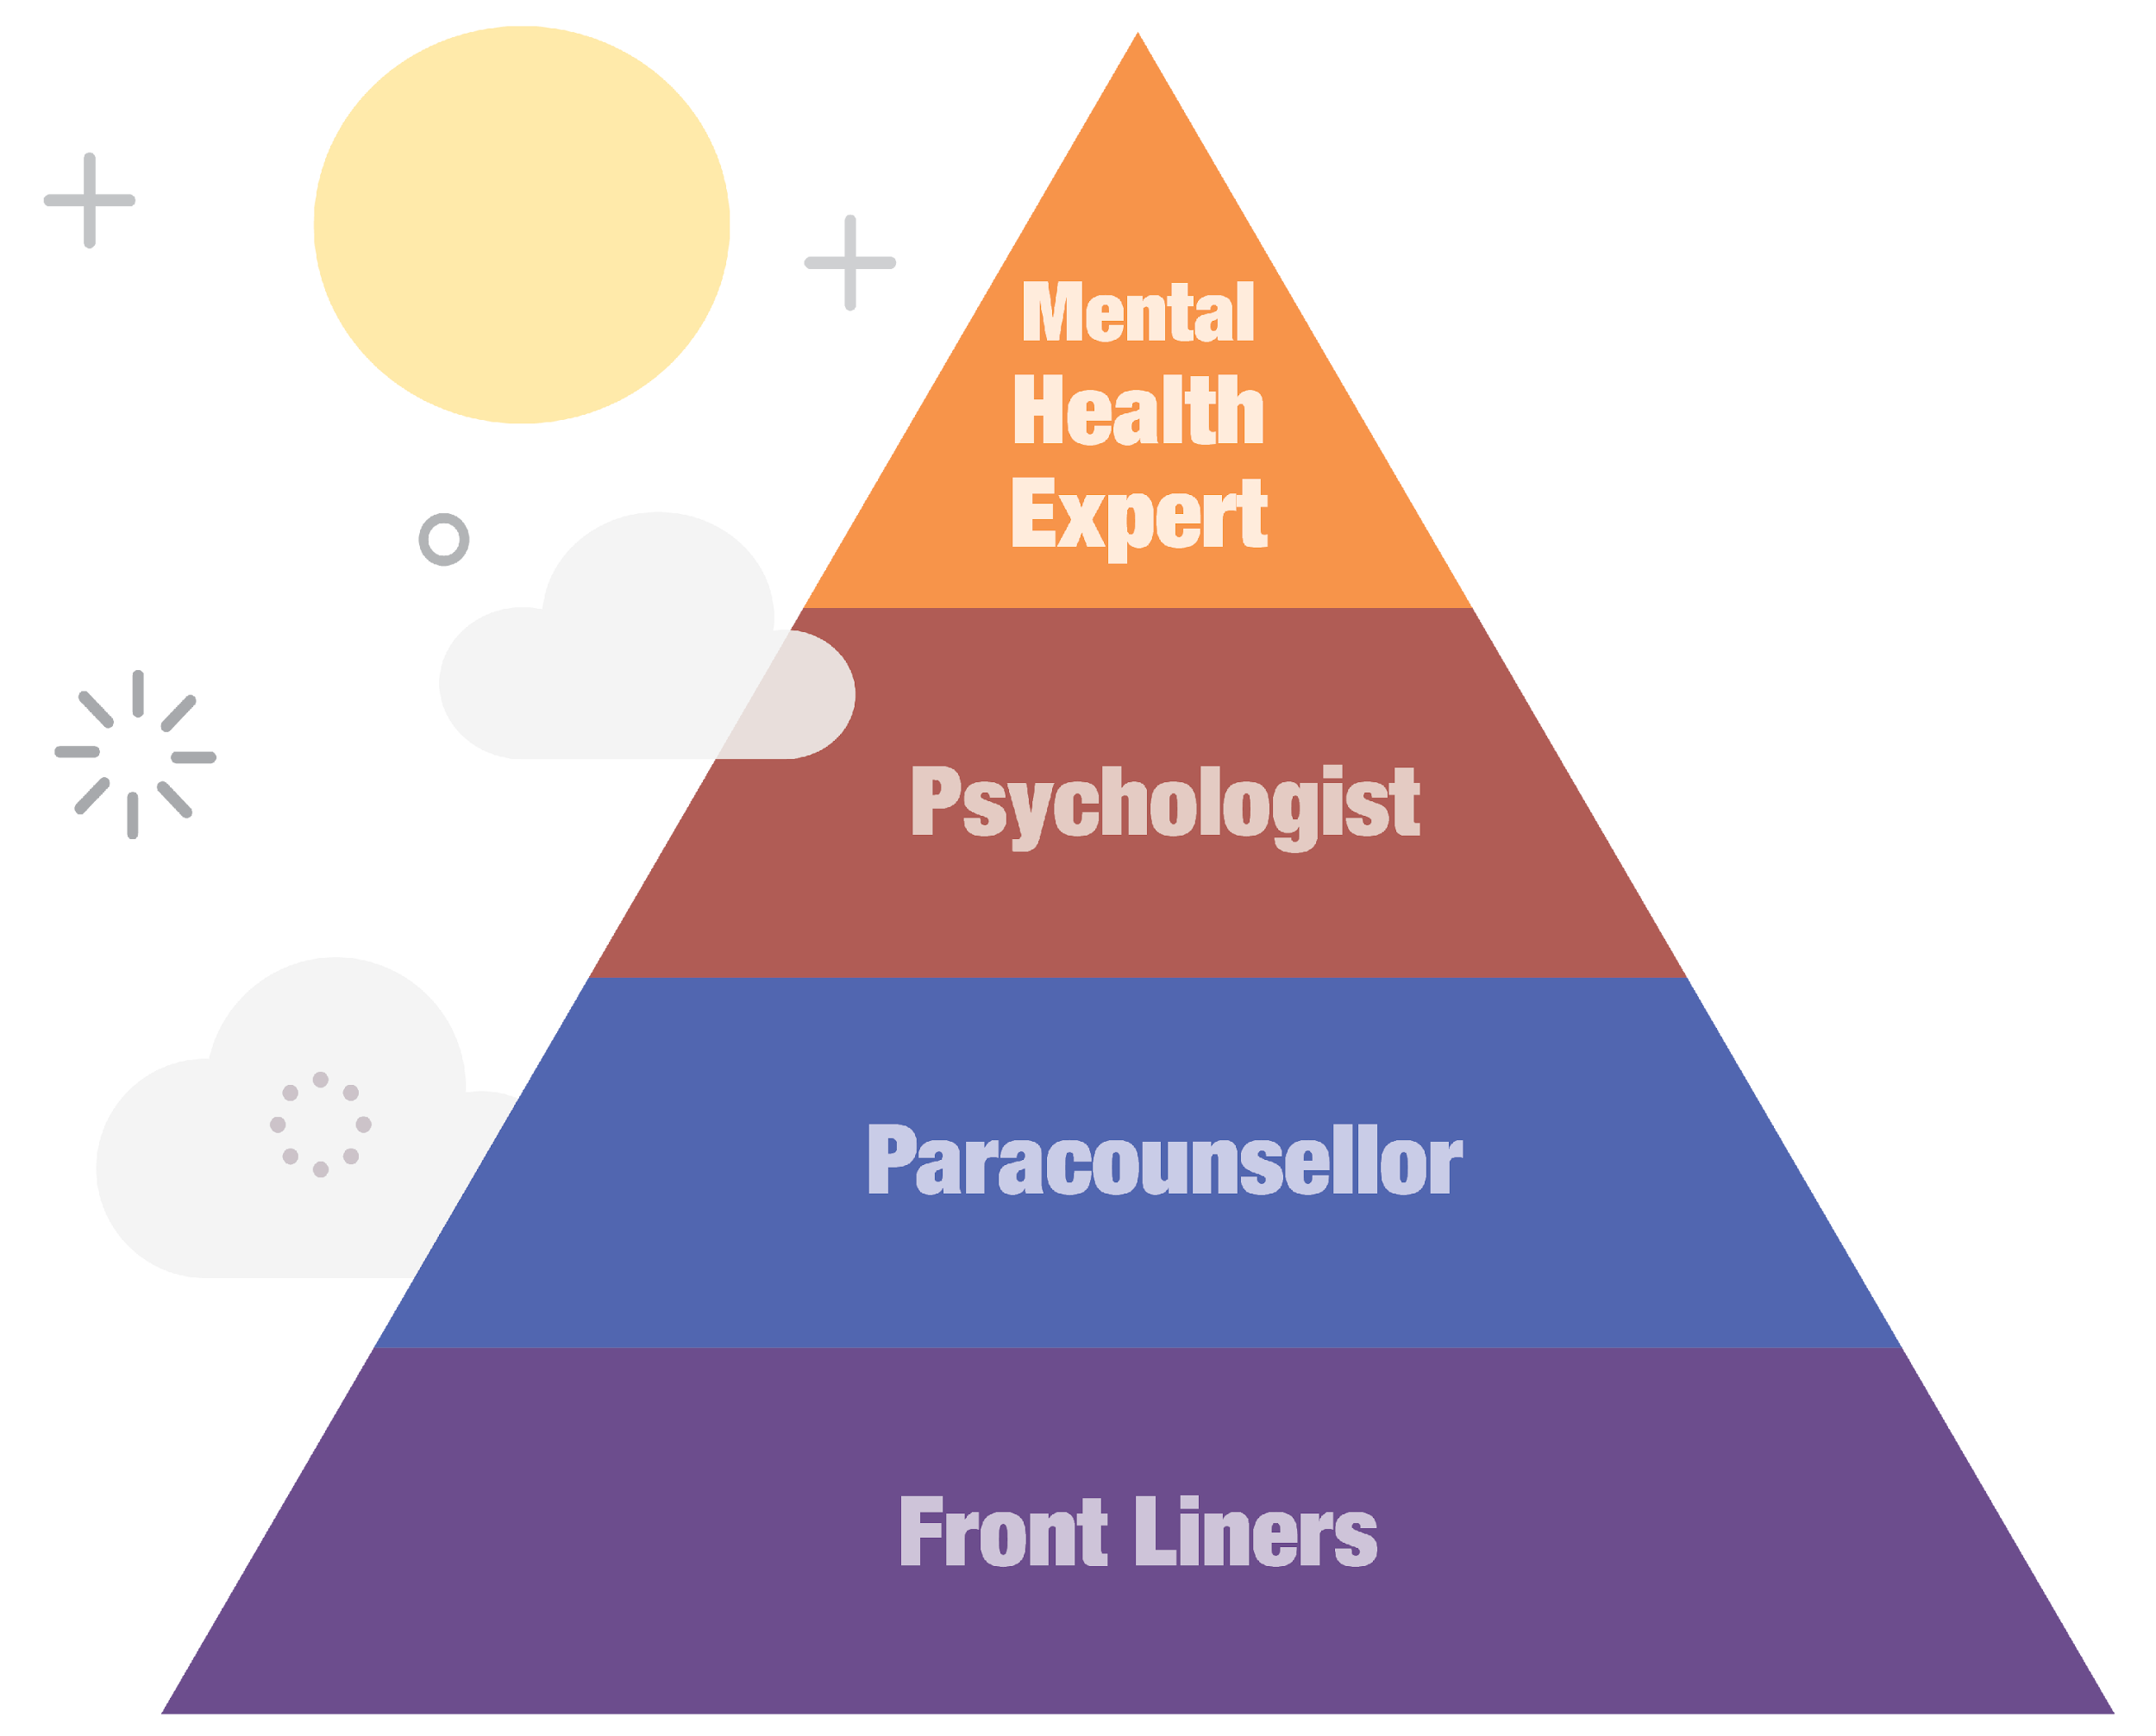
The BRAC Paracounsellor Model
Brac Intervention Model
Notes:
Resource Source: https://blend-on.org/the-brac-paracounsellor-model/#:~:text=The%20BRAC%20Paracounsellor%20Model%20is,documentation%2C%20regular%20supervision%2C%20etc.

Slide 16
Objectives of the Paracounsellor Model
Provide psychosocial support to the ones suffering from severe mental health issues and trauma from abuse and torture
Provide a confidential and safe space for clients through active listening, empathy, and holding a non-judgmental attitude towards them through a reflective supervision space for guidance and support for safe and ethical clinical practice
Provide access to mental health support to the marginalized and the vulnerable especially in a crisis setting
Encourage empathy and ensure resilience
Capacity-building & community engagement through local community members, working as play leaders, mother volunteers & front-liners
Detection of early on mental health issues among beneficiaries and treat them accordingly.
Empowering women as Paracounsellors
Notes:
Resource Source: https://bracied.com/impact-evaluation-of-paracounsellor-model/

Slide 17
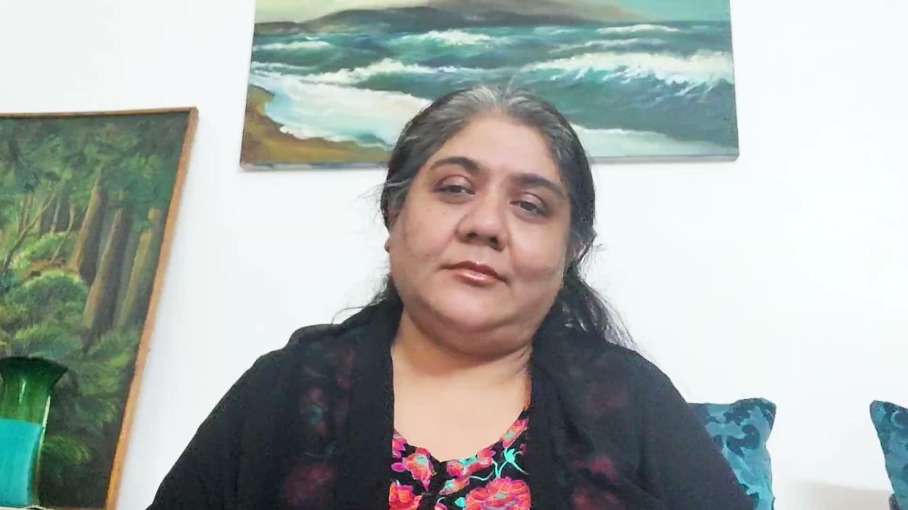
Let’s Listen from an Expert

Slide 18
Unique Features of the Paracounsellor Model
Scalability and ability to reach the marginalized and vulnerable at a rapid rate
Adaptability is a core feature of the model which can help it sustain across different communities and schools in Bangladesh, reaching out and providing psychological and psychosocial support to the isolated, vulnerable and the marginalized
Support Approach is a unique way to support the beneficiaries through a referral system which is fast and effective
Preservation of culture & community bonding
It will foster a sense of community by creating a supporting environment for mothers & children while encouraging involvement from others
It empowers women leaders to volunteer as primary psychosocial service providers, training them to serve as role models and disseminators of knowledge within the community
Continue professional development of Para Counselors
Notes:
Resource Source: https://bracied.com/impact-evaluation-of-paracounsellor-model/

Slide 19
Reflection Question
Write one most interesting point from the discussion

Slide 20
Case Study
Noor (pseudonym) was 4 years old. He used to visit our HPL regularly. He used to play with children, his favorite was physical play. He would group with friends and engage in a lot of physical play during free play. Our Play leader also had a lot of fun with it. But it seems for some time, he was not regular in play lab. He was not talking with his friends as he did before, not engaging even if playing. Got angry very quickly, lashes out at other children. The play leader became very concerned. She then began to observe. It was seen in that Noor's family life was not going well for some time. The relationship between parents was not going well. His father remarried. Meanwhile, the mother was facing more domestic violence. While talking to the mother, it was seen that the mother was completely broken mentally. Noor was seeing these things every day.

Slide 21
Integration of Paracounsellor Model into HPL
1
2
3
To ensure the mental health wellbeing of the children and caregivers of the HPL
To ensure socio-emotional development of the children
To build the strong referral system in the HPL

Slide 22
How The Models Work together
Read the PDF for 5 Minutes
Notes:
Reading Materials: https://drive.google.com/drive/search?q=The%20Difference%20between%20IASC%20Multi%20Layered%20Support%20System%20and%20BRAC%20Paracounsellor%20Model.pdf

Slide 23
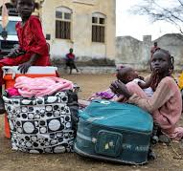
Case Example
The Humanitarian Country Team (HCT) of South Sudan is committed to a future that sees people being self-reliant. Sadly, evidence-based needs remain high, and the people of South Sudan will continue to require significant support from the international community throughout 2024. An estimated 9 million people, including refugees in South Sudan, will experience critical needs in 2024. As the HCT, we aim to target 6 million of these people with some form of humanitarian support, depending on the resources available. This means that some people will experience needs that humanitarians cannot respond to. An estimated 7.1 million people will require food assistance during the lean season from April to July 2024, as projected through the Integrated Food Security Phase Classification (IPC). Children remain at critical risk of malnutrition, and the IPC projection is that 1.6 million children aged 6 to 59 months are at risk of acute malnutrition, of whom 480,000 are at risk of severe acute malnutrition.The impact of the Sudan crisis resulted in the arrival of vulnerable population that require assistance, increasing market costs and further stretching people’s coping capacities.Women and girls remain at risk of gender-based violence (GBV) as they try to undertake their daily activities. Violence, displacement and high levels of deprivation is felt in some parts of the country. People in South Sudan suffer the consequences of development deficit characterized by chronic poverty, lack of livelihoods and limited access to basic social services. South Sudan is one the countries badly affected by climate change. Dry spell and flooding contribute to people’s food insecurity situation.
Notes:
Case Source: https://sheltercluster.org/south-sudan/documents/south-sudan-humanitarian-needs-and-response-plan-2024

Slide 24
Self Assessment
Which Model do you feel will fit in this context?
A
IASC Model
B
Paracounsellor Model
C
Both

Slide 25
Thank
You!

