Slide 1
Day
Mental Health and Psychosocial Wellbeing in Humanitarian Contexts
4

Slide 2
Make us relax for a while!
Just listen to the instructions and follow accordingly…

Slide 3
Learning outcome
Explain mental health and its significance in humanitarian context
Analyze a variety of emotions, particularly through trauma focused methods, within humanitarian context
Identify different mental health conditions in humanitarian emergencies
Define Psychological First Aid (PFA) and how it works in Humanitarian setting
Analyze different approaches and implications of PFA

Slide 4
At first, closely observe the images and try to figure out-
How are you feeling after seeing these images?
Write down your understanding about mental conditions of these people in the pictures

Slide 5
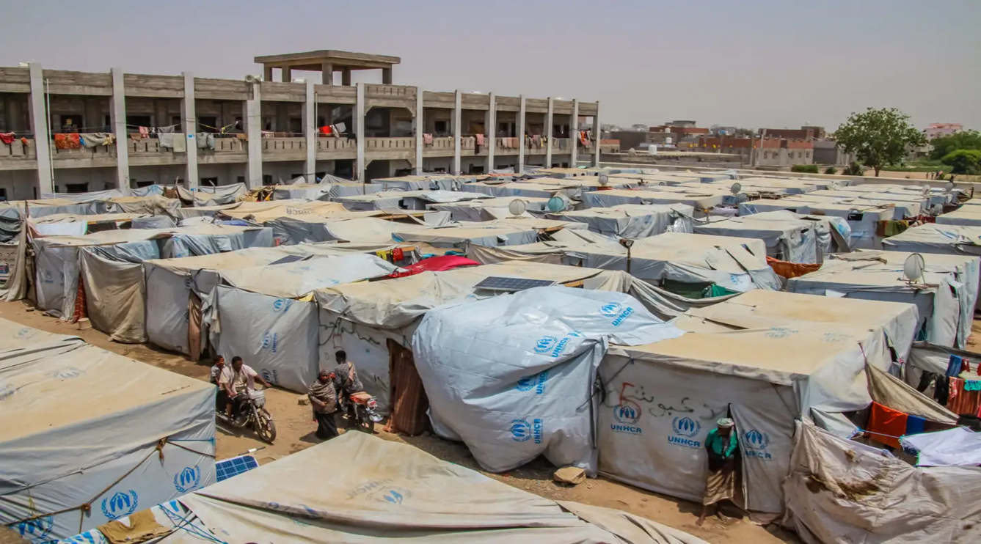
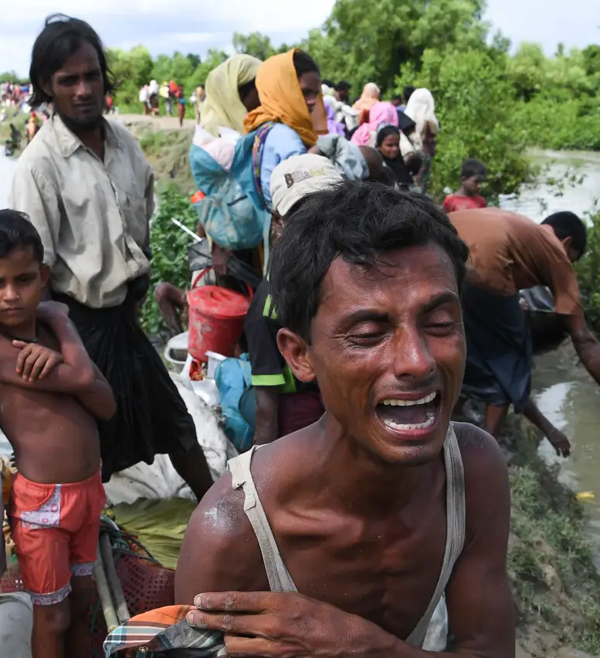
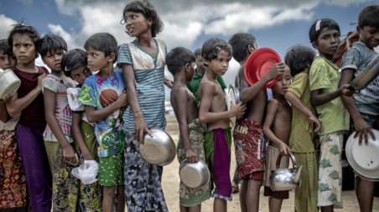
Notes:
Picture Source: UNHCR Official page, Daily Prothom Alo Newspaper, Dhaka Tribune online portal, The Business Standard

Slide 6
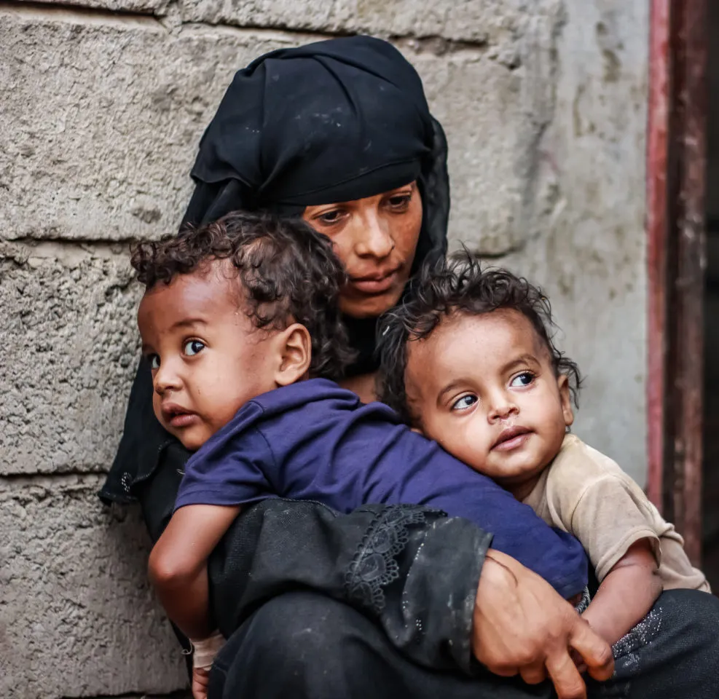
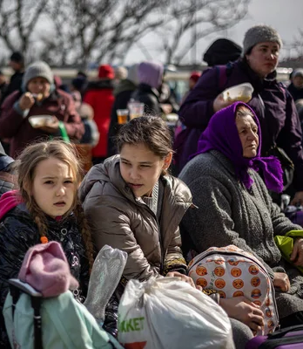
Notes:
Picture Source: Yahoo Image, Depositphotos (Stock Editorial Photo)

Slide 7
Any sort of emergencies can cause significant stress and have a negative impact on the mental health of individuals, families and societies as a whole.
Most people affected by emergencies may experience distress, e.g. feelings of anxiety and sadness, hopelessness, difficulty sleeping, fatigue, irritability or anger and/or aches and pains

Slide 8
Prevalence of MH issues in crisis situation
WHO’s review of 129 studies in 39 countries showed that among people who have experienced war or other conflict in the previous 10 years, one in five people (22%) will have depression, anxiety, post-traumatic stress disorder, bipolar disorder or schizophrenia
According to WHO’s review, the estimated prevalence of mental disorders among conflict- affected populations at any specific point in time (point prevalence) is 13% for mild forms of depression, anxiety, and post-traumatic stress disorder and 4% for moderate forms of these disorders
The estimated point prevalence for severe disorders (i.e. schizophrenia, bipolar disorder, severe depression, severe anxiety, and severe post-traumatic stress disorder) is 5%. It is estimated that one in 11 people (9%) living in a setting that has been exposed to conflict in the previous 10 years will have a moderate or severe mental disorder
From these findindings we can easily relate to the fact that how crucial it is to drive our attention to the afflicted people’s mental health along with other support
Notes:
Research Source: https://www.who.int/news-room/fact-sheets/detail/mental-health-in-emergencies#:~:text=The%20burden%20of%20mental%20disorders,post%2Dtraumatic%20stress%20disorder%2C%20bipolar

Slide 9
Mental Health & it’s importance
The World Health Organization (WHO) conceptualizes mental health as a “state of well-being in which the individual realizes his or her own abilities, can cope with the normal stresses of life, can work productively and fruitfully, and is able to make a contribution to his or her community” (WHO, 2021).
Mental health is important because-
It encompasses our psychological, emotional and social well-being
It impacts how we feel, think and behave each day
It also contributes to our decision making process, coping ability and how we relate to others in our lives

Slide 10
Think & Relate…
As we know, any form of humanitarian emergencies increase the risk of developing mental health conditions, we need to-
Respond to the psychosocial needs of the community
Attend the afflicted people
Stabilize them (try to make them calm & emotionally oriented)
Provide safe space to vent out regarding their traumatic experiences

Slide 11
Understanding Mental Health Condition of Humanitarian context

Slide 12
Imagine a sudden crisis where you must swiftly leave your home & you do not know when you will return or even ever will you be able to return back . You need to take 3 to 4 very essential things with you & the rest you need to leave behind. Think & write ….
Let’s
think….
What are the 3 to 4 things that you will take with you
How are you feeling in such situation
Think about the left things behind & observe your feelings & write down in a notebook. You may give a picture of the feeling & color that if you wish

Slide 13
Identifying Emotions in Humanitarian Ccenarios (Child, Adolescents and Adult (parents, families & caregivers)
A traumatic experience is any event in life that causes a threat to our safety and potentially places our own life or the lives of others at risk. As a result, a person experiences high levels of emotional, psychological, and physical distress that temporarily disrupts their ability to function normally in day to day life.
Recognizing and understanding the emotions of children, adolescents & adults during crisis is essential for effective humanitarian aid and support.
(more information in google dochttps://docs.google.com/document/d/1SmBpJyB3zIs0D6xf1jxu3jKzkmPhQ26pdrHKwJ8NPn4/edit)

Slide 14
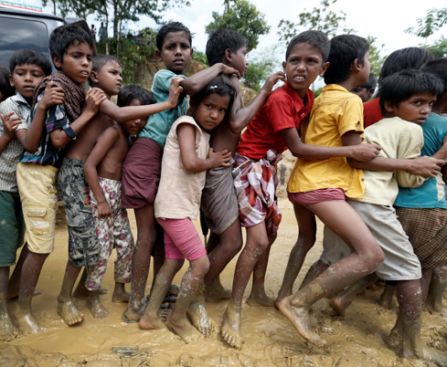
Children who have experienced complex trauma often have difficulty identifying, expressing, and managing emotions, and may have limited language for feeling states. They often internalize and/or externalize stress reactions and as a result may experience significant depression, anxiety, or anger. (more information in google doc)
https://docs.google.com/document/d/1SmBpJyB3zIs0D6xf1jxu3jKzkmPhQ26pdrHKwJ8NPn4/edit

Slide 15
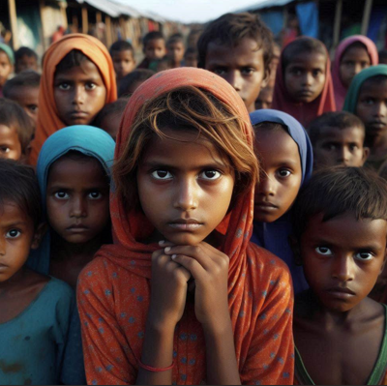
Emotion of Adolescents

Slide 16
Teenagers and adolescents who experience a distressing or frightening event are often concerned by these strong emotions. Some common symptoms of distress include sadness,anger,anxiety and guilt.
(more information in google doc) https://docs.google.com/document/d/1SmBpJyB3zIs0D6xf1jxu3jKzkmPhQ26pdrHKwJ8NPn4/edit
Sadness
Anger
Anxiety
Guilt
Overwhelmed due to the traumatic experience
Trauma can trigger intense anger
especially if they perceive injustice or loss
Adolescents may experience heightened anxiety,
Worrying about their safety or futures
Feelings of guilt may arise even if they were not directly responsible for trauma

Slide 17
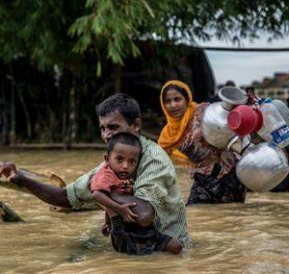
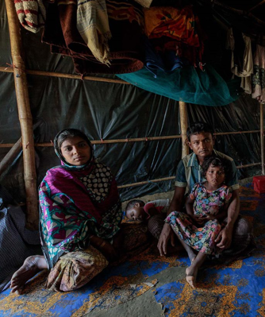
Emotion of Adults (Mother-Father, caregiver)
In humanitarian situations, parents face immense emotional challenges like-stress,anxiety,conflict,anger,depression and so on. Acknowledging parents’ emotional experiences and providing support is crucial for holistic
(more information in google doc) https://docs.google.com/document/d/1SmBpJyB3zIs0D6xf1jxu3jKzkmPhQ26pdrHKwJ8NPn4/edit

Slide 18
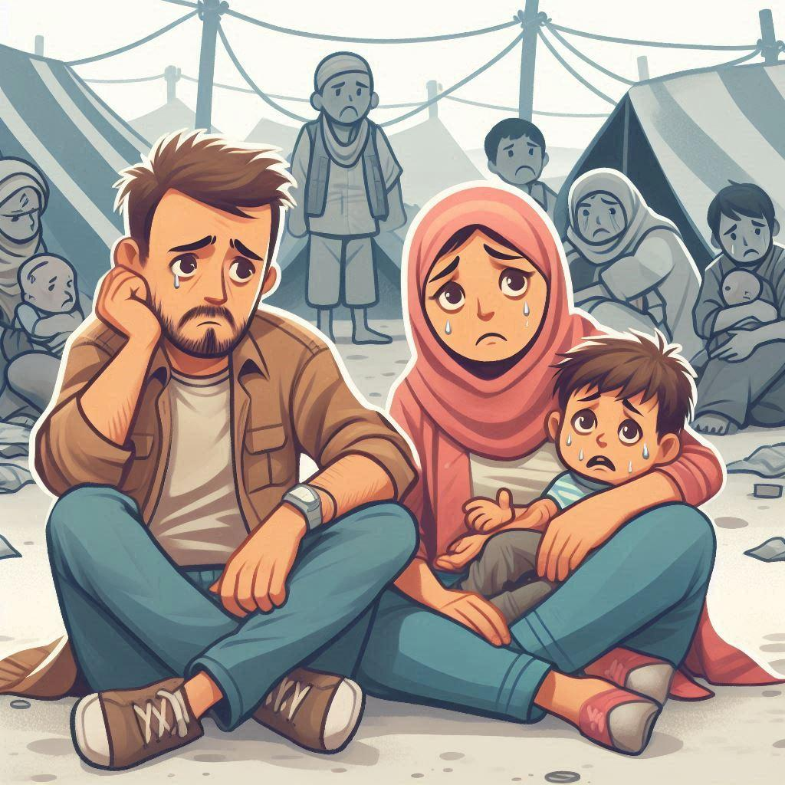
Let’s reflect on people’s emotion in a trauma prone situation
• Women
• children
• Elderly people
• Men

Slide 19
Trauma focused support

Slide 21
How can you design to provide a trauma focused support in your community following the steps?
(Think & write)

Slide 23
Think…
What comes to your mind when you hear…
‘’Psychological First Aid”

Slide 24
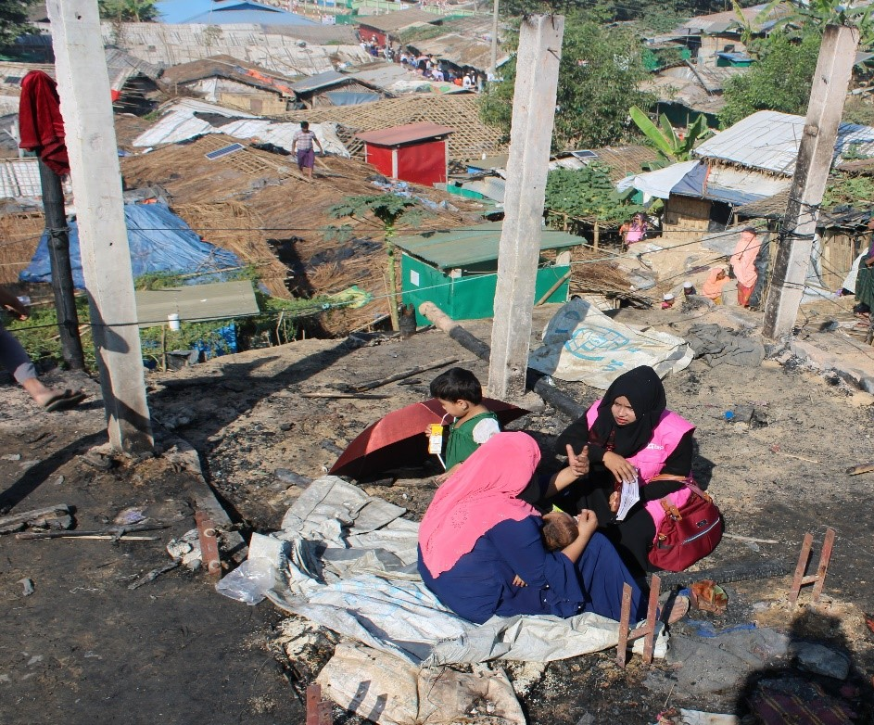
Psychological First Aid
Psychological First Aid or PFA is the instant mental, cooperative, and realistic aid one receives from the people around after a very disastrous or pressurising situation which helps the person cope with the situation and return to a normal state
For example: Right after a disastrous situation occurs, the support that others provide to the sufferer by talking, and without any other resources is PFA.
Notes:
Picture Source: BRAC official Page
Resource Source: https://iris.who.int/bitstream/handle/10665/102380/9789241548618_eng.pdf?sequence=1

Slide 25
Key Purposes of PFA
Helping in realistic ways instead of unwarranted interference
Determining the needs, wants and concerns of the affected
Helping people fulfil their basic needs (food, water etc.)
Listening to the affected but not pressuring them to talk
Offering relief to people and helping them calm down
Saving the person from future damage
Giving the correct information to people and helping them connect to various humanitarian service and social support systems
Notes:
Resource Source: https://iris.who.int/bitstream/handle/10665/102380/9789241548618_eng.pdf?sequence=1

Slide 26
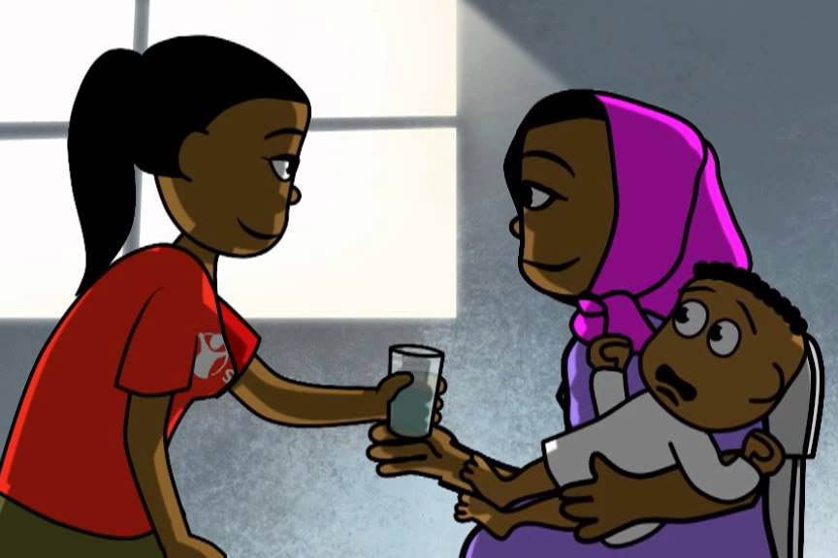
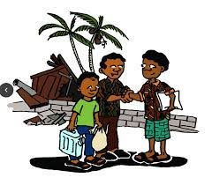
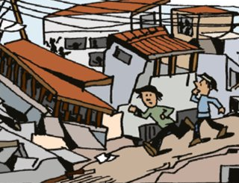
PFA for Whom & When
Can be provided to both adults and children
At the first meeting with the crisis affected people
Usually right after the disaster or crisis
After a few days or few weeks
Crisis affected person who has recently been through a traumatic or disastrous experience
Notes:
Resource and Picture Source: https://iris.who.int/bitstream/handle/10665/102380/9789241548618_eng.pdf?sequence=1

Slide 27
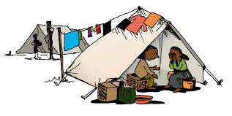
PFA: Where?
Community settings like the place of the disaster or places where people are provided service like health centres, shelter homes, camps, schools or relief centres that provide other aids.
Notes:
Resource and Picture Source: https://iris.who.int/bitstream/handle/10665/102380/9789241548618_eng.pdf?sequence=1

Slide 28
PEOPLE WHO ARE LIkELY TO NEED SPECIAL
ATTENTION IN A CRISIS
People with health conditions or physical and mental disabilities
Children – including adolescents –
People at risk of discrimination or violence, such as women or people of certain ethnic groups,
Notes:
Resource and Picture Source: https://iris.who.int/bitstream/handle/10665/102380/9789241548618_eng.pdf?sequence=1

Slide 29
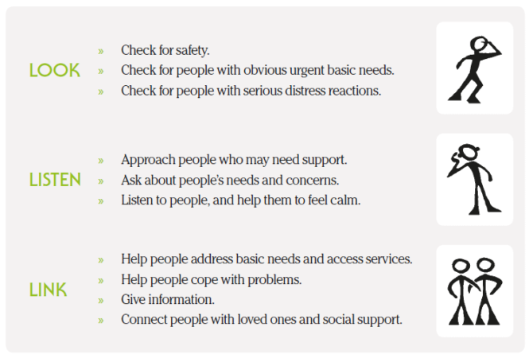
PFA Implication: Look-Listen- Link
Notes:
Resource Source: https://iris.who.int/bitstream/handle/10665/102380/9789241548618_eng.pdf?sequence=1

Slide 30
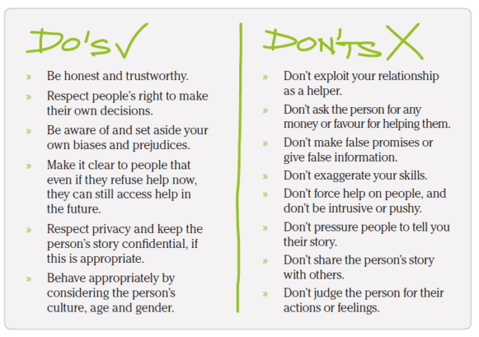
Notes:
Resource Source: https://iris.who.int/bitstream/handle/10665/102380/9789241548618_eng.pdf?sequence=1

Slide 31
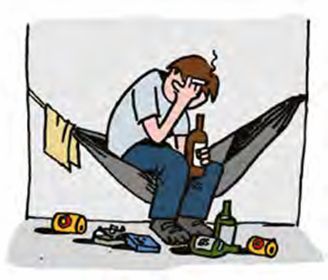
Care for the PFA Provider
Getting Ready to Help
Managing Stress: Healthy works and Life Habits
Rest and Reflection
Notes:
Resource and Picture Source: https://iris.who.int/bitstream/handle/10665/102380/9789241548618_eng.pdf?sequence=1

Slide 32
Shahida (pseudonym) is a resident of Cox's Bazar Rohingya Camp since the Rohingya influx. She lives with her family. She has three little children. A sudden fire broke out in the camp where she lived. The fire destroyed her living space and essentials. After that fire incident, she is now in a temporary shelter centre. But there also inadequacy of food, clothes and other essential things. She cannot provide enough food and comfort to her three little children. Her husband is also trying by various means to manage this situation. Currently she is in distress with her family. Struggling to meet even basic needs. She is now at a great loss, not knowing what to do. She is having flashbacks of that incident. Can't forget the terrible incident of fire, even the small parts of that incident is popping in her mind.
Case Scenario
How can PFA be provided to Shahida in such a situation?
What challenges can one face when attempting to provide PFA support to Shahida in such situations?
Notes:
Case Source: BRAC MHPSS Work

Slide 33
Let’s reflect on case scenario…
Prepare: How will you prepare yourself for providing PFA?
Look
What will you LOOK for in this crisis setting?
Listen
What is important to consider when you approach to LISTEN Shahida?
Link
How will you LINK in this situation- what she needs in this situation & what resources can you draw upon?

Slide 34
Self Assessment…
Mental health support in humanitarian crises is-
A
Complementary
B
Essential

