Slide 1



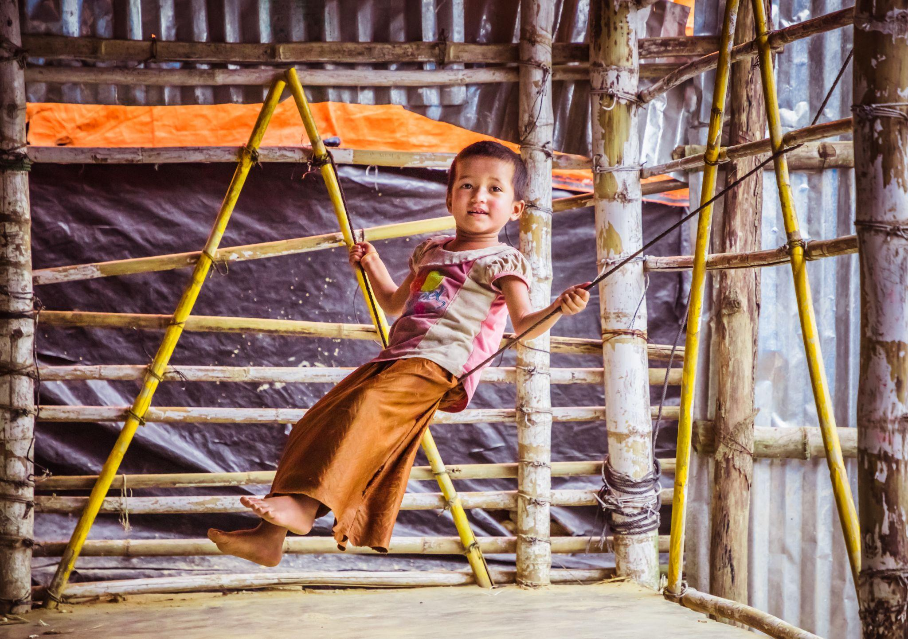
Day
7
Play-Based ECD Models across
Humanitarian Settings
Notes:
Photo Source: BRAC IED photo achieves

Slide 2
Learning Outcome
Explain about different global models for ECD and caregivers currently established across the world
Analyze the methods, steps and activities that different play-based ECD models incorporate when working for children from afflicted communities
Identify steps in which different programs work with and for children across diverse geo-political landscapes

Slide 3
Time Allocation
Have extensive understanding and gather knowledge concerning the different models for ECD and caregivers currently being implemented around around the globe-
Save the Children HEART Model
- 20 minutes
BRAC Humanitarian Play Lab
- 20 minutes
Fathers Engagement Model
- 15 minutes
UNICEF CCD Model
- 20 minutes
Pashe Achhi Model
- 15 minutes

Slide 4

ECD Models in Humanitarian Settings
Early Childhood Development (ECD) is critical for the healthy growth and development of children, especially in humanitarian settings where children are extremely vulnerable and at risk. Implementing play-based ECD models in these settings is crucial to long-term development.
In humanitarian settings, various global and national Early Childhood Development (ECD) models have been adapted to address the unique needs of children in crisis situations.

Slide 5
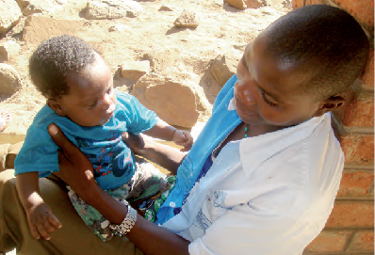
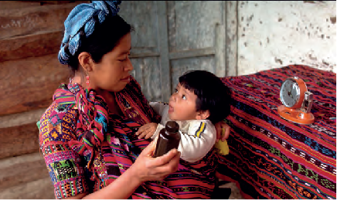
Care for Child Development Model (CCD)
The CCD model is developed by UNICEF, World Health Organization, based on the neuroscientific evidence that communicating through eye contact and playful interaction with children fosters strong bonding experiences between caregiver and child.
The model is currently implemented in 12 countries.
CCD promotes young children's motor, cognitive-language, and social-emotional skills through play and communication activities, integrating into health, nutrition, education, and child protection sectors.
This model includes the participant manual, counseling cards, facilitator notes, guide for clinical practice and framework for M&E.
Photo source:
WHO-342031.GAGGERO, C. (n.d.). Image from Care for Child Development. UNICEF. https://www.unicef.org/media/97376/file/1-2-CCD-Introduction-English.pdf
Lucas, J. (n.d). Image from Care for Child Development. UNICEF. https://www.unicef.org/media/97376/file/1-2-CCD-Introduction-English.pdf

Slide 6
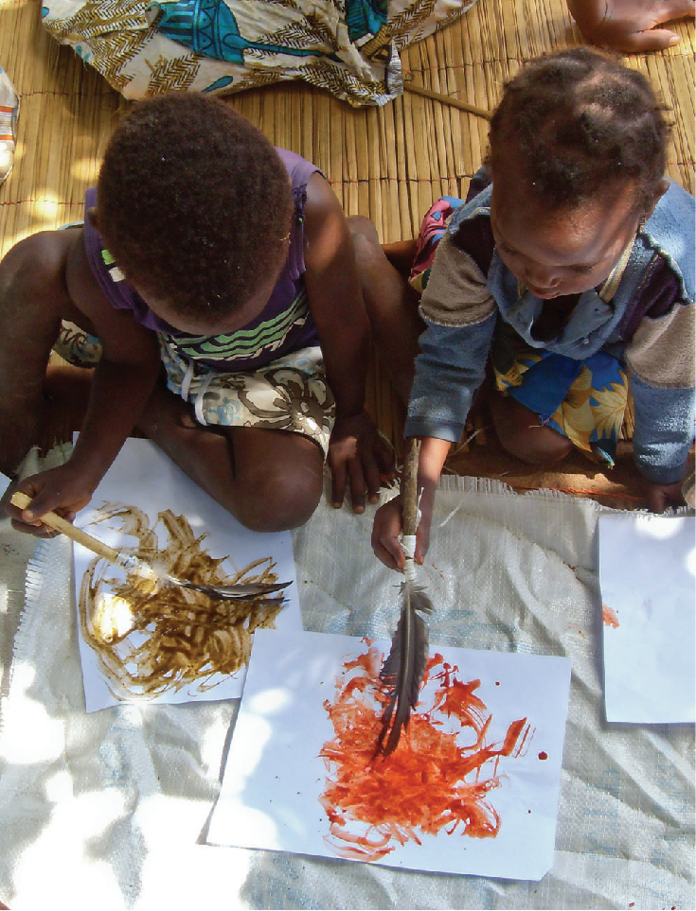
HEART: Healing and Education through the Arts
HEART, Save the Children’s visionary education program, brings the proven power of artistic expression to children in need aged 3-14 years old.
The model helps children cope with traumatic events and learn critical skills they need to reach their true potential in different emergency response programming.
This program includes-
guiding children in expressive arts activities
engaging the arts as a means for self-expression and critical skill development
recognizing and supporting children who need special help
involving children’s parents and communities in the process
incorporating local arts traditions and using local arts resources
Photo source:
Nelson Cossa, N. (n.d). Image from HEART: Healing and Education through the Arts Save the Children, Mozambique
https://image.savethechildren.org/heart:-healing-and-education-through-the-arts-ch11043673.pdf/x47120x0esut4kcpyw44yofrtn247588.pdf

Slide 7
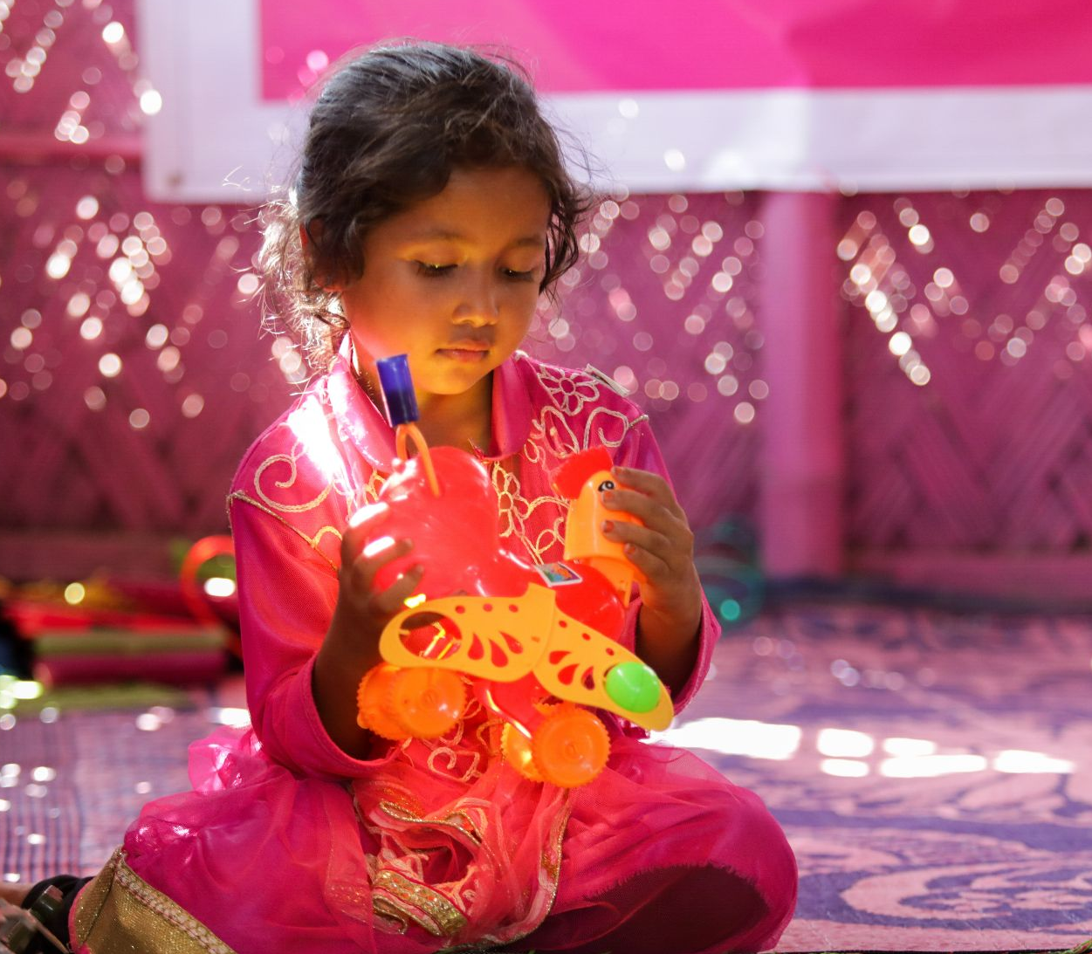

BRAC Humanitarian Play Lab (HPL)
Photo source:
BRAC IED photo achieves

Slide 8
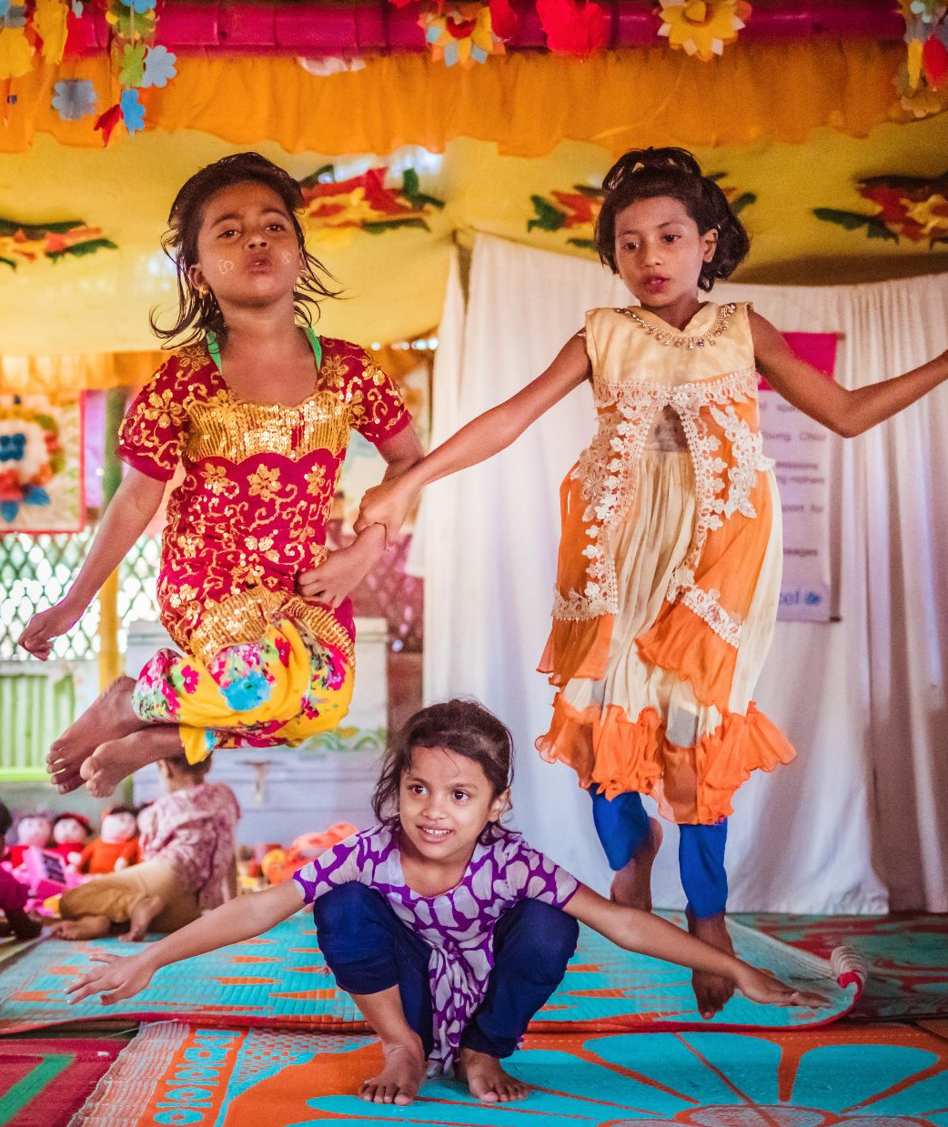
BRAC Humanitarian Play Lab (HPL) Centre-Based Model
Humanitarian Play Lab (HPL) is an interdisciplinary model for children aged 3-5 years old. The model addresses the wellbeing needs of parents & Communities as well, integrating play based ECD, psycho-social support, cultural preservation, community empowerment and resilience to develop a well-rounded model
This HPL model emerged and modified Child-Friendly Space (CFS) by incorporating Rohingya cultural elements such as Kabbya (poems), Kissa (story), play activities and art and craft, etc., so that the Rohingya culture and traditions can be preserved used effectively to foster resilience, retain cultural identity and create a sense of belonging among the children.
Let’s Watch together!
https://www.youtube.com/watch?v=ZoF4LHisXMI
https://youtu.be/MF7KJykOgxw
Photo source: BRAC IED photo achieves

Slide 9
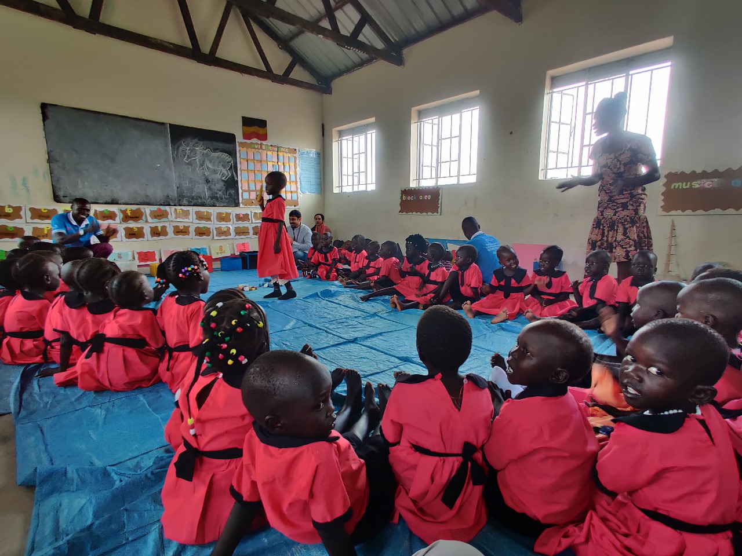
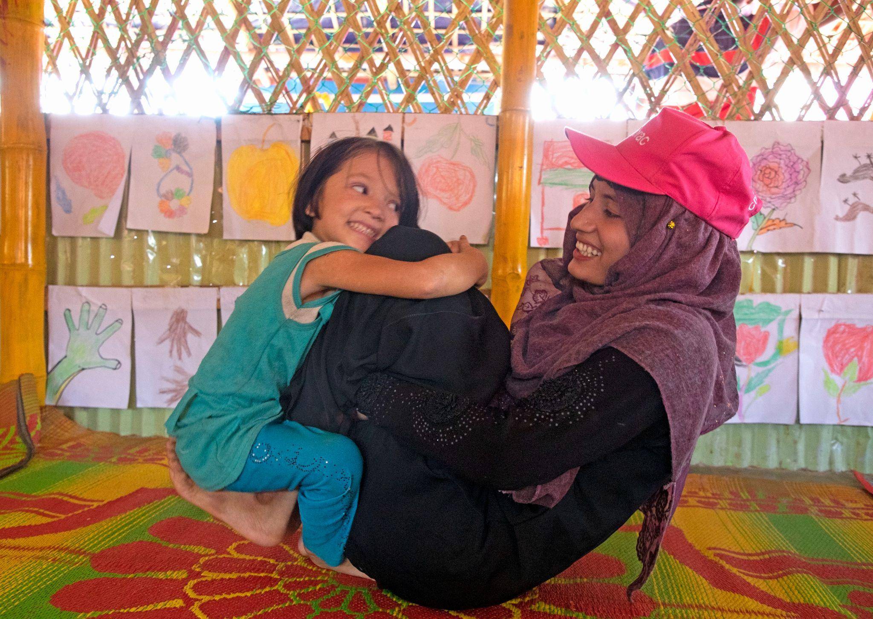
BRAC Humanitarian Play Lab (HPL) Characteristics
Highly iterative, involving extensive community consultations, focus group discussions, and formative research to ensure relevancy and contextuality.
Continuous refinement of the program content, ensuring it met the specific needs of the refugee community.
This model has been replicated in Uganda humanitarian setting because of it’s huge positive impact.
Let’s learn more:
https://sesameworkshop.org/play-to-learn-program/humanitarian-play-lab/
Photo source: BRAC IED photo achieves

Slide 10
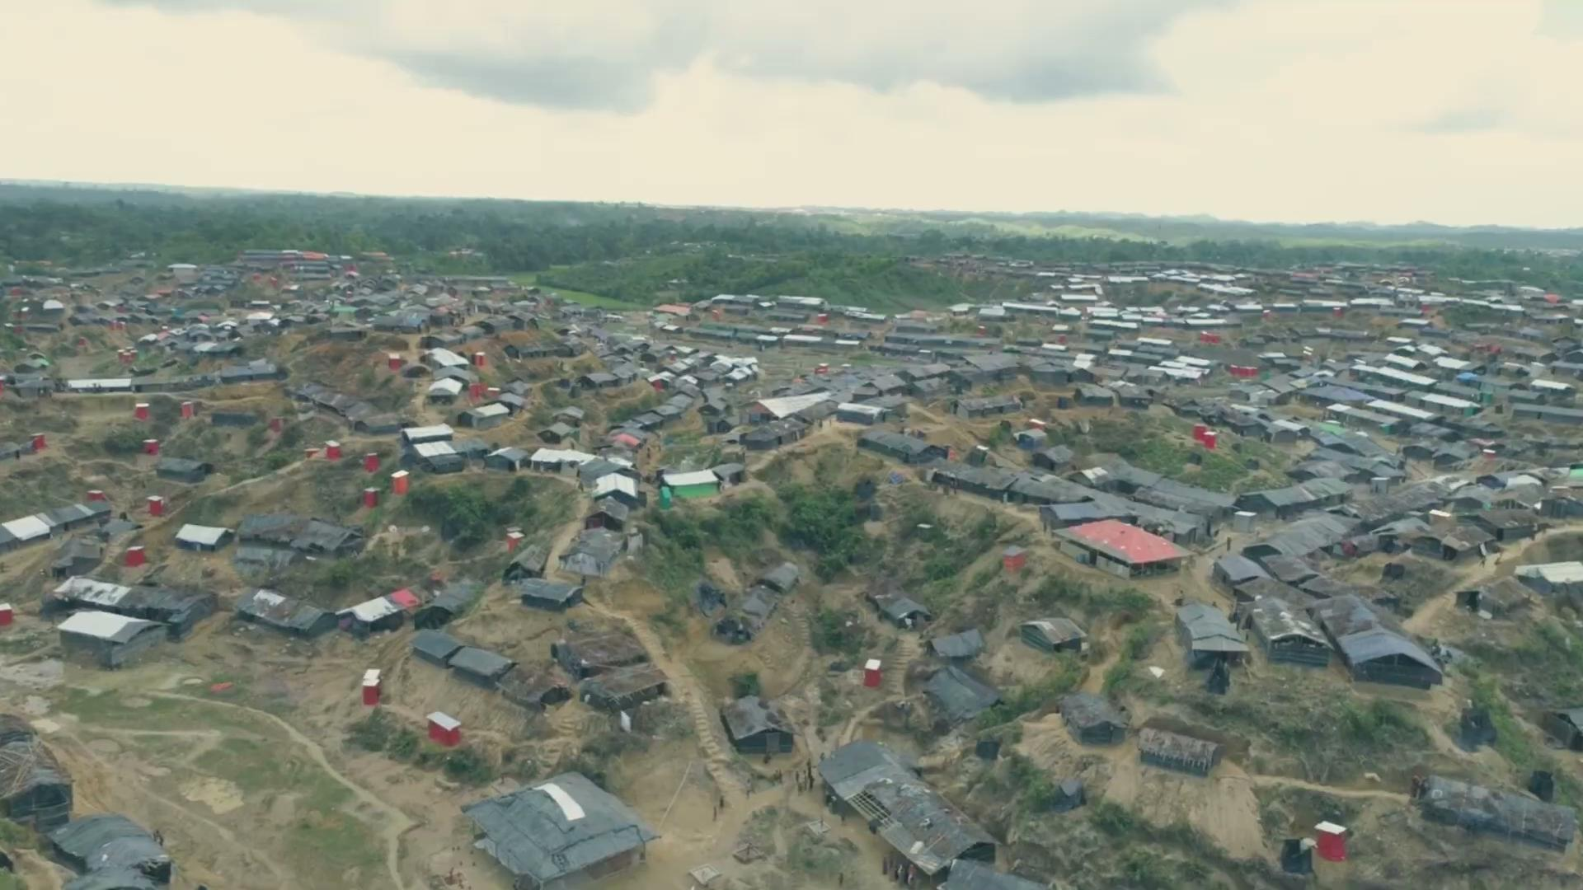
Let’s hear more about BRAC Humanitarian Play Lab model from an expert

Slide 11
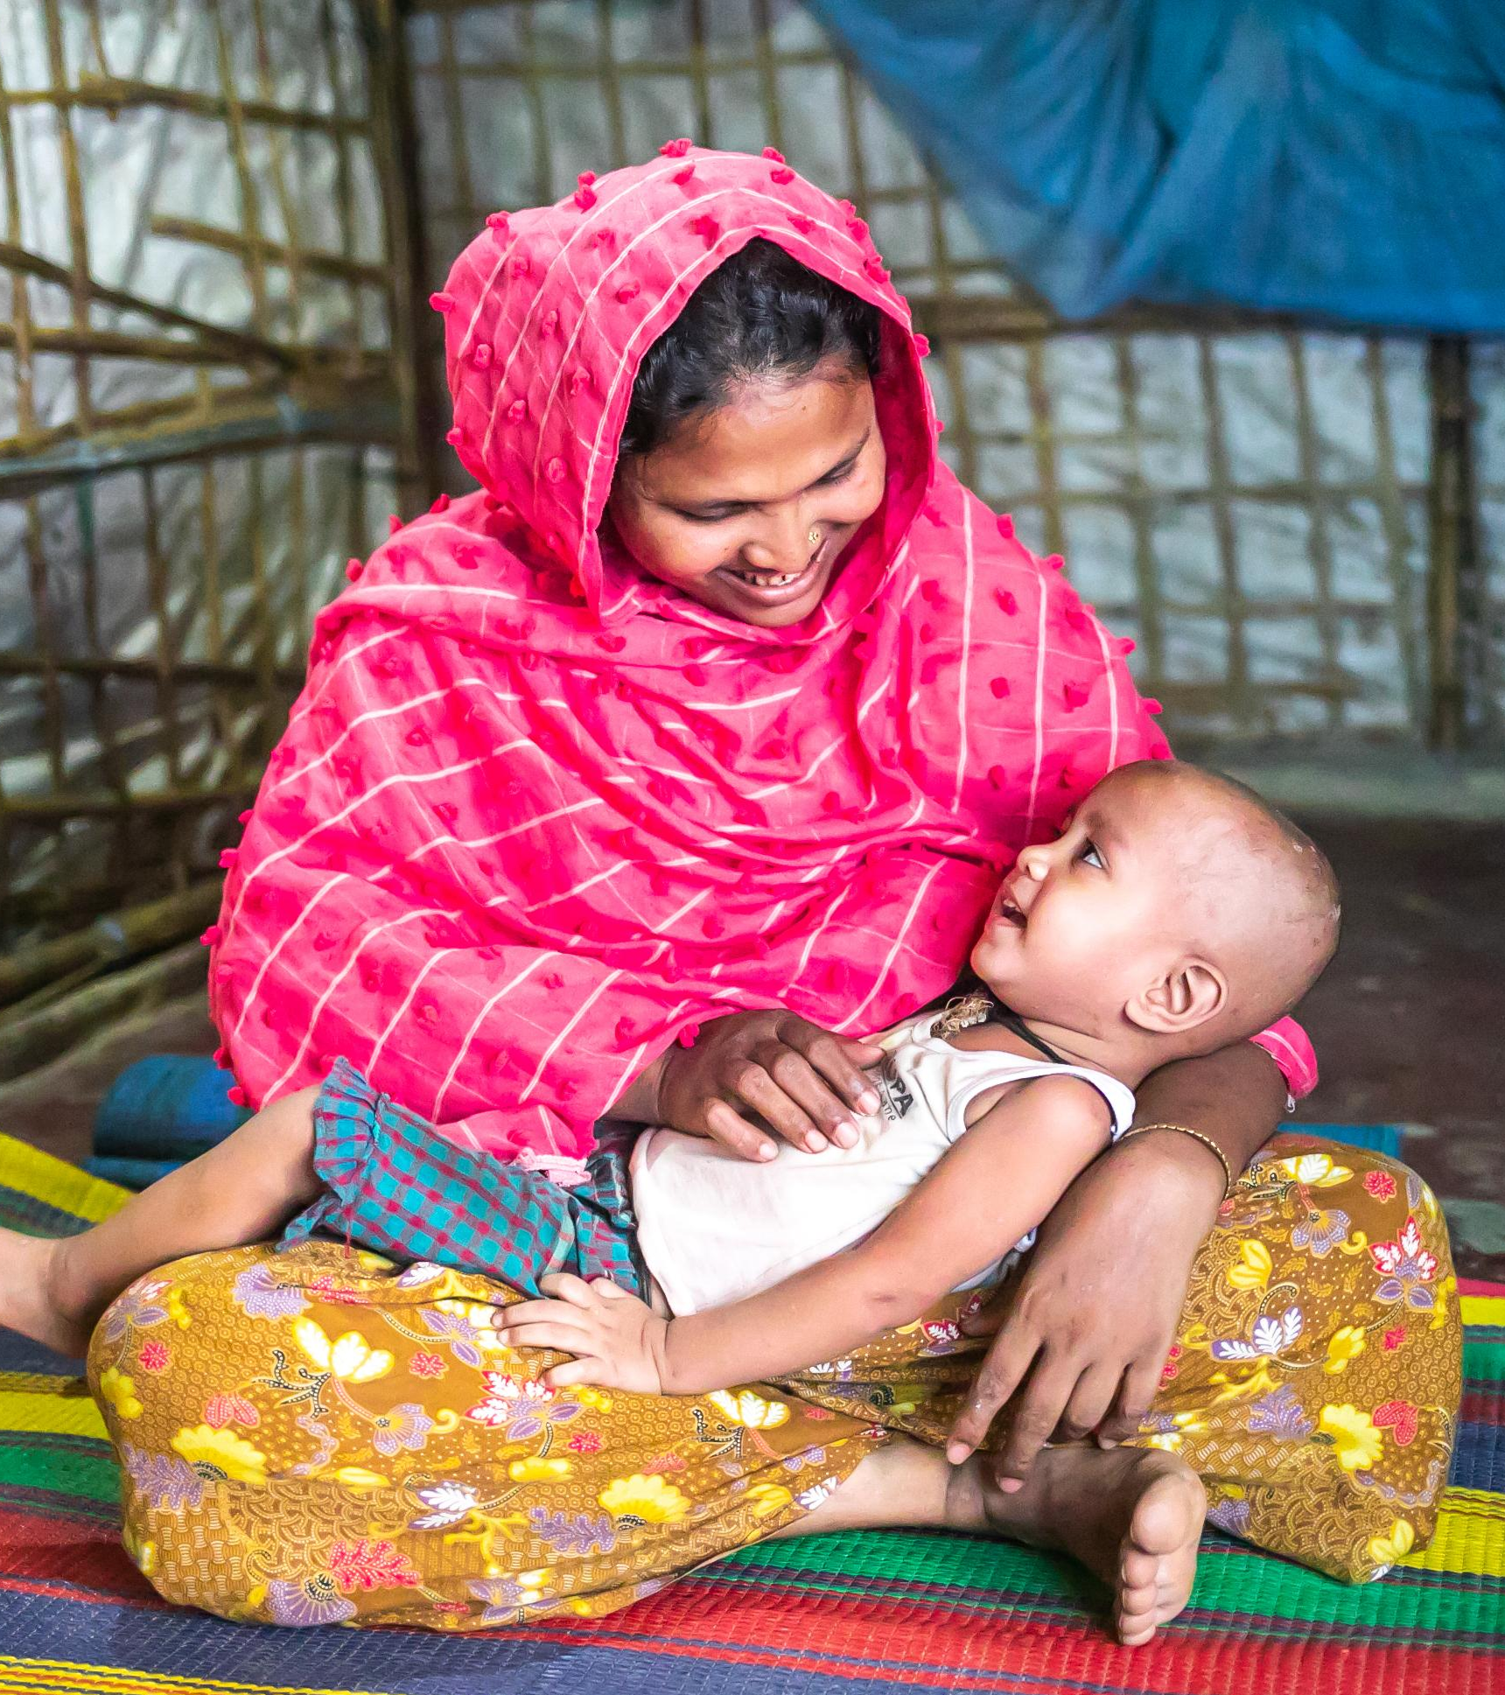
BRAC HPL Model: 0-3y Mother-Child Dyad (Home-based) Characteristics of the Model
A group session model that focuses on ensuring child and mother’s well-being and by extension their families
The model is a community based program which is facilitated my Rohingya Mother Volunteers supported by Paracounsellors
The model helps to raise awareness and enrich mothers’ understanding of healthy child development
It promotes the application of appropriate child rearing cultural practices which support healthy child development
Play is an integral part of this model. The model facilitates mothers’ understanding of the importance of play in child development
The model creates an enabling environment for the mothers and encourages experiential learning
Photo source: BRAC IED photo achieves

Slide 12
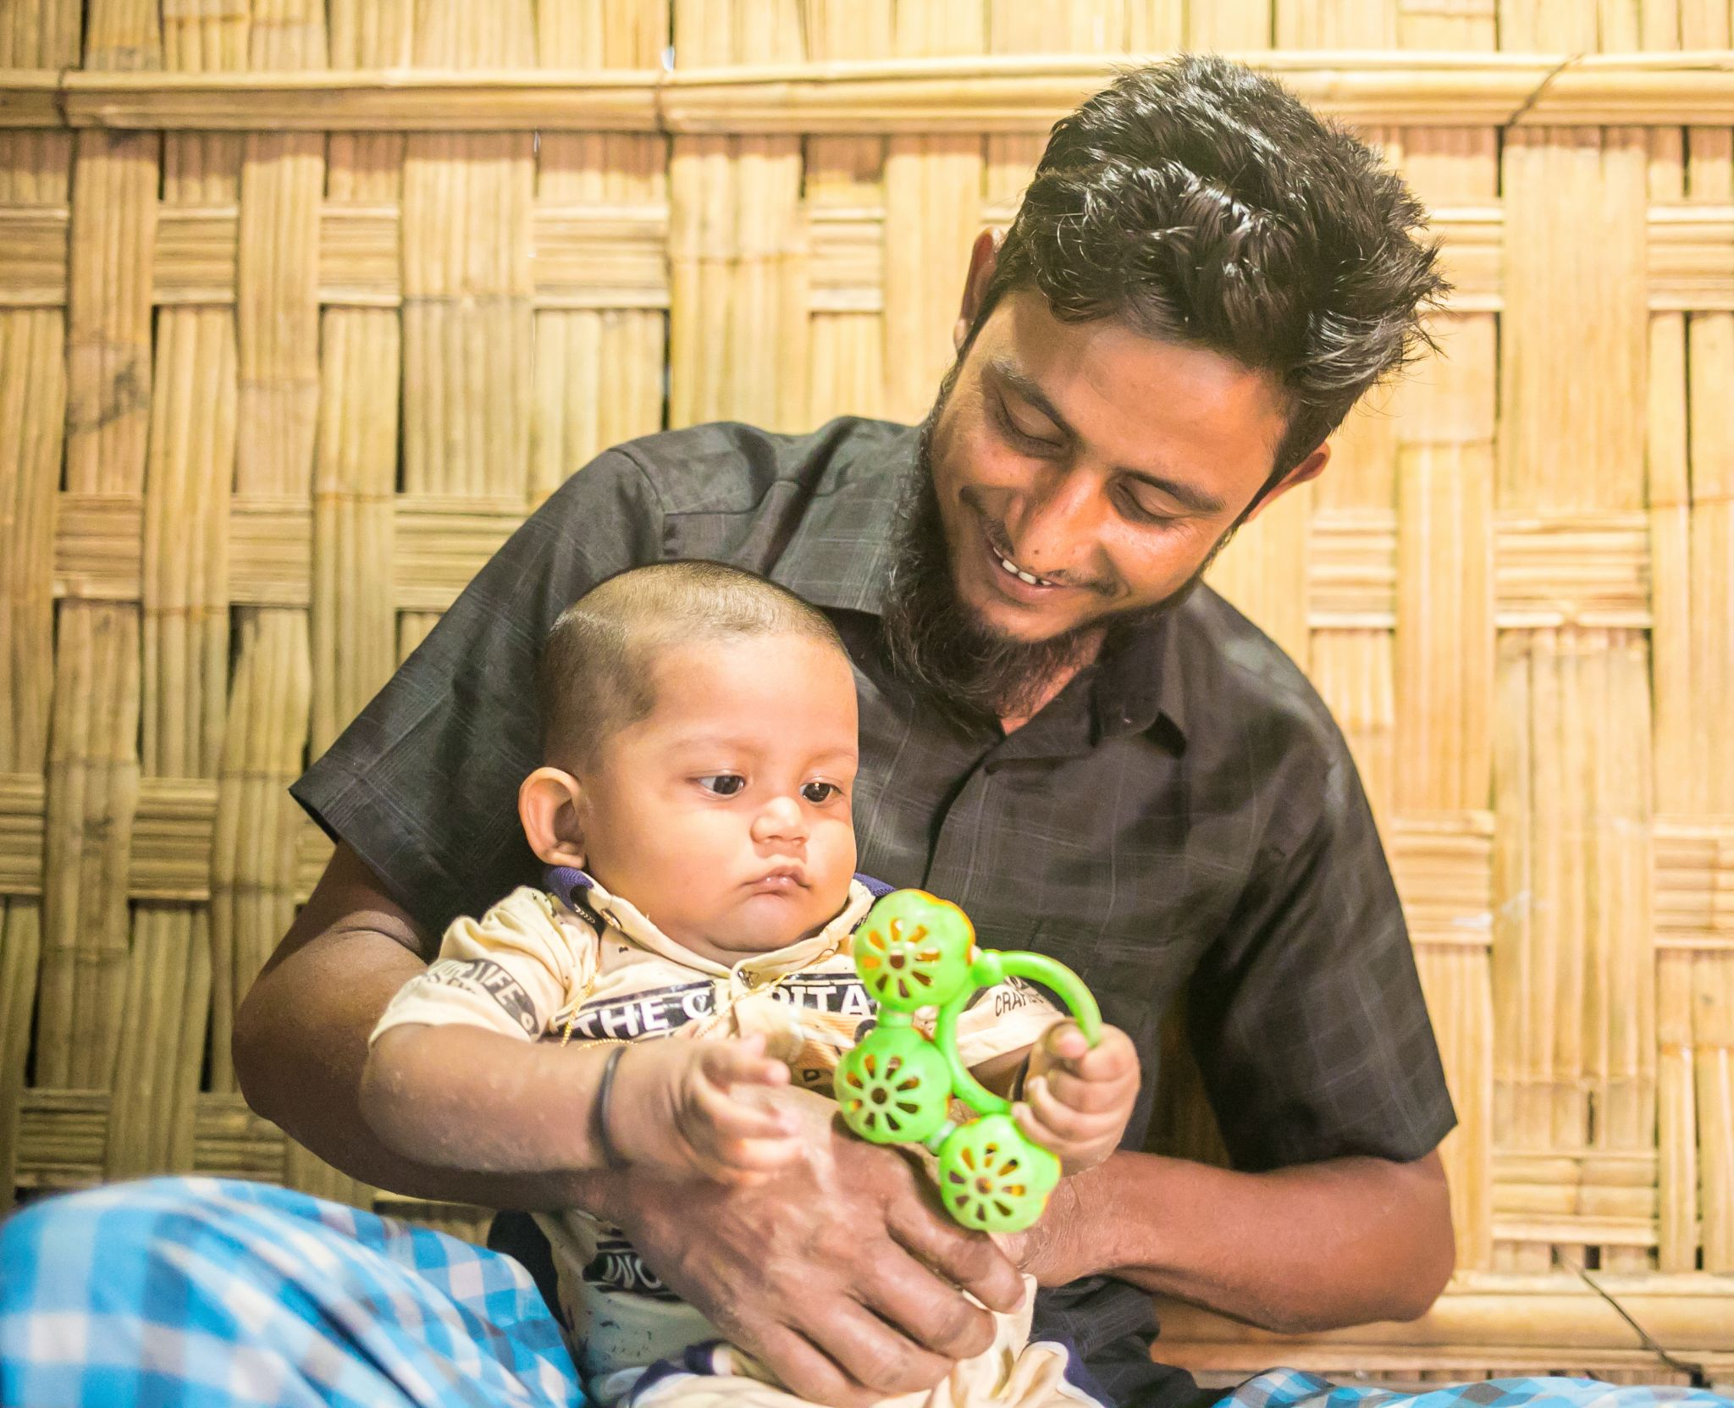
Characteristics of the Fathers’ Engagement Model
A study examining Rohingya men's emotional regulation, self-care routines, and mental health revealed that fathers prioritize family unity and meaningful time with their children
Promoting fathers’ wellbeing by improving emotional literacy and encourage to develop healthy relationship among the family member and practicing responsive caregiving to promote nurturing the child and positive parenting are the core of this model
The Fathers’ Engagement Model is co-created with the community, an extension of the HPL model for the duration of six months
Culturally contextualized interventions were designed to address the specific needs of the Rohingya and host community fathers
Global TIES for Children at New York University conducted the impact evaluation of this model that found positive effects on several family dynamics such as improving relationship with spouse and positive parenting practices and reduction in fathers’ depression
and anxiety symptoms
Photo source: BRAC IED photo achieves
Notes:
Pictures of

Slide 13
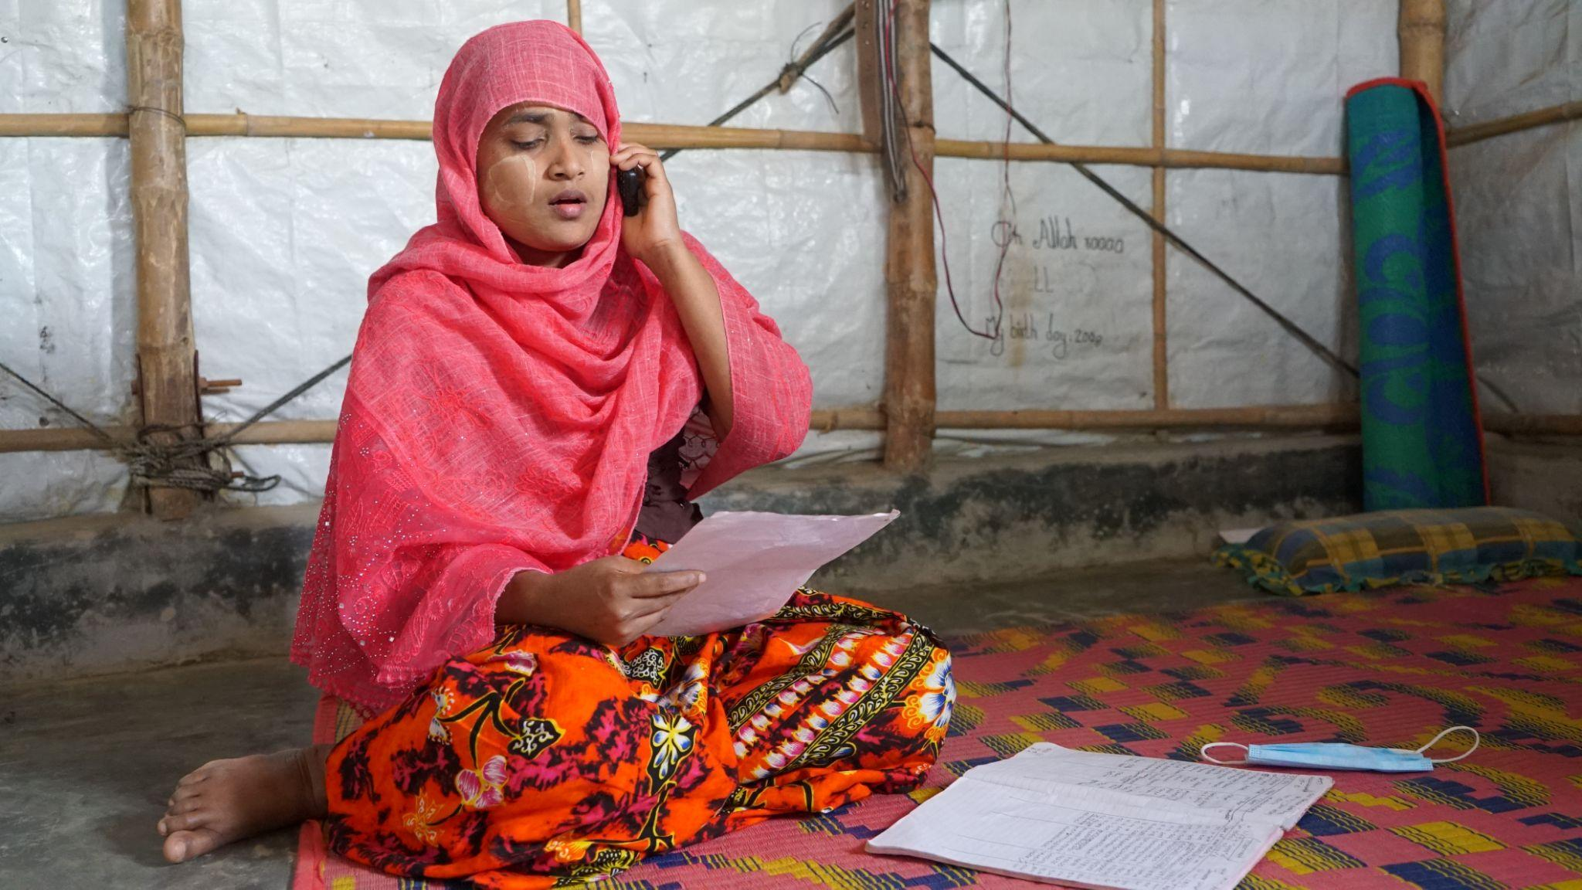
Pashe Achhi (Beside You) Telecommunication Model
BRAC IED launched 'Moner Jotno Mobile E' in April 2020, promoting mental wellbeing and encouraging the formation of the Pashe Achhi model in the Rohingya camp
It is telecommunication model with play-based and conversational-style approach, and was developed during COVID to deliver critical messages and make participants feel that they are connected.
This model developed through multiple iterations based on feedback from front liners and beneficiaries and rounds of piloting and implementing the learnings achieved from HPL.
Pashe Achhi showcased the cost-effectiveness of high-quality ECD interventions, demonstrating its scalability and adaptability, particularly in crisis situations, where there is no access to ECD intervention.
Let’s watch together:
Video link: https://youtu.be/RJO4wi2fid8
Photo source: BRAC IED photo achieves

Slide 14
References: Reading materials
Cabral De Mello, M., Ulkuer, N., & Engle, P. (n.d.). Care for Child Development. UNICEF. https://www.unicef.org/media/97376/file/1-2-CCD-Introduction-English.pdf
Mariam, E., Ahmad, J., & Sarwar, S. S. (2021). BRAC Humanitarian Play Lab Model: Promoting Healing, learning, and Development for Rohingya Children. Journal on Education in Emergencies, 7(1), 96. https://doi.org/10.33682/u72g-v5me
Mariam, E., Ahmad, J. (2023). Pashe Achhi: Supporting children and caregivers in Bangladesh during the COVID-19 pandemic. Young Children in Humanitarian and COVID-19 Crises. Routledge. https://www.taylorfrancis.com/chapters/oa-edit/10.4324/9781003415213-4/pashe-achhi-erum-mariam-jahanara-ahmad?context=ubx&refId=7a92f01b-e3a0-46b1-a8f6-6eb785294669
Save the Children (n.d.). HEART: Healing and Education through the Arts. https://www.savethechildren.org/content/dam/global/reports/education-and-child-protection/heart.pdf
TIES for Children, G. (2024). Effects of a Father Engagement Model in Rohingya Camps and Host Communities in Cox's Bazar, Bangladesh: A Randomized Controlled Trial (Version 2). figshare. https://doi.org/10.6084/m9.figshare.25995928.v2
UNICEF (2021, September 22). Growing and learning through play. https://www.unicef.org/lac/en/stories/growing-and-learning-through-play
UNICEF (2019). Participant manual: Care for Child Development. UNICEF LACRO. https://www.unicef.org/lac/media/8561/file/Participant%20Manual.pdf

Slide 15
References: Image
Lucas, J. (n.d). Image from Care for Child Development. UNICEF.
https://www.unicef.org/media/97376/file/1-2-CCD-Introduction-English.pdf
Nelson Cossa, N. (n.d). Image from HEART: Healing and Education through the Arts Save the Children, Mozambique
https://image.savethechildren.org/heart:-healing-and-education-through-the-arts-ch11043673.pdf/x47120x0esut4kcpyw44yofrtn247588.pdf
Pictures of BRAC IED photo achieves
WHO-342031.GAGGERO, C. (n.d.). Image from Care for Child Development. UNICEF. https://www.unicef.org/media/97376/file/1-2-CCD-Introduction-English.pdf

Slide 16

Thank You!

