Slide 1




Day
Discovering Cultural Practices of Displaced Communities
6

Slide 2
Learning Outcome
Identify what is culture, cultural practices and elements of culture
Distinguish between different cultural practices in Humanitarian contexts
Analyze and apply different methodologies for collecting cultural practices
Define the importance of incorporating cultural practices in co-designing programs and how to preserve best traditional play practices

Slide 3
Time Allocation
Identify what is culture, cultural practices and elements of culture
- 15 mins
Distinguish different cultural practices in Humanitarian context
- 30 mins
Analyze different methodologies for collecting cultural practices
- 20 mins
Define the importance of incorporating cultural practices in co-designing programs and how to preserve best traditional play practices
- 20 mins

Slide 4

What is Culture?

Slide 5
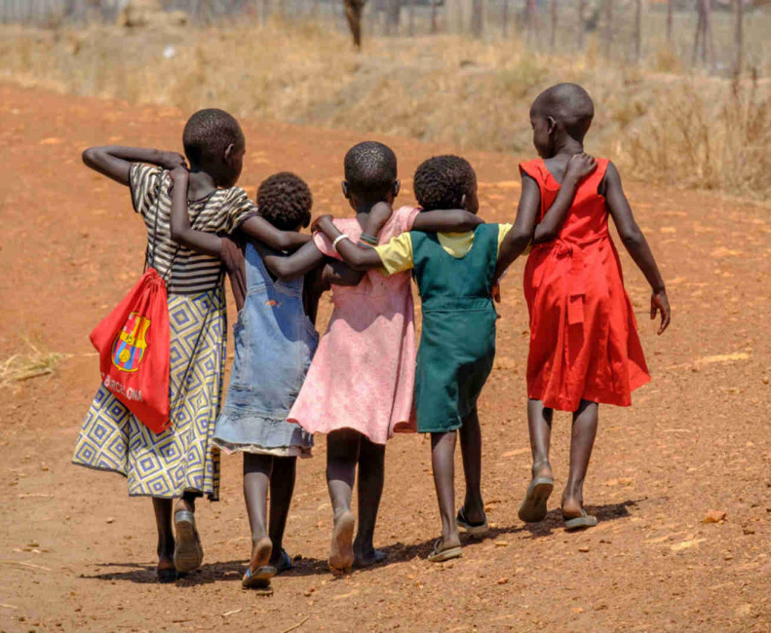
Culture refers to the collective patterns of behavior, beliefs, and customs shared by a group of people. It is the totality of socially transmitted behavior patterns, art, beliefs, institutions, and all other products of human works and thought (Duarte & Smith, 2000).
Photo source: Photo source: BRAC IED photo achieves
UNICEF/UN056966/Ose. (2017, October 2). Inclusion of refugee children in national child protection systems. UNICEF Eastern and Southern Africa. https://www.unicef.org/esa/reports/inclusion-refugee-children-national-child-protection-systems

Slide 6

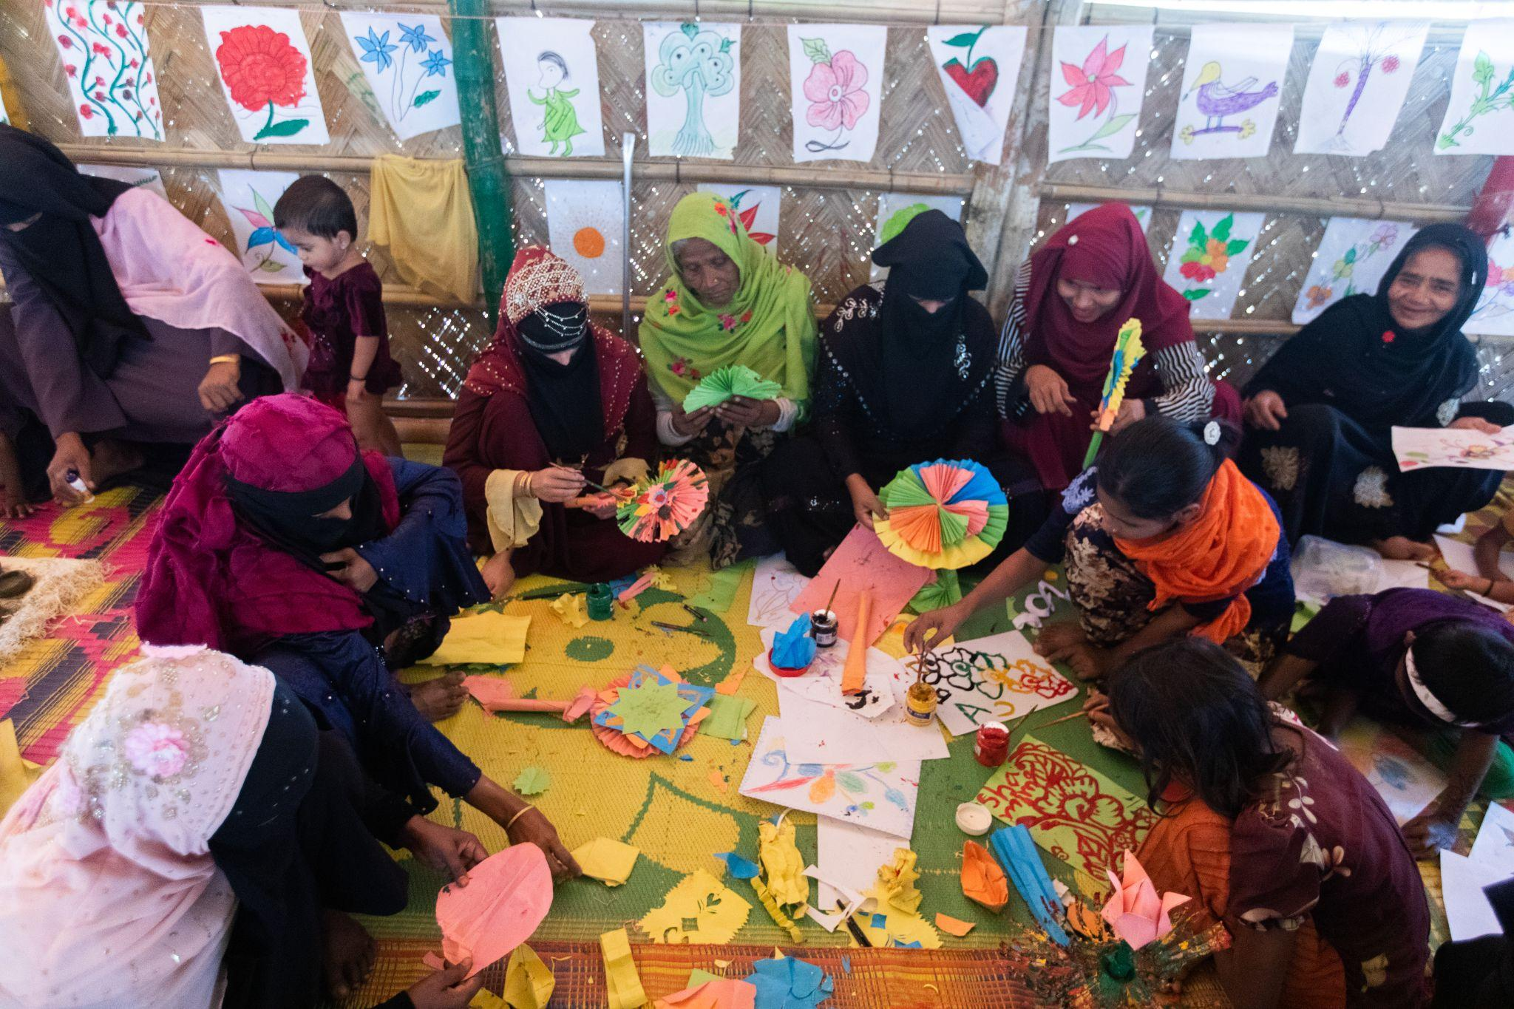

What are Cultural Practices?
Cultural practices include the behaviors, actions, and processes that define and shape the identity of a particular cultural group. These behaviors convey the particular values, beliefs, traditions, and customs of their culture.
It also encompasses the way people within a culture interact, communicate, celebrate, and conduct their daily lives. Cultural practices are shaped by a variety of factors, including history, religion, geography, social norms, and values.
Photo source: BRAC IED photo achieves

Slide 7
Elements of Culture
Language & Symbols
Norms,
Beliefs & Values
Costumes & Manners
Folkways
Material Culture Including Art, Play Activities etc.

Slide 8
Language and Symbol
Norms, Beliefs & Values
All cultures have a spoken language even if written language is not developed. Each language can have several different dialects.
Culture is system of symbols. Symbols are anything used to represent, express and stand for an event or situation.
Rules and expectations by which a society guides the behaviour of its members. These are the shared expectations of the people that govern their behavior.
Beliefs are expressed as agreements or disagreements with worldviews.
Values are society’s ideas about what is good or bad, right or wrong. Values are an important element of culture; social behavior is viewed as partly caused by dominant values and ideologies.

Slide 9
Customs and Manners
Folkways
Customs are common and established practices within a community.
Manners are behaviours that are regarded as appropriate in a particular society. These indicate the rules of behaviour which enforce ideas of right and wrong. These can be traditions, rituals, ceremonies, etc.
Folkways are the everyday habits and conventions in social interactions. This includes greetings, etiquette, food habit, etc.
Material culture including art,play activities etc.
Another element of culture is the artifacts, or material objects, that constitute a society’s material culture. These include elements such as attire, play activities, traditional decorations, cuisines, stories, rhymes, art, etc.

Slide 10

Which of these is not
an element of cultural practices?
Activity
(3 min)
Nature
2. Norms
3. Folkways
4. Customs

Slide 11

Every culture has a unique set of traditions, values, and social norms that shape how people perceive and respond to crises. Understanding and respecting cultural diversity helps to foster mutual respect and promote inclusivity.
Communities self-nominate cultural practices that they recognise as significant, is transmitted and recreated across generations, and provides a sense of identity. It is crucial to address cultural practices in humanitarian settings because their norms, beliefs, customs and other elements often differ significantly from the host community.
Let’s discover the unique cultural practices of three humanitarian contexts for instance, Syria, Uganda, Rohingya culture in Humanitarian settings. Each of these communities have unique historical, social, and cultural practices that influence how people navigate emergencies and respond to the crisis.
Cultural Practices in Humanitarian Contexts

Slide 12
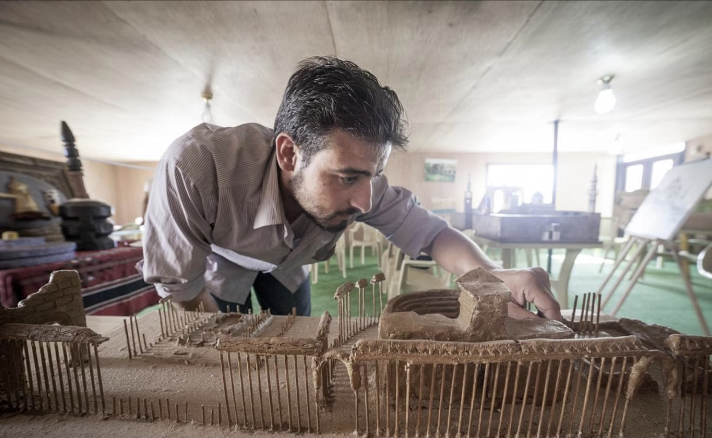
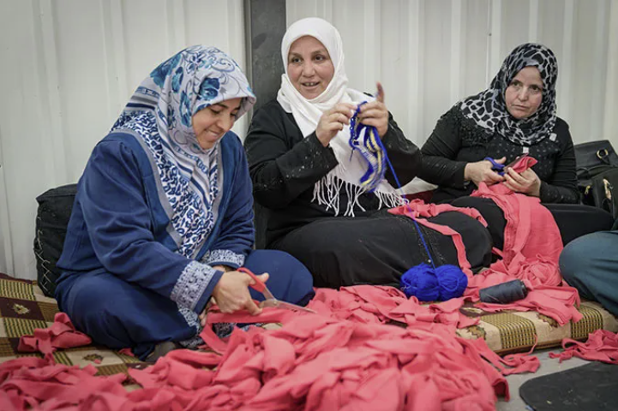
Cultural Practices of the Refugees from Syria
Syrians demonstrate a strong affection for children and uphold a patriarchal societal structure where the eldest man holds authority and provides protection, particularly for women. Family units are typically large and inclusive of extended relatives, emphasizing communal dining and modest dress codes in public. Traditional handicrafts such as pottery, weaving, and woodworking are integral parts of Syrian cultural heritage.
Photo source:
UN Women (2017, April 4). Weaving helps women Syrian refugees to find peace. HuffPost. https://www.huffpost.com/entry/women-syrian-refugees-weave-to-find-peace_b_58de80eee4b0ca889ba1a535
UNHCR/Christopher Herwig. (2016, January 8). Using clay and wooden kebab skewers, Syrian refugee Mahmoud Hariri built a model of the ancient city of Palmyra. Archinect. https://archinect.com/news/article/145267758/to-preserve-cultural-memory-these-syrian-refugees-recreate-lost-monuments-in-miniature

Slide 13
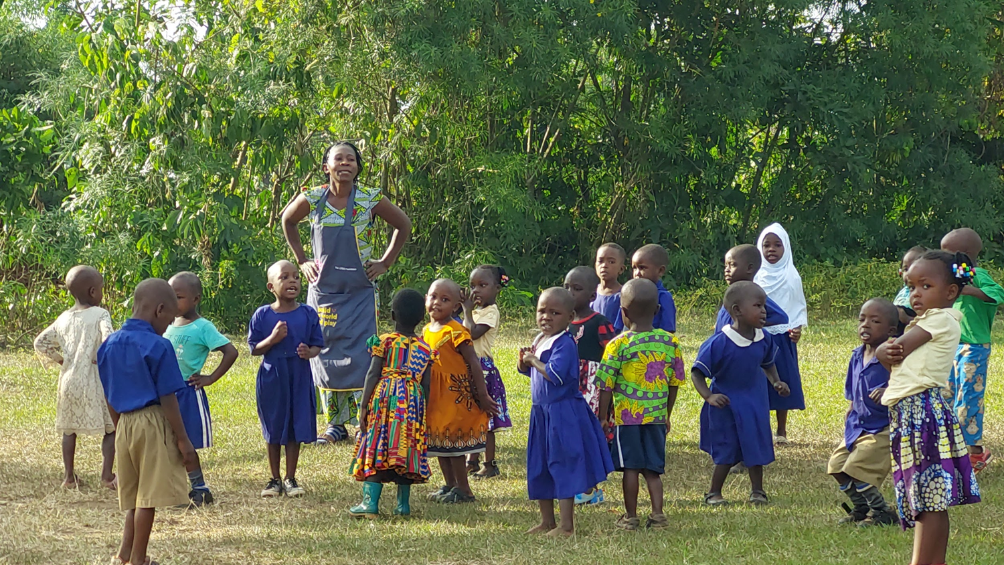
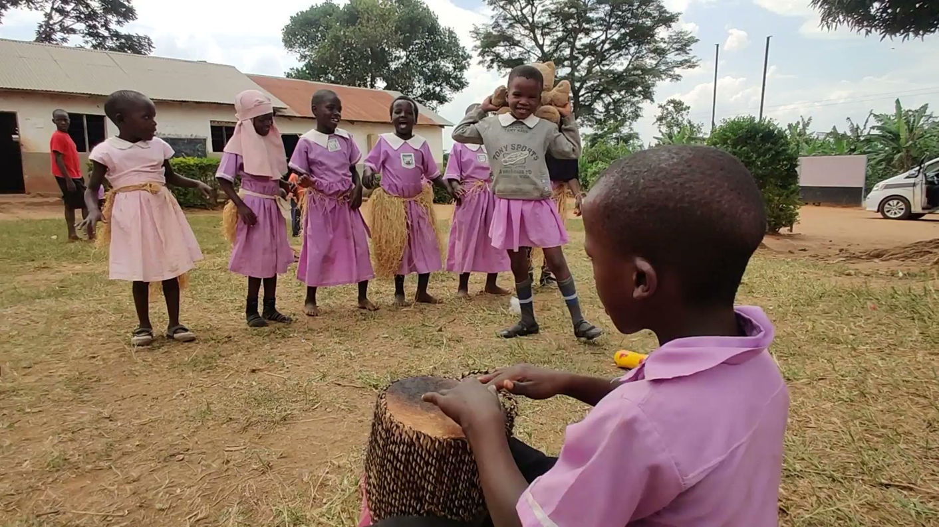
Cultural Practices of South Sudanese Refugees in Uganda
South Sudanese refugees in Uganda embrace their cultural heritage through traditional dances, folk songs, food presentations, clay work and storytelling, each reflecting their ethnic identity and history. These expressions of culture serve as vital connections to their roots and resilience in the face of displacement.
Photo source: BRAC IED photo achieves

Slide 14
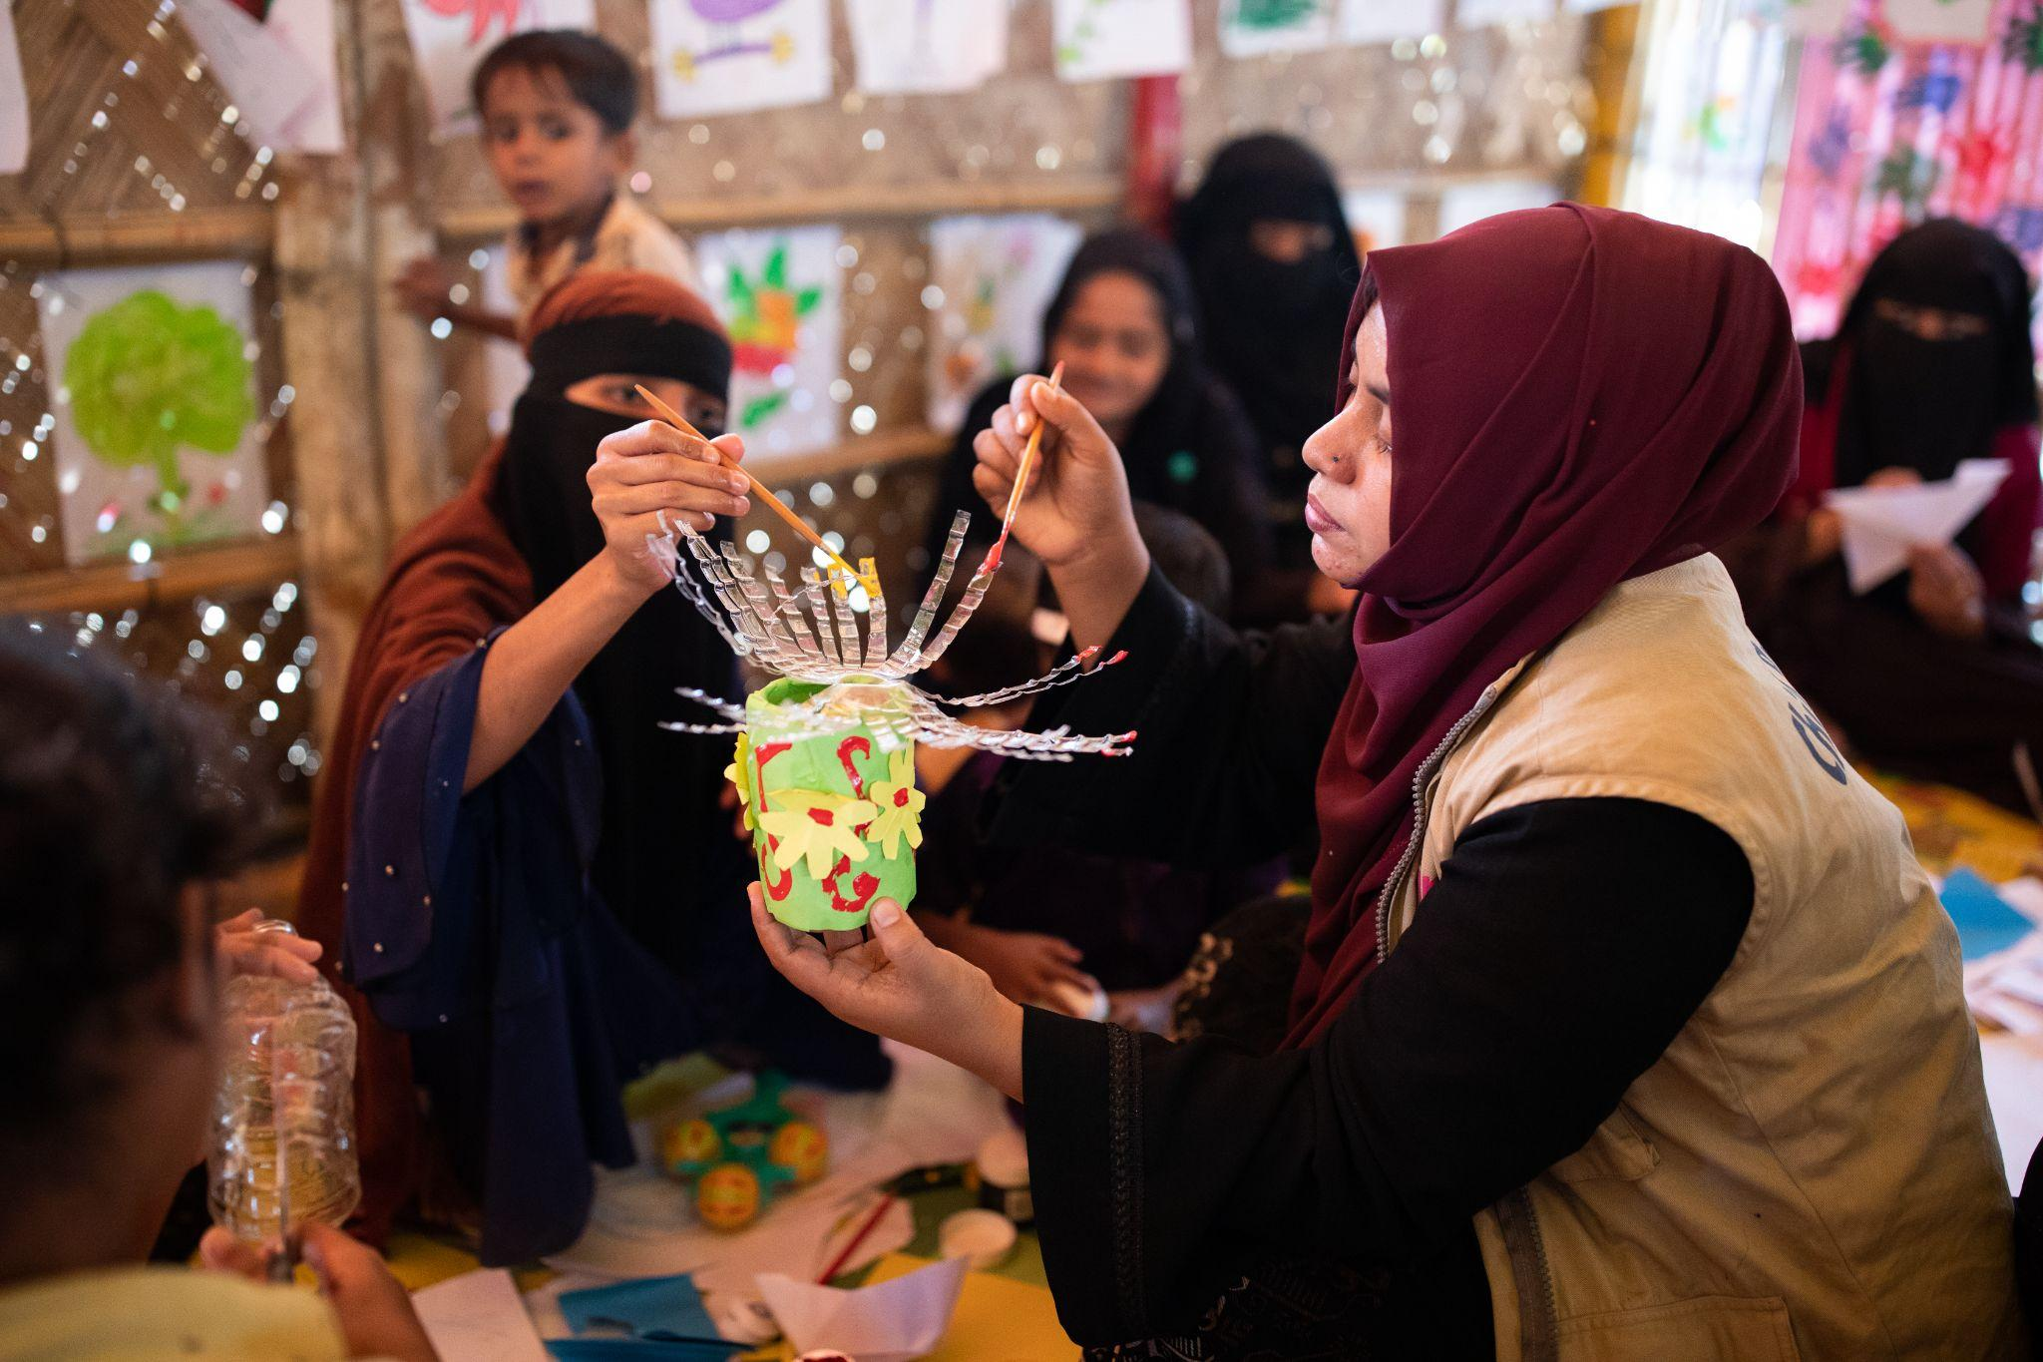
Cultural Practices of Forcibly Displaced Myanmar Nationals (Rohingya Community)
The Rohingya community's rich cultural traditions encompass cuisine, rituals, attire, and communal practices such as making Jhalor (Decorative piece), samiana (Decorated Ceiling), bamboo crafting, painting Chandan (Aromatic Herb) on face and storytelling. They emphasize respect for elders, traditional gender roles, and a strong connection to nature. Children participate in various traditional games that promote teamwork and creativity, reflecting their cultural resilience and adaptability despite displacement.
Video: https://www.youtube.com/watch?v=hiThgvDRqYk
Photo source: BRAC IED photo achieves

Slide 15
While working for children, families and communities in humanitarian settings, it is essential to understand the cultural norms and customs of that distressed community. When working with diverse populations, especially in humanitarian crisis, community participation and co-created approaches to collect cultural practices and traditional play activities of the community are essential components and is a fundamental building block to humanitarian community engagement and child development.
How to collect cultural practices and traditional play activities

Slide 16





To collect different elements of culture and play, various techniques can be followed. Such as-
Observation
Focus group discussion
In-depth interviews with selected community members
Participation of the community members
in the implementation process
Design and crafting workshops

Slide 17
Collecting cultural elements and play practices: Different techniques
Observation
Focus Group Discussion (FGD)
Observation and learning about communities' habits and customs is crucial for early childhood development programs. It helps to develop the foundation for co-creating culturally responsive play, folk stories and rhymes, colloquial art, design and pattern etc.
Focus group discussions are an excellent method for both continuously revising the content of the interventions and identifying components of the local cultures involving frontline staff, caregivers, and community members.

Slide 18
Collecting cultural elements and play practices: Different techniques
In-depth interviews with selected community members
Participation of the community members in the implementation process
Having in-depth interviews with children, parents, and distinguished members from the community is essential to gathering traditional games, rhymes, stories, traditional art pieces, interior design aesthetics, and design processes. These can serve as the foundation for the content.
Frontliners or facilitators might be chosen from within the community and extensive training can be provided to build their capacity. This promotes sustainability of the interventions while also empowering and elevating the community.

Slide 19
Collecting cultural elements and play practices: Different techniques
Design and crafting workshops
Workshops with children, adolescents, parents, and community members is helpful for collecting indigenous design, pattern and crafts. It is also useful for creating artwork and making models of the play spaces and equipment that community members want, using low-cost, recycled materials for sustainability.

Slide 20
Importance of incorporating cultural practices in co-designing programs and how to preserve best traditional practices
Integration of cultural practice can improve the effectiveness of humanitarian operations. Culture provides a sense of identity and solidarity for community.
Incorporating cultural practice in co-designing program is crucial for preserving cultural heritage, enhancing community cooperation, and promoting personal growth.
For impacted communities, it is imperative that program implementation takes cultural nuances into account.
For instance, folktales, rhymes and chants and traditional play practices such as Beng Khela (Frog Game) from the Rohingya community in Bangladesh played a significant role in the implementation of an early childhood development program that fostered empowerment and ownership.

Slide 21

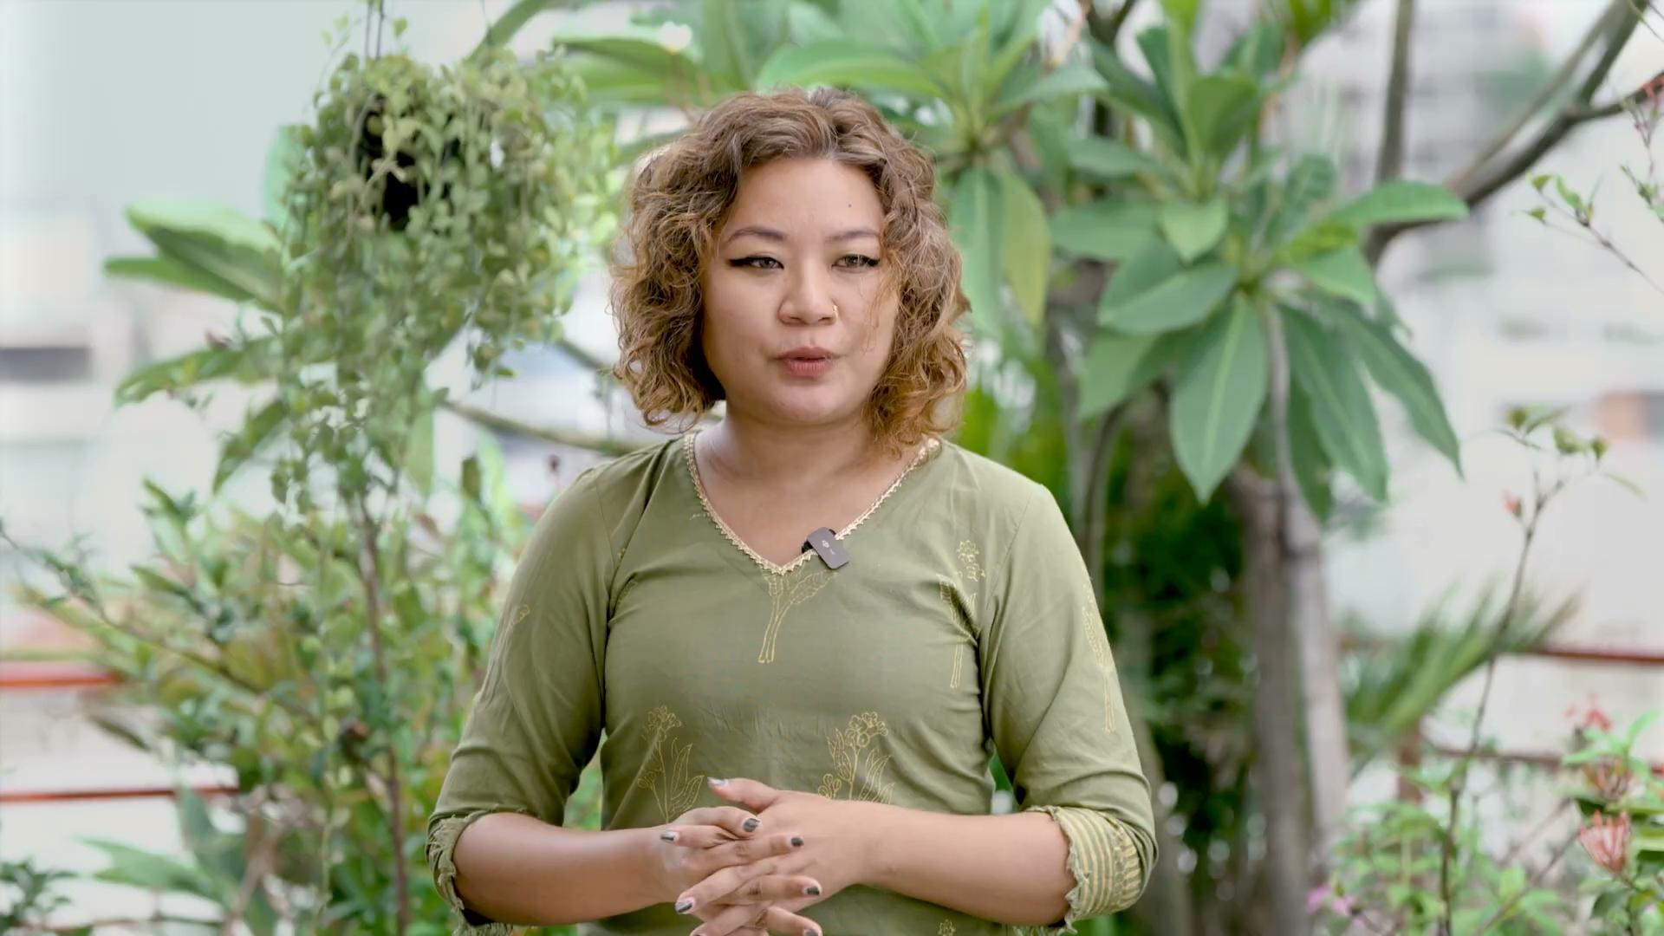
Let’s hear from an expert about incorporating cultural practices and co-designing play-based ECD programs in humanitarian settings

Slide 22
Identify which cultural elements would be most important to consider when designing a humanitarian intervention

Slide 23
References: Reading materials
Community Engagement & Cultural Contextualization as an Integral Approach to Working and Implementing in Programs (2022). Internal document. BRAC IED Achieve
Jaya Krishna, S., & Daniel, J. A. (2021). Impact of Culture on Humanitarian Operations: Review and Insights. SCMS Journal of Indian Management. https://www.researchgate.net/publication/353018647
LWF Uganda holds cultural gala to promote peace among refugees. (2021, April 27). Uganda. https://uganda.lutheranworld.org/content/lwf-uganda-holds-cultural-gala-promote-peace-among-refugees-106
Perera, C., Salamanca-Sanabria, A., Caballero-Bernal, J. Feldman, L., Hansen, M. & Bird, M. (2020).No implementation without cultural adaptation: a process for culturally adapting low-intensity psychological interventions in humanitarian settings. Journal of Medical Case Reports, Conflict Health 14 (46). https://doi.org/10.1186/s13031-020-00290-0
An Exploration of Rohingya Culture and Identity, Study Summary (2021). Internal document. BRAC IED Achieve
Refugees from Syria, (2014, October). Cultural Orientation Resource Center. https://coresourceexchange.org/wp-content/uploads/2019/09/Syrians-Backgrounder.pdf
Tay, A. K., Riley, A., Islam, R., Welton-Mitchell, C., Duchesne, B., Waters, V., Varner, A., Moussa, B., Alam, A. N. M. M., Elshazly, M. A., Silove, D., & Ventevogel, P. (2019). The culture, mental health and psychosocial wellbeing of Rohingya refugees: a systematic review. Epidemiology and Psychiatric Sciences, 28(5), 489–494. https://doi.org/10.1017/s2045796019000192
THE PLAY TO LEARN PROJECT, & Childhood Education International. (2024). Co-Creation, Iteration, and Adaptation: Real-World Examples from Play to Learn Programs. Childhood Education International. https://sesameworkshop.org/wp-content/uploads/2024/08/PTL_Explainer_co-creation-and-adaptation_v2.pdf

Slide 24
References for Images
Pictures of BRAC IED photo achieves
UN Women (2017, April 4). Weaving helps women Syrian refugees to find peace. HuffPost. https://www.huffpost.com/entry/women-syrian-refugees-weave-to-find-peace_b_58de80eee4b0ca889ba1a535
UNHCR/Christopher Herwig. (2016, January 8). Using clay and wooden kebab skewers, Syrian refugee Mahmoud Hariri built a model of the ancient city of Palmyra. Archinect. https://archinect.com/news/article/145267758/to-preserve-cultural-memory-these-syrian-refugees-recreate-lost-monuments-in-miniature
UNICEF/UN056966/Ose. (2017, October 2). Inclusion of refugee children in national child protection systems. UNICEF Eastern and Southern Africa. https://www.unicef.org/esa/reports/inclusion-refugee-children-national-child-protection-systems

Slide 25
Thank You!

