Slide 1




Day
ECD IN EMERGENCIES: Cultivating Healing & Learning through Play
3

Slide 2
Learning outcome
Describe child, child development, Early Childhood Development (ECD) and domain of child development concisely
Explain about the importance of ECD in humanitarian settings
Identify the ways in which play can work as a tool for healing and learning in humanitarian context
Describe the importance of ensuring mental well-being of parents, caregivers and children

Slide 3
Time Allocation
15 mins
30 mins
Define what is child, child development, Early Childhood Development (ECD) and domain of child development
Recognise why ECD is important in humanitarian settings
30 mins
15 mins
Identify how play work as a tool for healing and learning in humanitarian context
Analyze the importance of ensuring mental well-being of parents, caregivers and children

Slide 4
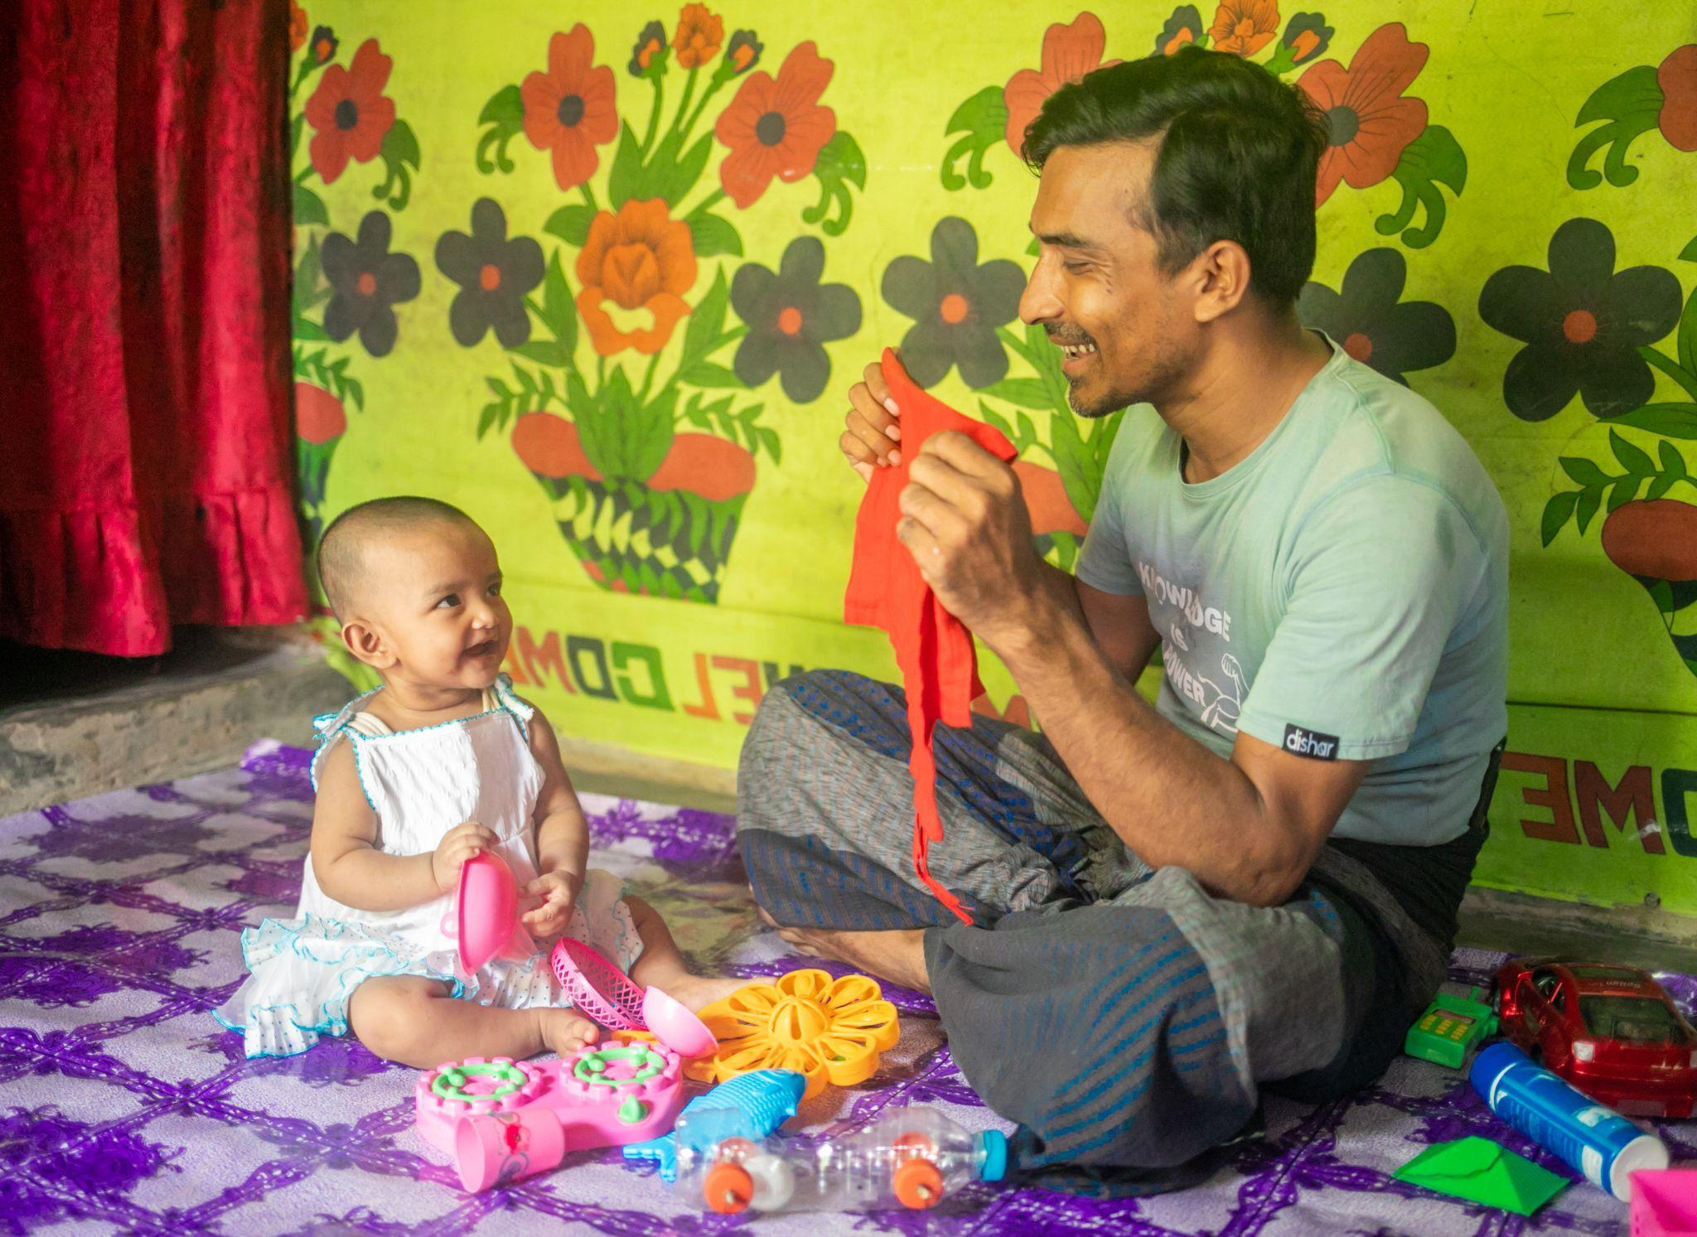
Let’s think! (3 min)
Let’s look at this pictures and then write down our answer in the below box-
What comes first in your mind when you see this picture?
At which stages of life do you think these types of activities are conducted?
Picture: Father is playing peek-a-boo with his child
Photo source: BRAC IED photo archives

Slide 5
Definition of a Child
UN Convention on the Rights of the Child (UNCRC) defines a child as any human being under the age of 18

Slide 6
What is Child Development?
The process by which humans change both qualitatively and quantitatively as they grow older
It is not just adding more knowledge or ability with time, it is the process of transforming, of becoming completely new
It involves change from- immature to mature behavior- simple to complex patterns of behavior.

Slide 7


Early Childhood Development
Early Childhood Development is defined as the development of children from conception and birth through age 8
Early experiences and relationships with parents and caregivers play a crucial role in shaping the brain's neural connection, leading to potential long-term cognitive and emotional difficulties

Slide 8
Domains of Child Development
To observe and understand the child’s behavior, child development is often divided into domains by psychologists. Play can be one of the vital elements in achieving all the domains.
Physical Domain (the ability to move and co-ordinate)
For instance, running, swimming, sports etc.
Cognitive Domain (the ability to think and learn)
Critical thinking, problem solving, imagination etc.
Socio-emotional Domain (the ability to develop positive feeling and relate to others)
Self-esteem, expressing emotion, interaction with others etc.
Language Domain (the ability to listen, speak):
Communication with others, talking, vocabulary etc.

Slide 9

Reflection (5 min)
Think about a play activity from where a child in the early years can
achieve all the domains of development. What steps are required in that activity to fulfil developmental requirements?

Slide 10
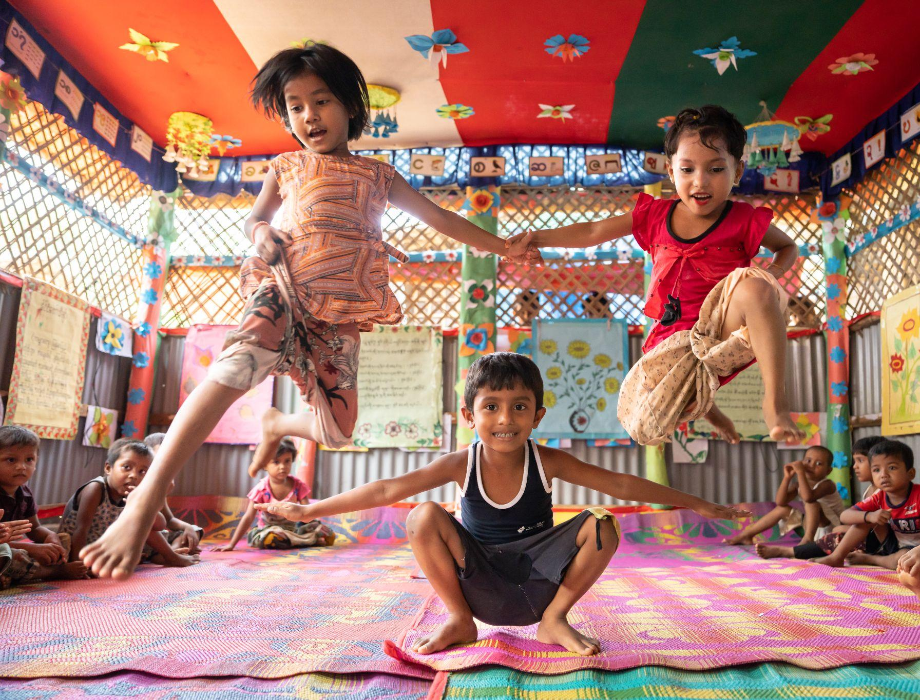
Importance of ECD in humanitarian settings
Millions of children worldwide are in humanitarian situations due to war, natural disasters, crises, pandemics, climate change displacement, and fear of persecution.
Caregivers facing conflict and crisis encounter significant barriers to providing healthy parenting and responsive care, which are also the components of Nurturing Care Framework.
Early Childhood Development (ECD) activities, as recommended by the Nurturing Care Framework across different sectors, are often absent from Emergency and Refugee Response Plans
High-quality early childhood development (ECD) can save lives and lay the groundwork for a more positive life trajectory for young children and infants growing up in crisis situations.
Photo source: BRAC IED photo achieves

Slide 11
Reflection (5 min)
Imagine you are a humanitarian worker working for a displaced community.
Now make a sketch on some opportunities for early learning that you along with your team can provide in that context and upload it in the padlet.
Note: It’s not about the quality of the art, it’s just the medium of your reflection.

Slide 12
The Nature of Play and its Essentiality
Play is an essential developmental tool for the children. It improves cognitive, language, physical, social, and emotional well-being of children
Through play, children learn about their world. It is a natural medium of communication of any child
Play can be therapeutic for children as it can naturally release stress and help children process various feelings and experiences through it
Play varies from culture to culture. It is a form of expression of children’s cultural identity
Playfulness is a crucial aspect of play, where children actively participate, engage, and express their emotions and creativity in a friendly and joyful environment
Play is spontaneous and non-coercive
It is a fundamental right enshrined in the UN Convention on the Rights of the Child, and a key component of the 2030 development agenda. Play is universal for all the children around the world.

Slide 13
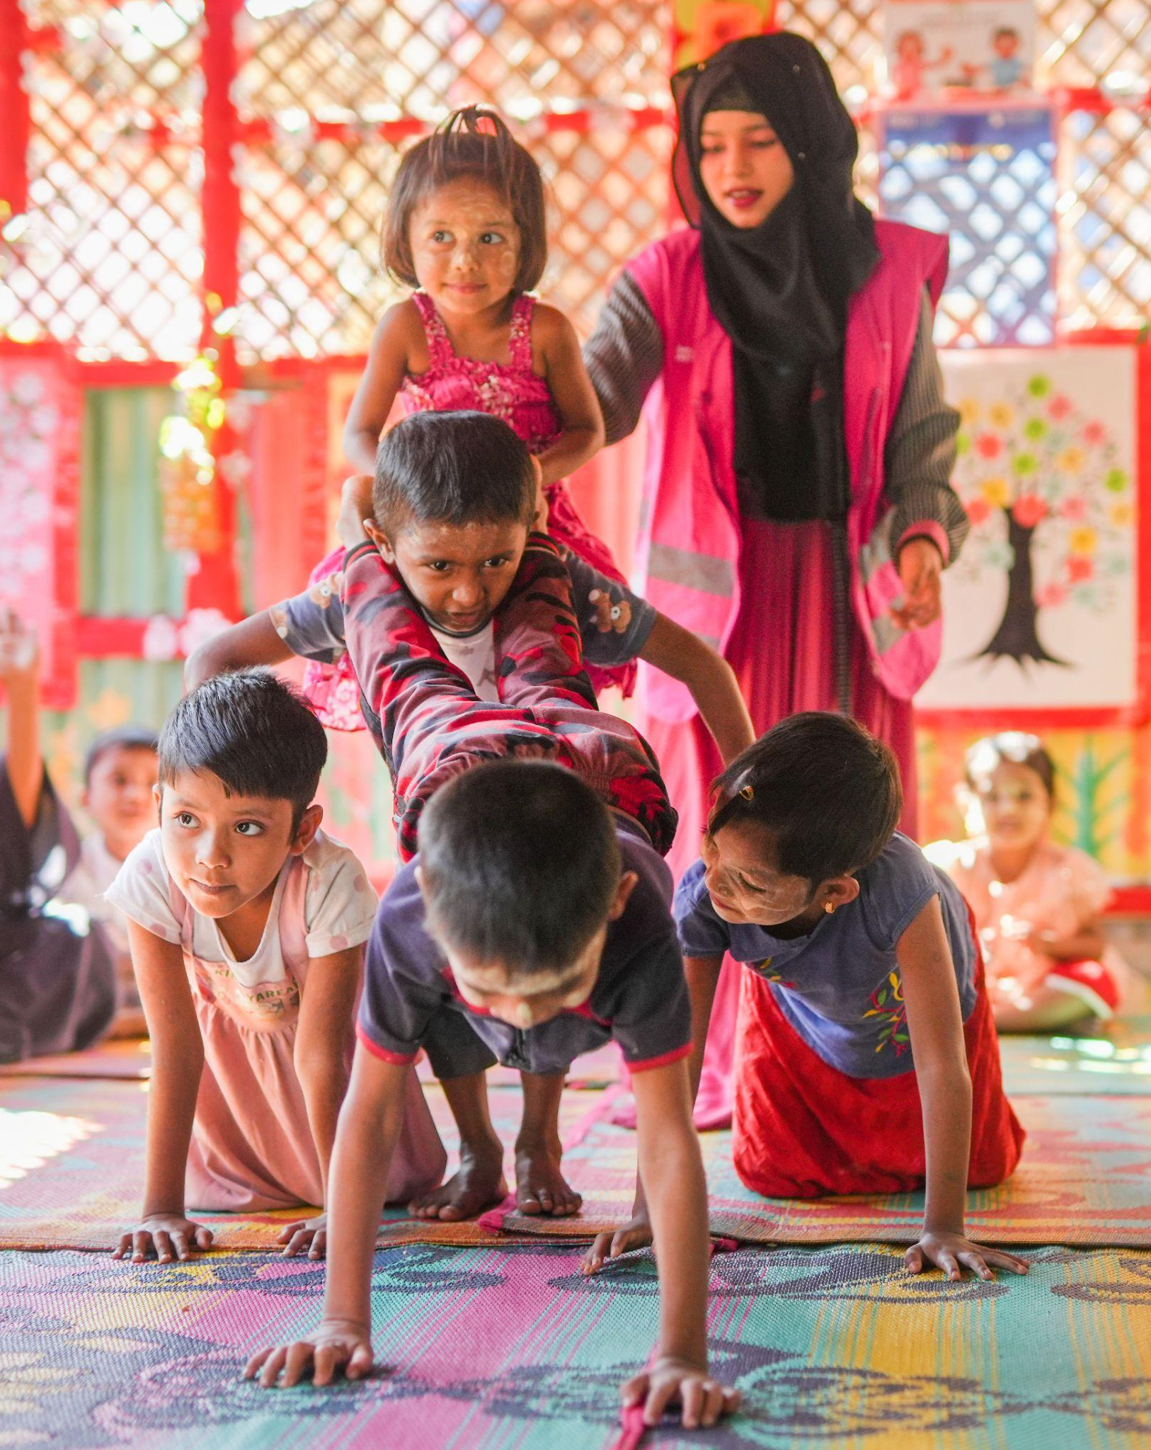
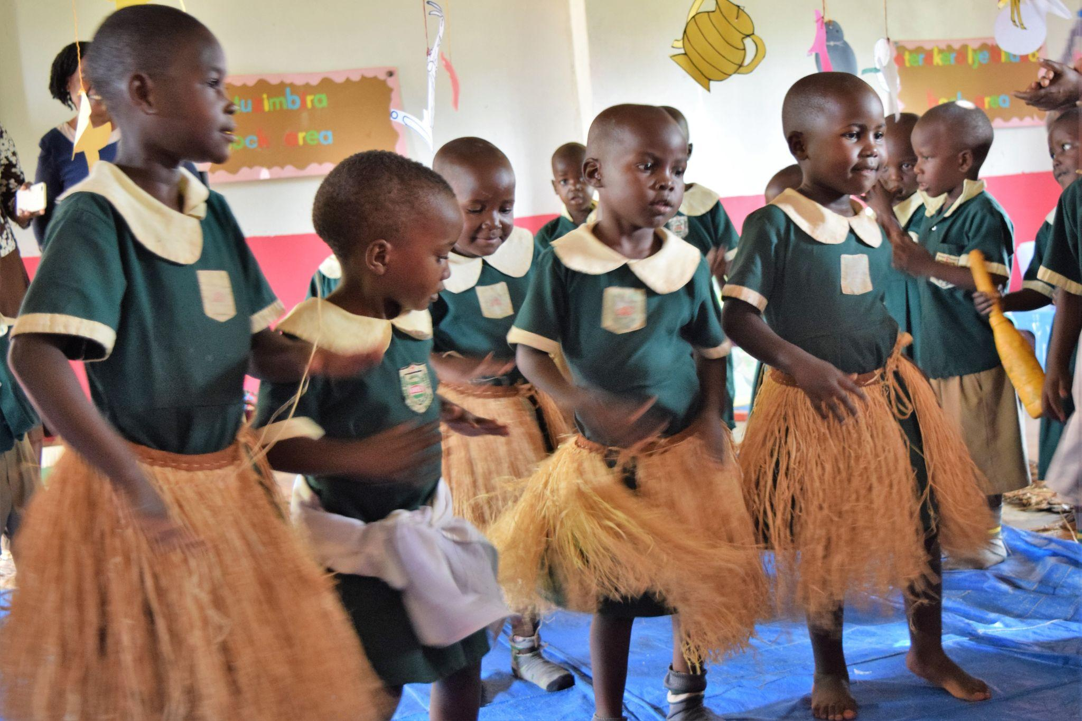
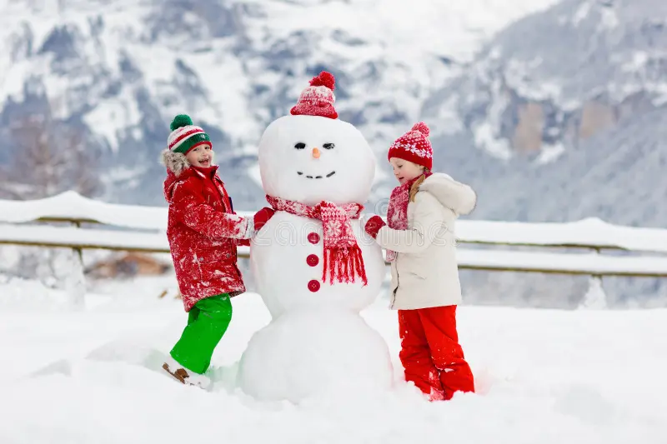
Let’s see some play activities from different cultures
Sources (clockwise):
BRAC IED Photo Archives
BRAC International Photo Archive
https://www.dreamstime.com/child-building-snowman-kids-build-snow-man-boy-girl-playing-outdoors-snowy-winter-day-
outdoor-family-fun-christmas-vacation-image131739523

Slide 14
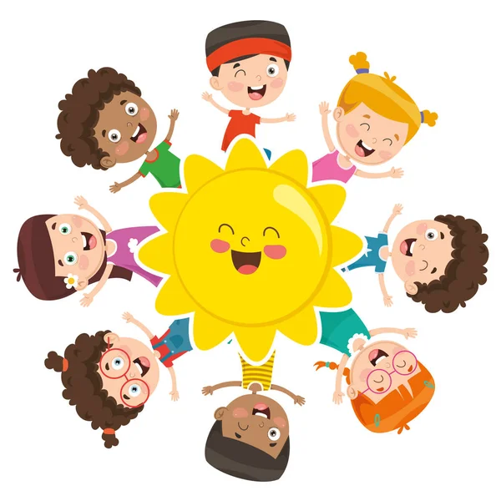
Activity (3 min)
Think about any play/play activity from you culture which reminds you of an enjoyable moment!

Slide 15
Play in Humanitarian Contexts
Play is a fundamental right that must be protected and nurtured, especially for the most vulnerable children who are at risk of losing their childhood to hardships
In situations of crisis and insecurity, quality and cultural inclusive play helps to facilitate the social and emotional wellbeing, development and resilience of children and young people in all their diversity
Through play, children try to ease their pain, can express and better understand their emotions and try to see new perspectives of a better life, in peace. Play helps displaced children to socialise and to integrate into the new context
Play also helps to build resilience among the children living in humanitarian settings

Slide 16
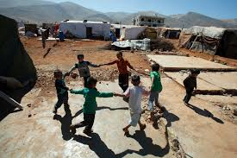
Play in a Humanitarian Context:
(Syrian Refugee Children)
Children are playing as they wish by holding their hands
Photo source: Karim, S. (2013, July 31). A Glimpse of Syria's 1 Million Child Refugees. [jpeg]. Reuters. https://www.npr.org/sections/thetwo-way/2013/08/23/214793685/a-glimpse-of-syrias-1-million-child-refugees

Slide 17
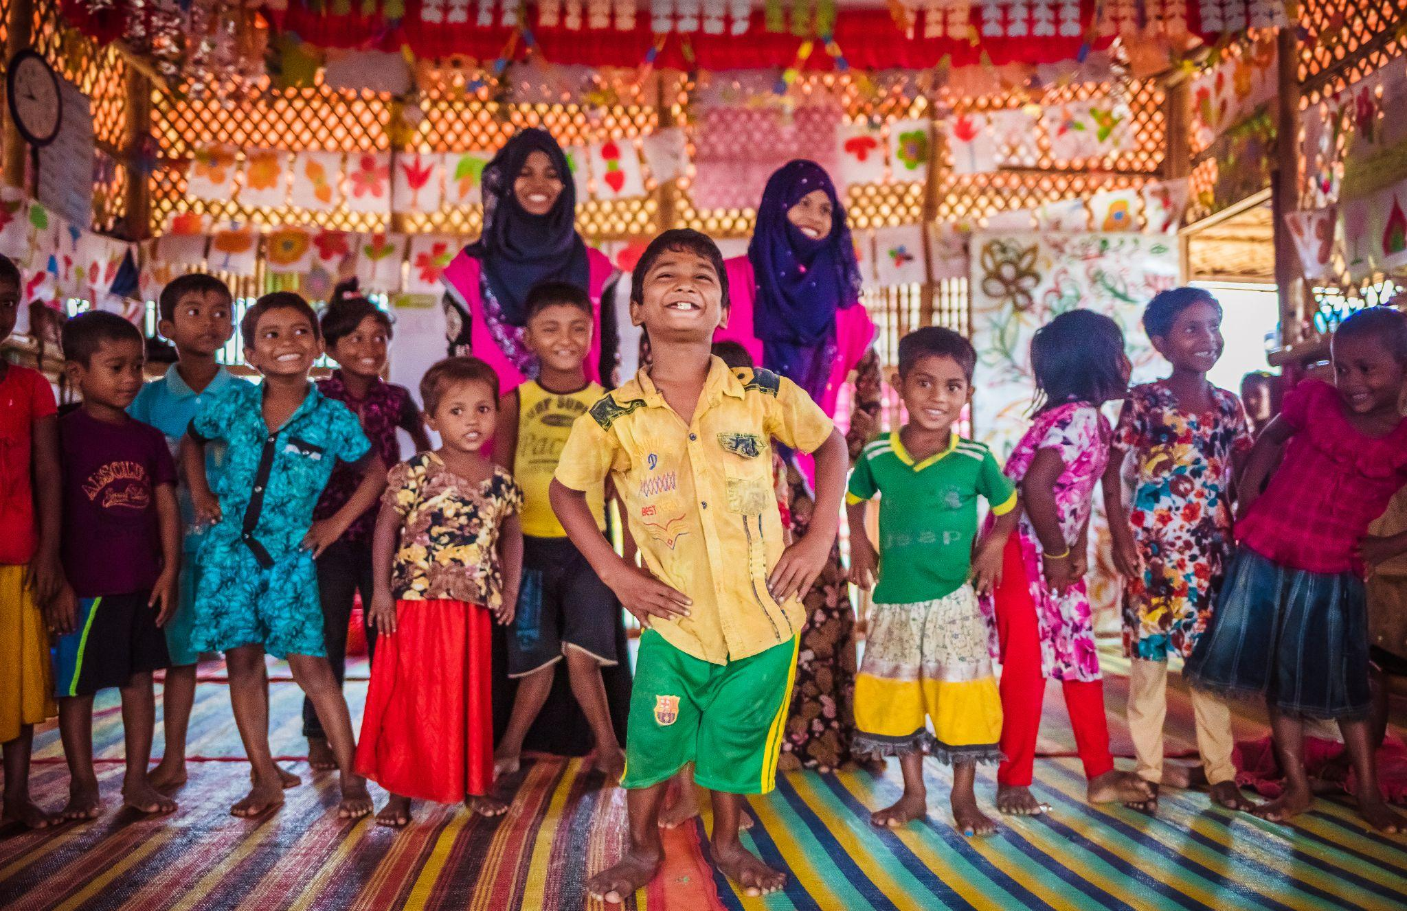
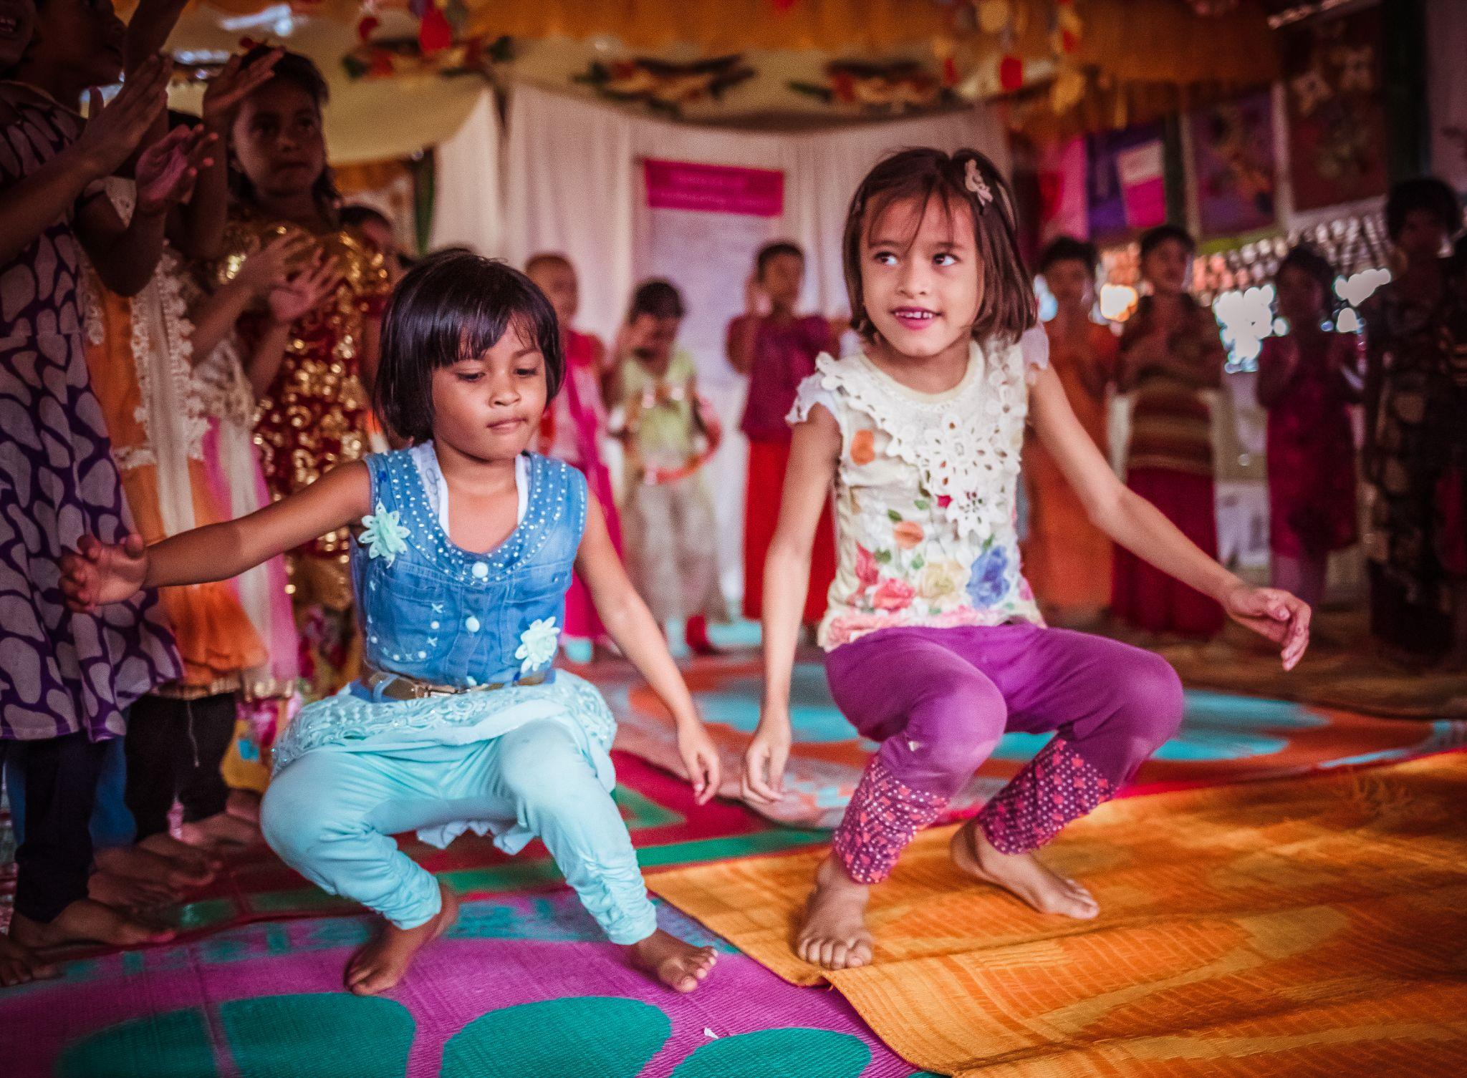
Play in a Humanitarian Context
(Rohingya Refugees)
Reciting kabbya (rhyme) with gesture
Playing bang khela (frog game)
Photo source: BRAC IED photo archives

Slide 18
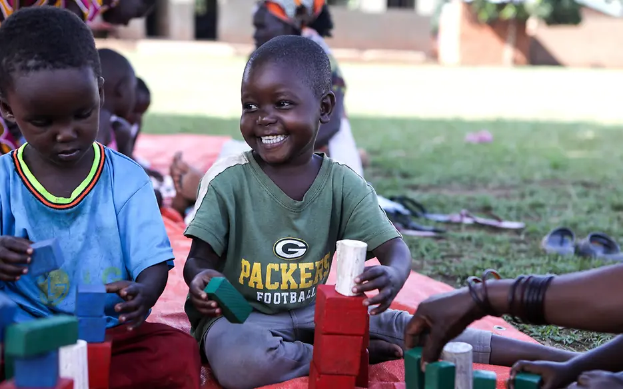
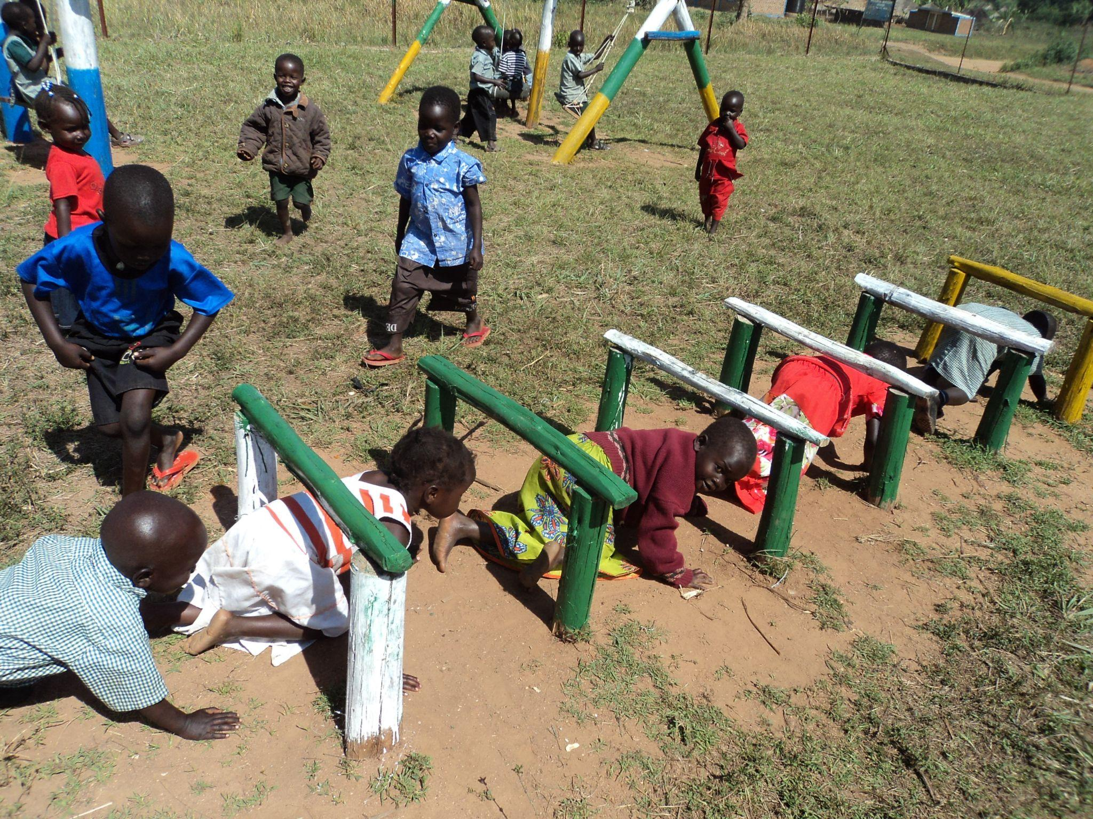
Play in a Humanitarian Context
(Refugees from South Sudan Residing in Uganda)
Children are playing with blocks
Children are playing physical play
Photo source: BRAC IED photo archives
Hajarah Nalwadda, H. (2024, January 22). Sustainability More than just a playgroup: Lively Minds in Uganda. [jpg]. LGT. https://www.lgt.com/li-en/market-assessments/insights/sustainability/more-than-just-a-playgroup-lively-minds-in-uganda-197222

Slide 19
Learning & Healing through Play
Learning through play enables children to acquire and practice a wide range of abilities, including empathy, coping mechanism, problem-solving, collaboration, and ensuring well-being that they will need to thrive and contribute meaningfully to society.

Slide 20
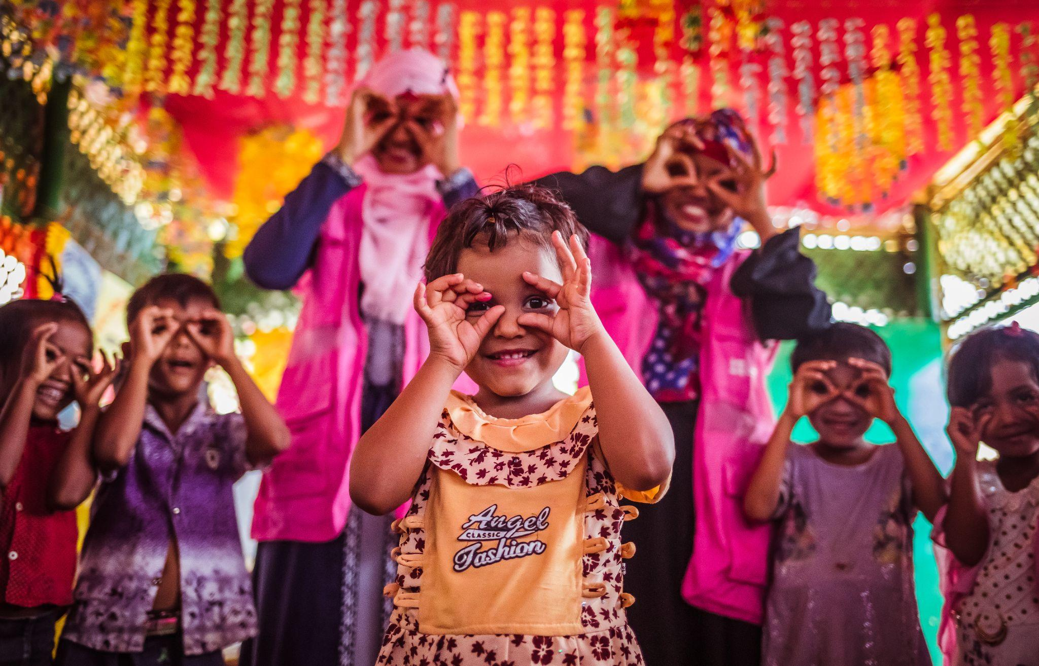
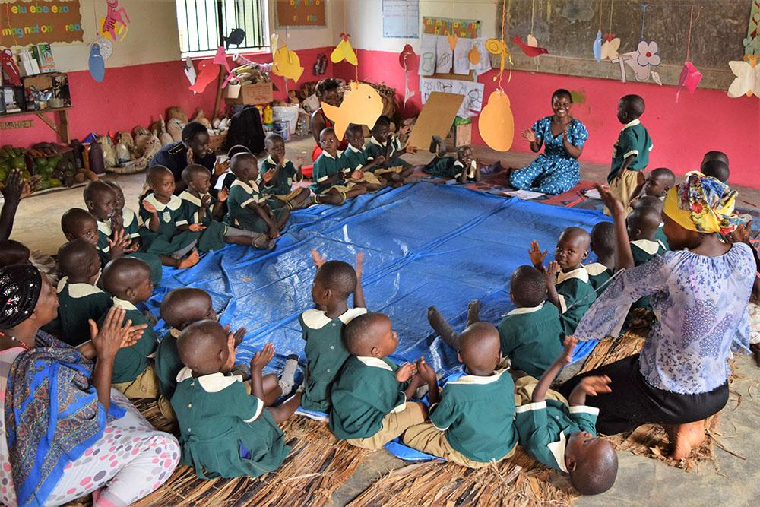
Play as a Tool for Healing in Humanitarian Contexts
Early learning activities or play activities foster resilience in children who live in fragile settings by providing a nurturing environment, reducing stress, healing trauma, regulating emotions, and learning social skills.
Play, such as music, dance, and storytelling, can help people thrive in humanitarian crises, as seen in the Healing in Harmony program in Democratic Republic of Congo and THRIVEGulu Trauma recovery center for South Sudanese Refugees in Northern Uganda.
Video link: https://youtu.be/PLUG2iQrQNU
Photo source: BRAC IED photo archives

Slide 21
Play as a Tool for Learning in Humanitarian Contexts
Play boosts children's creativity, language, problem-solving, social skills, emotional regulation, and self-confidence. It's a powerful learning tool in humanitarian settings, boosting self-esteem, reducing stress and fostering growth.
Let’s see how does learning through play look like in humanitarian setup-
Video link: https://www.youtube.com/watch?v=3s2qo-xCDvM&pp=ygU3aGVhbGluZyBhbmQgbGVhcm5pbmcgdGhyb3VnaCBwYXkgaW4gaHVtYW5pdGFyaWFuIGNyaXNpcw%3D%3D
Video link: https://www.youtube.com/watch?v=B0FDZkMZhS0&pp=ygU3aGVhbGluZyBhbmQgbGVhcm5pbmcgdGhyb3VnaCBwYXkgaW4gaHVtYW5pdGFyaWFuIGNyaXNpcw%3D%3D

Slide 22
Reflection (3 min)
Think about any humanitarian context, where children have a chance to play and how does it helpful for their well-being??
(Write down your answer in the comment box below-)

Slide 23
Ensuring mental well-being of parents, caregivers and children of humanitarian settings through play
During the humanitarian crisis, caregivers and children both are experiencing trauma, with caregivers playing a crucial role in their survival and thriving, requiring parents' well-being
Play is a key tool for supporting child and caregivers’ well-being through interactive activities like games, storytelling, and art. It improves children’s cognition while boosting caregivers’ self-esteem and mental well-being
Understanding cultural play elements is crucial to developing early childhood programs, as people nurture their traditions through play, regardless of their location. Culturally appropriate play fosters pride, belonging, socio-emotional development, and reduces caregivers' depression, as seen in the Rhino settlement in Uganda and the ECD interventions for Rohingya people in Bangladesh by incorporating folk rhymes, stories, art, play activities , preserving refugee culture.
Video link: https://www.youtube.com/watch?v=6J6hbiOpnww&t=15s&pp=ygURYnJhYyBodW1hbml0YXJpYW4%3D

Slide 24
Anderson, K., & Saeed, S. (2022). Research on Young Children in Emergencies: Current Evidence and New Directions. Moving Minds Alliance. https://movingmindsalliance.org/wpcontent/uploads/2022/12/MMA_ResearchForum_Research-on-Young-Children-in-Emergenices_Dec2022.pdf
Mariam, E., Ahmad, J., & Sarwar, S. S. (2021). BRAC Humanitarian Play Lab Model: Promoting Healing, learning, and Development for Rohingya Children. Journal on Education in Emergencies, 7(1), 96. https://doi.org/10.33682/u72g-v5me
Nurturing Care Framework. (2018). Nurturing care for early childhood development: a framework for helping children survive and thrive to transform health and human potential. World Health Organization. https://iris.who.int/bitstream/handle/10665/272603/9789241514064-eng.pdf
References: Reading
Material
Shah, S. (2023). Supporting young children affected by crisis. Young Children in Humanitarian and COVID-19 Crises. Routledge. https://www.taylorfrancis.com/chapters/oa-edit/10.4324/9781003415213-2/supporting-young-children-affected-crisis-sweta-shah
Sluss, D. R. (2005). Chapter 1: Valuing Play. Supporting Play Birth through Age Eight. pp. 6-11. Thomson Delmar Learning.
UNICEF. (2018). Learning through play: Strengthening learning through play in early childhood education programmes
https://www.unicef.org/sites/default/files/2018-12/UNICEF-Lego-Foundation-Learning-through-Play.pdf

Slide 25
BRAC IED photo achieve
BRAC Uganda, Early Childhood Development. Photo & Video Gallery
Famveldman ID 131739523. Child building snowman. Kids build snowman. Boy and girl playing outdoors on snowy winter day. Outdoor family fun on Christmas vacation. [jpeg]. Dreamstime.com. https://www.dreamstime.com/child-building-snowman-kids-build-snow-man-boy-girl-playing-outdoors-snowy-winter-day-outdoor-family-fun-christmas-vacation-image131739523
References:
Image

Slide 26
Hajarah Nalwadda, H. (2024, January 22). Sustainability More than just a playgroup: Lively Minds in Uganda. [jpg]. LGT. https://www.lgt.com/li-en/market-assessments/insights/sustainability/more-than-just-a-playgroup-lively-minds-in-uganda-197222
Karim, S. (2013, July 31). A Glimpse of Syria's 1 Million Child Refugees. [jpeg]. Reuters.
References:
Image
https://www.npr.org/sections/thetwo-way/2013/08/23/214793685/a-glimpse-of-syrias-1-million-child-refugee
Photography, S.T. (2018, February 17). An image of children playing in the open field of a rural area near Dhaka, Bangladesh.[jpg]. Shutterstock. https://www.shutterstock.com/image-photo/dhaka-bangladesh-17-february-2018-image-1050060725

