Slide 1
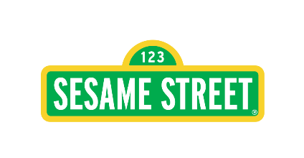



Cultural Contextualization, Healing, and Community-Based Co-Creation in Humanitarian Settings
Day
2

Slide 2
Learning Outcomes
Understand cultural identity and its importance on the dividual and community
Analyze the role of culture in healing for displaced communities
Identify bottom-up approaches to identifying community-based practices
Define the importance of community-based practices for the process of healing

Slide 3
Activity 1: Identifying One’s Cultural Identity (2-3 minutes)
01
02
What is your country’s or state’s unique cultural aspects?
Write two or three words or a few sentences which describe your idea of what your national culture entails
Define your community/family’s unique cultural aspects
Write two or three words that describe your idea of what your community’s or family’s culture entails. Write them down for reflection in the padlet
02
03
03
Why did you choose these cultural aspects?
Write down your reflections in the padlet 4 or 5 lines

Slide 4
What is Cultural Identity?
Cultural identity represents an individual's identity as a member of a group with shared characteristics, which often (but not always) include racial, ethnic, or geographical origins
It influences multiple life domains, including the habits, clothing & food practices, beliefs and ways in which people make decisions about performing behaviors
Each person comes from a different cultural landscape, determined by one’s country, community and family. These elements construct one’s individual and collective identity
While it may seem that one’s cultural background is similar to others, if we look closer, we can see nuance and uniqueness as well, which makes up one’s cultural identity. This is the same for communities as different communities have their unique cultural identity.

Slide 5
A Few Examples of Cultural Identity
01
02
Different types of folktales, folk songs and stories passed from generation to generation
Unique clothing patterns and designs of different regions and communities, according to religious or community beliefs, climate necessity, etc.
03
04
05
Religious and societal laws of different communities
Unique art and use of colours and patterns by community members
Regional, community and national variations in food dishes

Slide 6

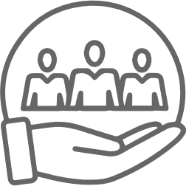



How Differences in Cultural Identity Can Affect Individual and Collective Perspectives
Approach to life’s different opportunities and challenges
Work ethics and principles
Morals and life values
Resilience building and healing
Introspection of oneself and interpersonal relationships with other people within and outside community

Slide 7
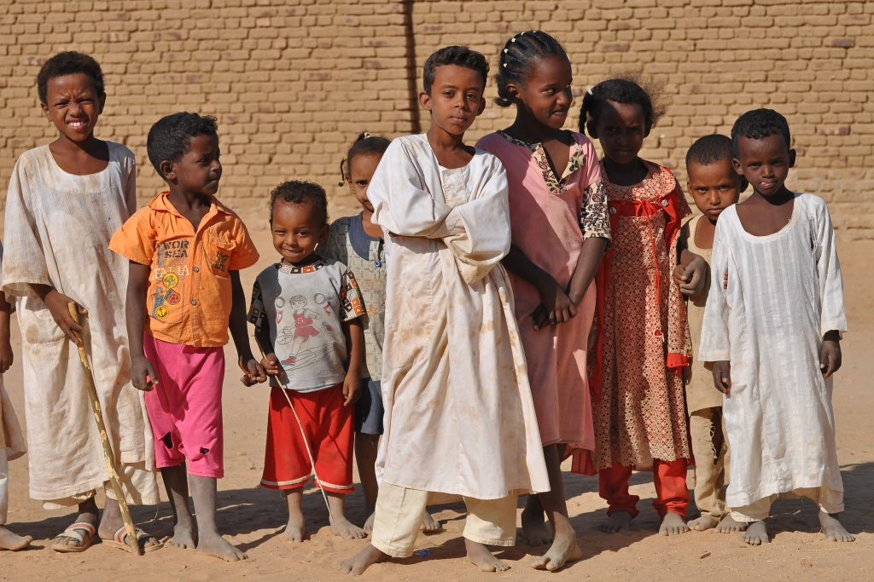
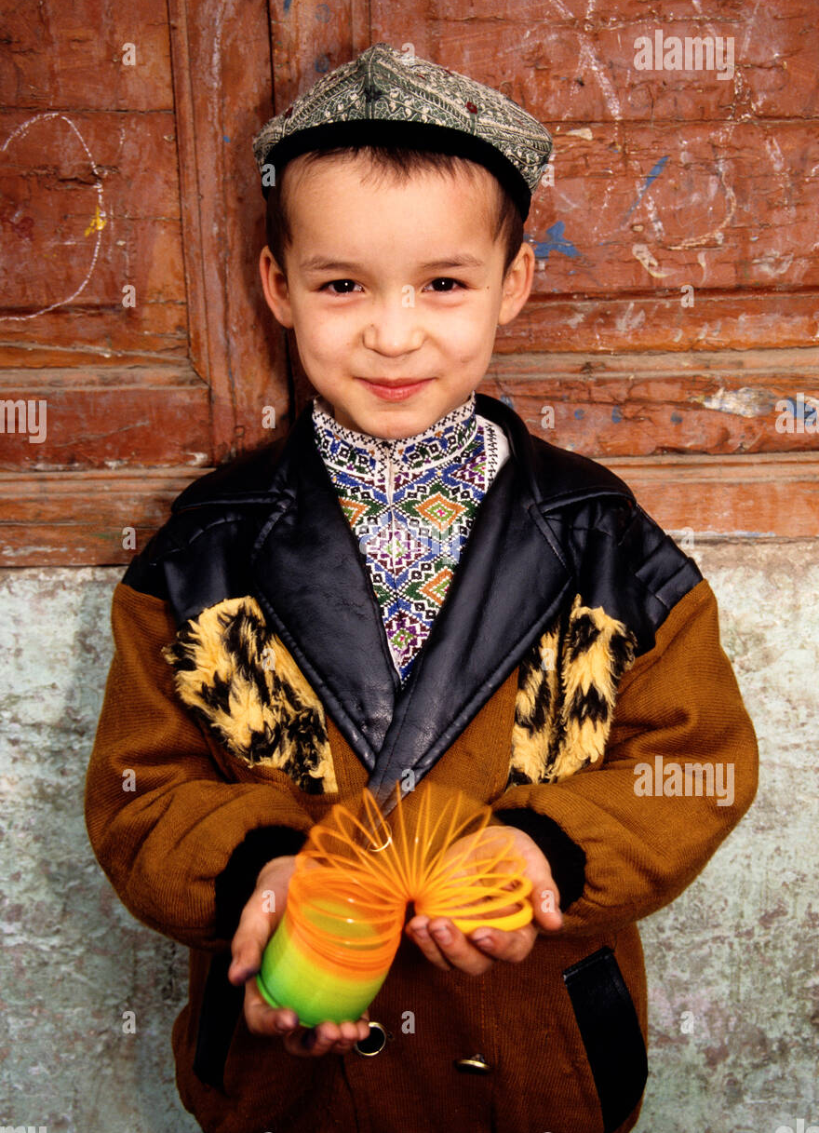

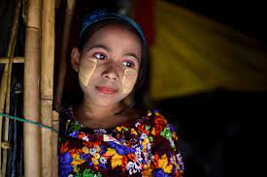
Activity 2: Let’s Look At Three Pictures

Slide 8

Now Let’s Reflect on The Following Questions and write them down in the Padlet (5 minutes)
What are the cultural differences between these pictures?
In your opinion how do differences in cultural identity factor in when working with children in humanitarian settings?
How does cultural identity affect a community’s collective healing process?

Slide 9
Discussions on Cultural Identity
“ ”
“...being Indigenous [people or community] is anchoring oneself to a community, history, language, and people. [Corntassel] stresses that it is an active process rooted in a community that extends to ceremonies, institutions, and kinship networks. In his discussion of the deﬁnition of an Indigenous person, he centres the description on a shared culture, history, and institutions grounded in communities.
(Corntassel, 2003, p. 92).

Slide 10
Discussions on Cultural Identity
“ ”
“ The term “cultural identity” is sometimes applied to some or all of those just named above, while at other times it is reckoned to be a distinct category. On the one hand, culture and identity are never entirely separable: It is a deﬁning trait of the concept of culture that whatever beliefs, values, inclinations, tastes, practices, and texts constitute it must also serve an identity function for those who participate in the culture. On the other hand, no group can be expected to be culturally homogeneous; the urge to tribalize is too deeply rooted in human nature, indeed its ubiquity in animal behavior testiﬁ es to how deep it runs in our evolutionary heritage.”
Joseph, 2012

Slide 11
The role of culture in healing for displaced communities
Activity 3
Participant will read an article for 7 to 10 minutes & will answer the following questions in their padlet-
How do cultural practices help us heal? (At least 4 points)
Make a list of some contextualized examples from your community that can be used for healing
Describe 2 or 3 practices in your community which fosters healing during painful or tragic circumstances (e.g. death, loss, disaster, etc.)
Reference
https://www.tbsnews.net/thoughts/bangladeshi-culture-rich-practices-help-mental-health-859141
(https://trauma-informed.ca/recovery/phases-of-trauma-recovery/cultural-and-healing-practices/#:~:text=Cultural%20practices%20and%20traditions%20serve,sense%20of%20identity%20and%20purpose. )

Slide 12
The Role of Culture in Healing for Displaced Communities
Culture plays a vital role in the healing process of forcibly displaced communities. Let’s explore how culture contributes to resilience, well-being, and social cohesion in these contexts:
Psychosocial Consequences of
War and Forced Migration
Conflict and political terror have led to the displacement of over 65 million people worldwide.
Survivors of persecution and forced migration often experience trauma and loss.
Cultural retention and sensitivity is central to their coping mechanisms and provide pathways toward healing and rebuilding their lives.
Cultural Dislocation and Alienation
Forced migration disrupts cultural connections, leading to a sense of dislocation and alienation.
Loss of cultural support impacts survivors’ coping strategies.

Slide 13
The Role of Culture in Healing for Displaced Communities
Arts and Culture
The arts and culture contribute to resilience, health, and well-being.
The people of Bangladesh enjoy a rich cultural heritage in music, art, literature, and culinary delights, and these are valuable self-care activities when people are in despair, stressed, or emotionally broken. The soul-stirring melodies of Kazi Nazrul Islam, Rabindranath Tagore, and Baul songs, or the timeless wisdom of Bangla literature and cultural expressions, provide avenues for emotional catharsis, reflection, and healing.
Spirituality and Coping
Religious beliefs and spiritual practices are also strong components of Bangladeshi identity. Intercultural understanding is essential for addressing trauma.
Community-Based Healing Spaces
As much as traditional practices and cultural factors contribute to wellbeing and emotional resilience, it is crucial to be open to accepting that new cultures and global influences are also changing social norms and creating new practices. Fast-evolving technological advancements, rapid urbanisation, exposure to global trends, and their amalgamation with the existing culture are leading to the emergence of new practices for wellbeing and self-care.

Slide 14

Activity 4: Importance of resilience
Let’s
Watch a
Video
https://www.youtube.com/watch?v=cusbGK8tnO8&list=PPSV

Slide 15

Let's reflect on
What is resilience? (One or two sentences or more)
According to the video, what are the ways a person be resilient after facing any trauma provoking incidence through community/cultural practices?

Slide 16
How Culture Can Build or Foster Resilience
Participating in traditional rituals or ceremonies that provide a sense of belonging and connection to one's cultural heritage.
Drawing strength from cultural values, beliefs, and teachings that promote resilience, such as perseverance, solidarity, and spiritual faith.
Seeking support from family, friends, and community members who share similar cultural backgrounds.
Engaging in cultural activities or traditions that foster a sense of identity and pride, helping individuals to maintain a positive sense of self despite adversity.
Accessing culturally sensitive resources and services that cater to the unique needs and perspectives of diverse communities, facilitating healing and recovery.

Slide 17
Cultural Factors of Resilience
The human spirit has the amazing capacity to rebound, adapt, and thrive in difficult and harsh conditions. This resilience power is embedded in the very fabric of society, socio-cultural practices, and traditions, and all these factors play a pivotal role in shaping and nurturing the emotional resilience of the people.
Some cultural factors of resilience are-

Slide 18
Cultural Factors of Resilience
Affiliation with a religious organization
Tolerance for different ideologies and beliefs
Adequate management of cultural dislocation and a change or shift in values
Self-betterment
Having a life philosophy
Cultural and/or spiritual identification
Being culturally grounded by knowing where you come from and being part of a cultural tradition that is expressed through daily activities
(Reference: https://trauma-informed.ca/recovery/what-is-resiliency/)

Slide 19
Co-Creating with Communities: Utilizing the Bottom-Up Approach to Foster Cultural Identity, Healing & Resilience
What is Co-Creation?
Co-creation is a collaborative process that ensures inclusive and creative change, with communities as equal partners
It requires constant collaboration between stakeholders at different levels, from donors to local authorities to community members, during the planning, space design, creation of curriculum activities, and all other decision-making process
Utilizing the bottom-up approach (collecting information from communities and incorporating them into the programs) ensures that the voices, needs and opinions of afflicted people are heard and taken into account in all decision-making processes
Through co-creation and bottom-up approaches, identities become active processes that are aﬃrmed, supported and enhanced through communities and relations.
These connections from the individual to the community also help people who are on a healing journey towards recovery.

Slide 20
Importance of Co-Creation and Bottom-Up
Approaches when Working with Displaced Communities
Social work around the world has been, uncritically, defined from a mostly white western perspective influenced predominantly by Europe and North America. Western values and epistemologies have been taken as a given.
Co-creation and bottom-up approaches draw on alternative knowledge systems that match the lived experiences of the people and communities with whom social workers work.

Slide 21
Importance of Co-Creation and Bottom-Up Approaches to Working with Displaced Communities
With the increasing influence of social constructionism and post-colonialism, there is growing acceptance that knowledge of communities are cultural constructions and that the western perspectives do not reflect values and knowledge systems in other contexts such as those of families and children living in Rohingya camps
Calls for decolonization approaches reflect a growing need to embrace diversity in knowledge, explore alternative ways of thinking about and constructing social work, and creating approaches that are relevant, culturally appropriate, and respectful, to the people we work with

Slide 22
Let’s
Watch two
Video
Video 1

Slide 23
Let’s
Watch two
Video
Video 2

Slide 24
Cultural Factors of Resilience
The videos show how organisations can work with communities deeply, through deep conversations, observations and empathetic understanding, to understand the deep-rooted healing components within their culture
This allows organisations to identify the root-level needs of community members as well as navigate scopes for learning, healing and resilience from the community itself, through traditional and common community practices
Understanding and identifying the needs of the community and working together fosters a more culturally appropriate, community-centred approach to designing humanitarian models, which is ultimately more effective
Based on the video and the points above, let us reflect on ways in which the community-based approach to resilience differ from individual approaches

Slide 25
Case Study
Activity 5
“ ”
Participants will read and reflect on the case study shared.. There will be a series of questions which the participants will answer following the reading session. This will be for 25 minutes.
“Connections and Processes: Indigenous Community and Identity’s Place in the Healing Journey”
(Page 21 (‘Colonization & Trauma’) to 26)
(https://www.researchgate.net/publication/359272115_Connections_and_Processes_Indigenous_Community_and_Identity's_place_in_the_Healing_Journey)

Slide 26
Questions
Participants will share there answers via Padlet
01
02
How can communities help in building and retaining identities?
In what way do community or indigenous identity foster healing and why is it important?
03
04
In your opinion, how can a loss of cultural identity hinder the healing process of marginalised communities?
From the article, what elements of traditional practices were identified as potential healing elements for communities such as the people of Turtle Island?

Slide 27
Tusasiirwe, S. (2023). Disrupting colonization in the social work classroom: using the Obuntu/Ubuntu framework to decolonize the curriculum. Social Work Education, 115. https://doi.org/10.1080/02615479.2023.2246499
Urrieta, L. (2019). Indigenous reflections on identity, trauma, and healing: navigating belonging and power. Genealogy, 3(2),26. https://doi.org/10.3390/genealogy3020026
References
Maracle, G. (2021). Connections and processes. Turtle Island Journal of Indigenous Health, 1(2). https://doi.org/10.33137/tijih.v1i2.36052
Joseph, J.E. (2012). Cultural identity. The Encyclopedia of Applied Linguistics. https://doi.org/10.1002/9781405198431.wbeal0298
Groundwork. (2023b, July 26): Co-creation: the key to building inclusive, socially cohesive communities. https://www.groundwork.org.uk/co-creation-the-key-to-building-inclusive-socially-cohesive-communities/

