Slide 1




Day
Understanding the Humanitarian Setting or Landscape
1

Slide 2
Introduction
What made you interested in taking this course?
(Write down your answer in the box. It may take two-three minutes)

Slide 3
Learning outcomes
Identify disasters, emergencies, and crisis settings
Explain the characteristics, causes and effects of humanitarian crises on various groups
Describe Humanitarian Standards, Global Policies & Ethics
Categorize the roles of humanitarian actors and sectors

Slide 4


Activity:
Ice Breaking
Activity
Think of a song, movie, or book that depicts a crisis.
Write the title and briefly mention how it portrays the challenges of the affected population. This may take 2-3 minutes.

Slide 5
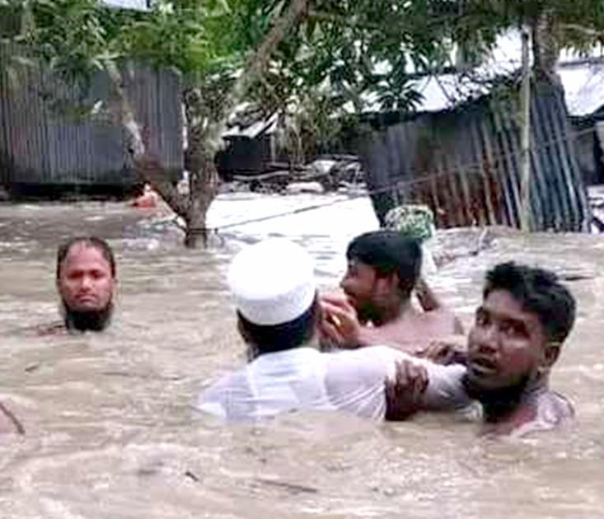
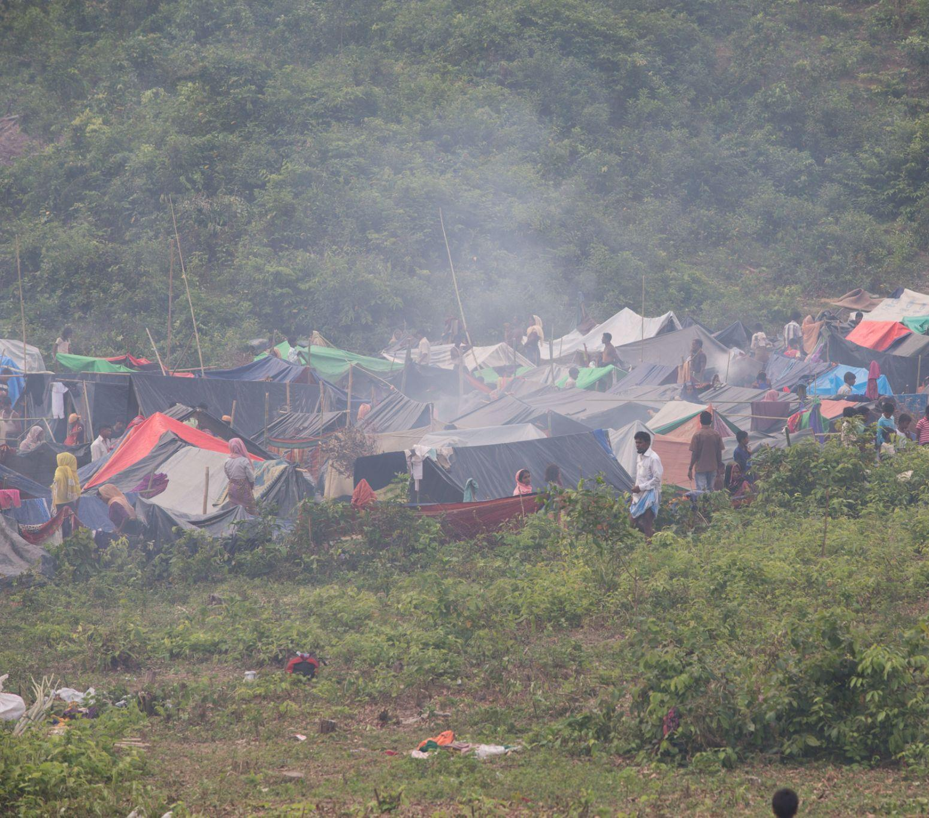
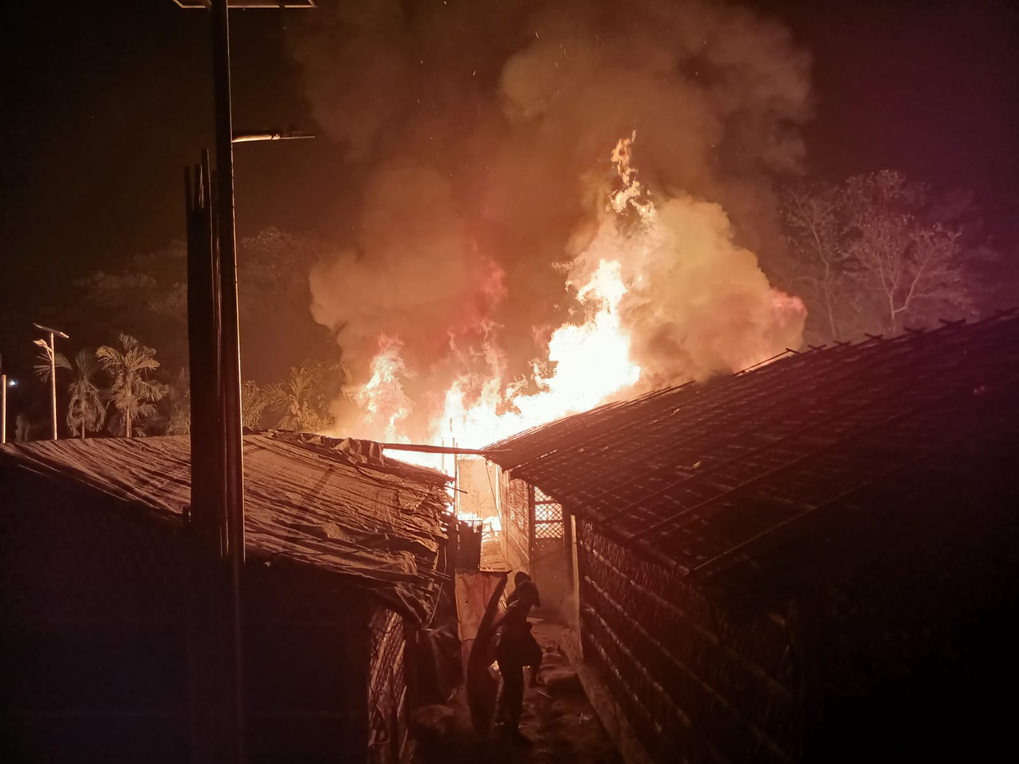
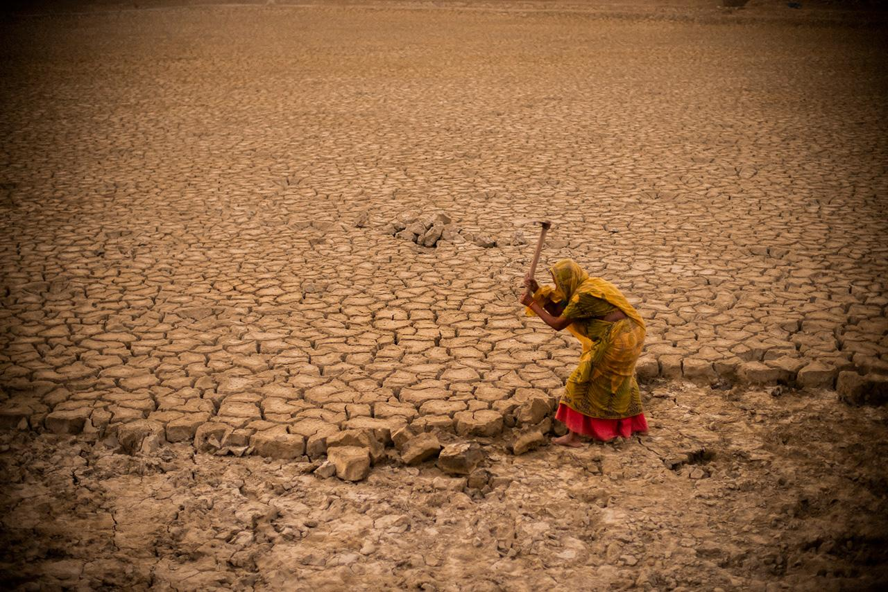
Understanding Disaster
The United Nations Office for Disaster Risk Reduction (UNISDR) states that disasters occur due to hazards, vulnerabilities, and a lack of proper measures. McEntire (2015, p. 3) defines disaster in relationship to underlying hazards but underscores that they are significant disruptive social events that require changes in routine behaviors.
Disasters are seen as the consequence of inappropriately managed risk. These risks are the product of a combination of both hazards and vulnerability.

Slide 6





Cycle of Disaster Management
Crisis
To deal with the disaster, a comprehensive approach is developed over the years named disaster management cycle. It is about proactive planning to lessen the impact of inevitable disasters. It's a continuous cycle where each stage builds on the previous one, creating a more resilient community in the face of adversity.
Preparedness
response
to prepare for managing the crisis
Disaster
to save lives and minimize imediate impacts
Pre-disaster
Post-disaster
Recovery
Prevention
to minimize impacts of future disasters
to minimize impacts of future disasters
Which phase of the disaster management cycle do you think is most challenging, and why?

Slide 7
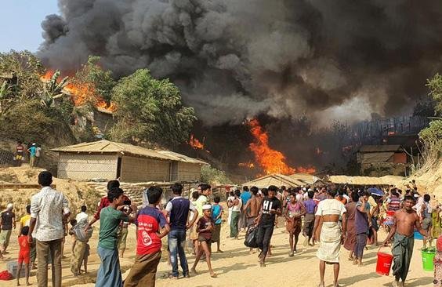
Understanding Emergency
An emergency is defined as a state where standard procedures are suspended, and extraordinary measures are taken to save lives, protect people, limit damage, and return conditions to normalcy as soon as possible.
The emergency situation is usually caused by a single sudden shock.
(Alexander, 2003; World Health Organization, 2002)
Shafiqur Rahman, 2021

Slide 8
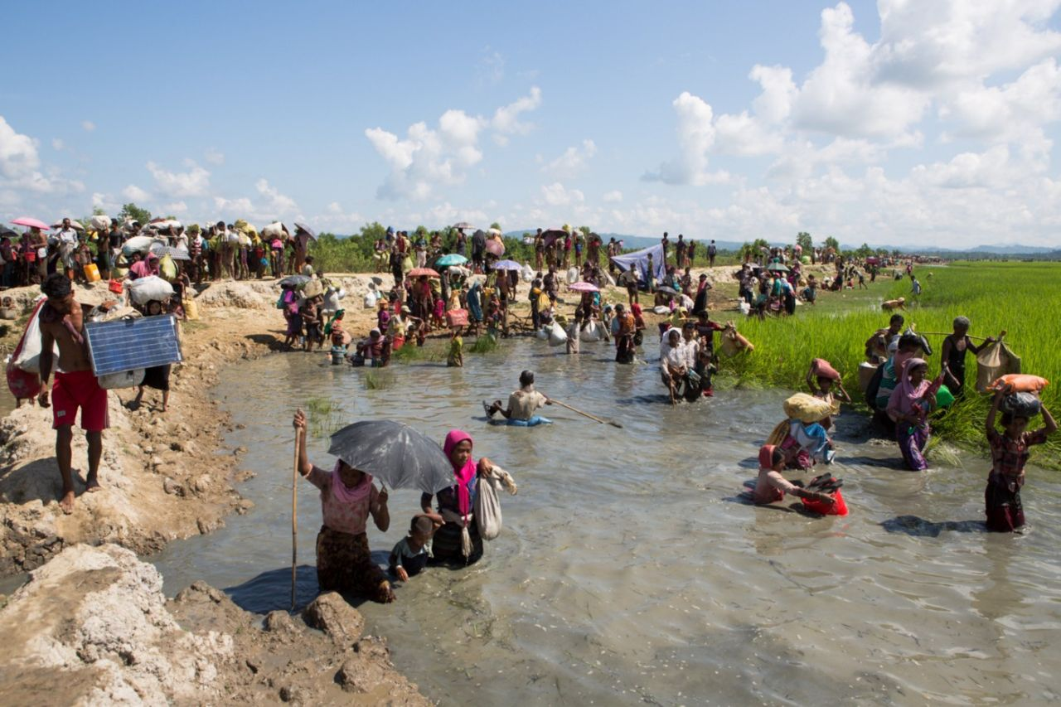
Understanding Crisis
A crisis is a situation that disrupts a system as a whole, threatening its basic assumptions and existential core (Pauchant & Mitroff, 1992, p. 15).
Alexander (2005b) also argues that "the significance of a crisis is its unexpectedness and uncontrollability, which disrupts and impedes normal operations.” Each crisis situation is unique, and managers must adjust and respond differently.
Kamrul Hasan, 2017

Slide 9
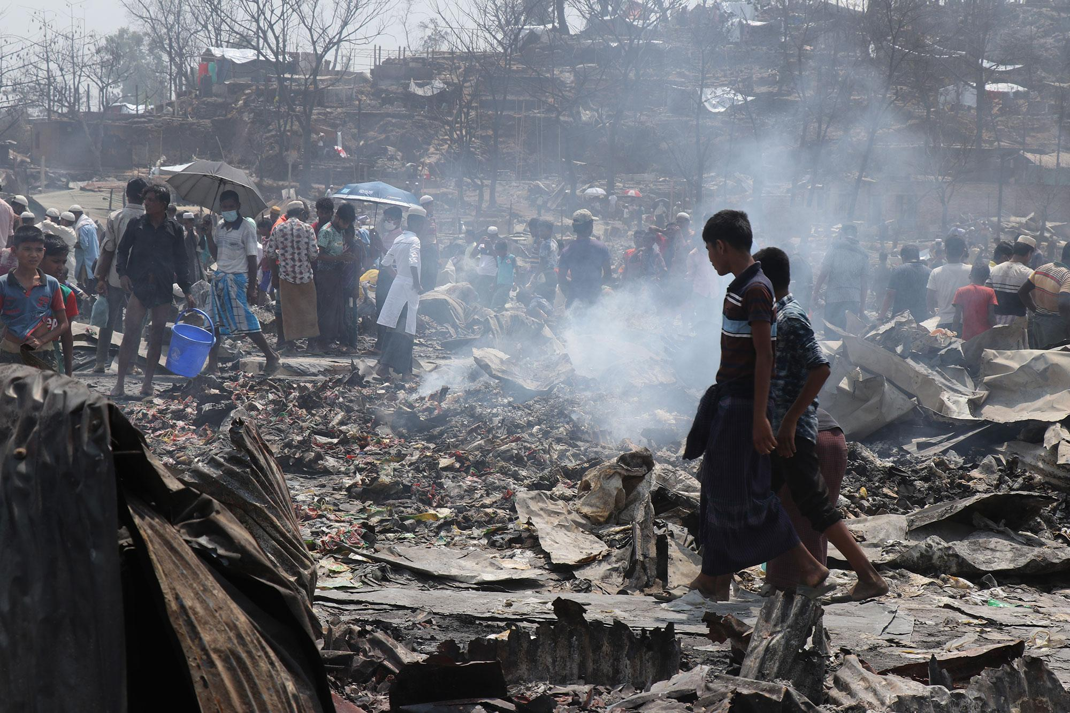
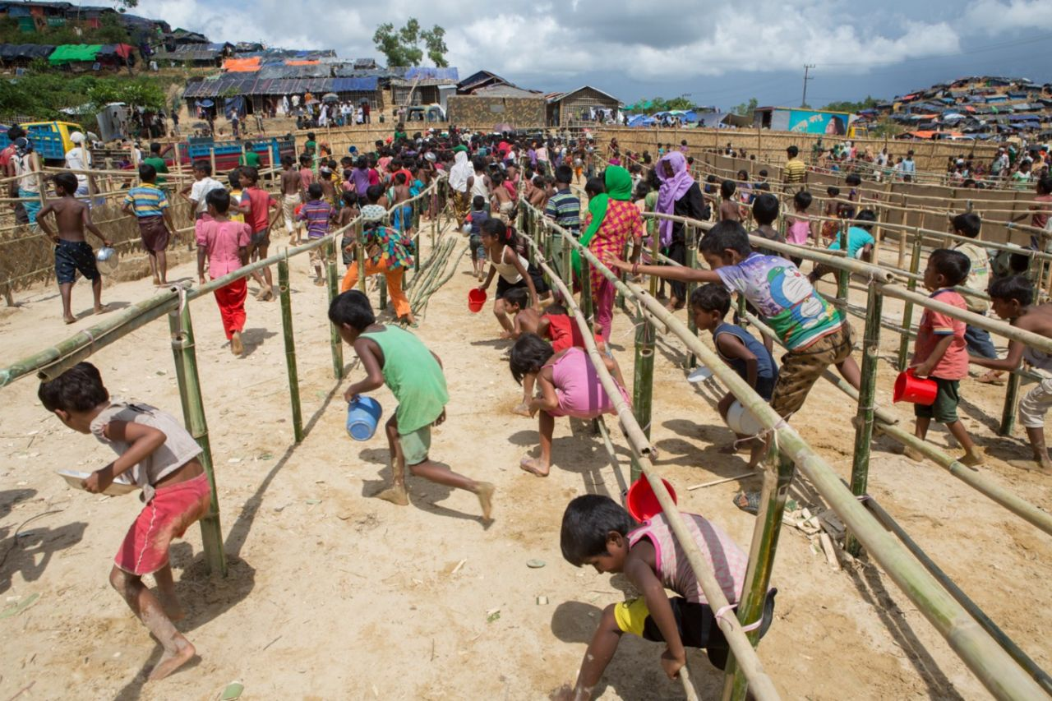
Pattern of Crisis
BRAC, 2021
BRAC, 2018
Kamrul Hasan, 2017
Sudden-onset crisis is usually caused by a single sudden shock, for example, fire outbreak, earthquake or cyclone.
A slow-onset crisis does not arise from a distinct event but rather emerges gradually over months, or even years. A good example of a slow-onset crisis is drought.
Protracted crises are situations where a significant part of the population is acutely vulnerable and dependent on humanitarian assistance over a prolonged period. Ex. Darfur crisis in Sudan.

Slide 10
Reflection
Differentiate between disasters, emergencies, and crisis settings
(Please identify the disasters, emergencies, and crises illustrated in the cases below. This may take 4-5 minutes)
The Skyline Bridge, a major transportation connection in Ting City, collapsed, resulting in terrible deaths and substantial interruption to the city's movement. For a week, people of the city had great difficulty crossing the river due to the broken bridge, which increased traffic and hampered economic activity.
A large migration of individuals seeking safety and asylum occurred in the middle of Thamus nation's growing conflict and political unrest. Families fled, leaving their belongings and livelihood behind as they took risky getaways in the crossfire of armed warfare.
A deadly contagious virus known as B10 suddenly and horrifically broke out in the metropolis of Pipilika, overwhelming the city's medical system. The virus had a unique strain of influenza with a shockingly high death rate, quickly spread through direct human contact. City officials failed to act quickly and issued an order to locked people inside their homes.

Slide 11
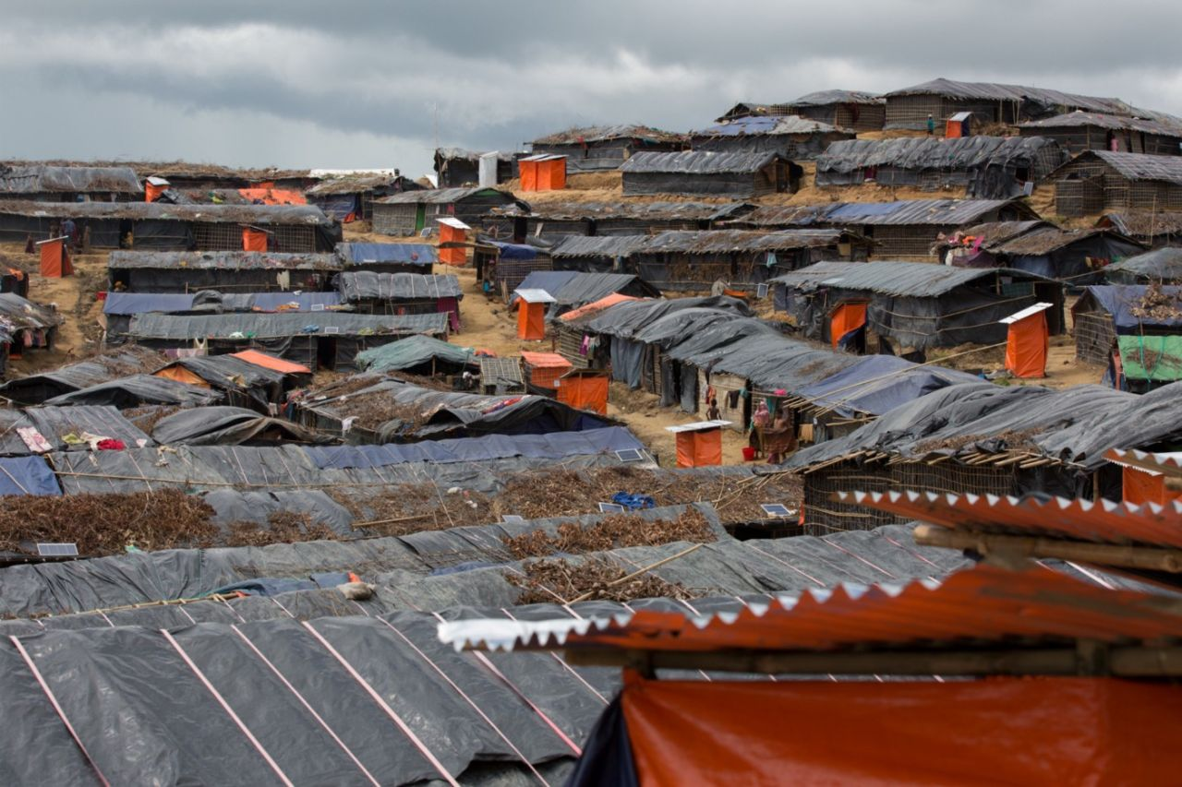
Humanitarian Crisis Setting
Humanitarian Crisis
A humanitarian crisis represents a critical threat to the health, safety, security, or well-being of a community or other large groups of people, usually over a wide area. (Calhoun 2008).
Humanitarian crises may arise because of Natural, Man-made & Complex Hazards
Natural disasters can be geophysical, hydrological, climatological, or biological.
Artificial emergencies include armed conflicts, plane & train crashes, fires, and industrial accidents.
Complex emergencies is a combination of natural and man-made elements. This may lead to a humanitarian crisis.
Kamrul Hasan, 2017

Slide 12
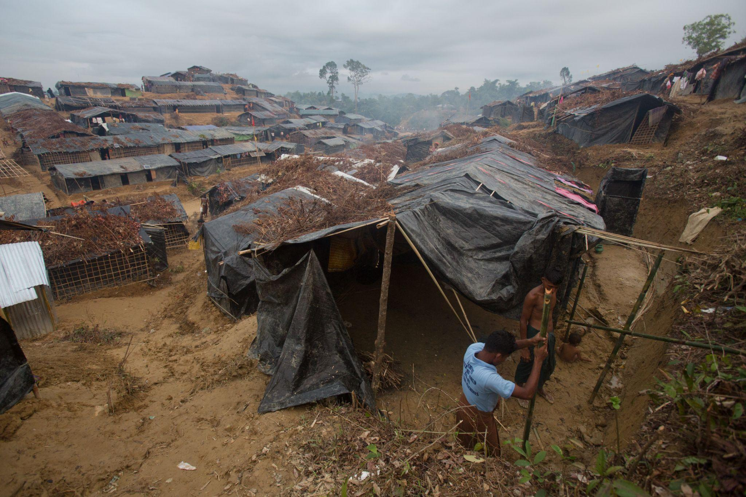
Humanitarian Crisis Setting
Humanitarian Crisis can be characterized by the following
Extensive violence and loss of life
Displacements of populations
Widespread damage to societies and economies
Need large-scale, multi-faceted humanitarian assistance
Response
Each humanitarian disaster has its own set of challenges, and must be responded to accordingly. The priority in any humanitarian response, regardless of the kind of disaster, is to save lives and reduce suffering through meeting humanitarian needs.
BRAC, 2017

Slide 13
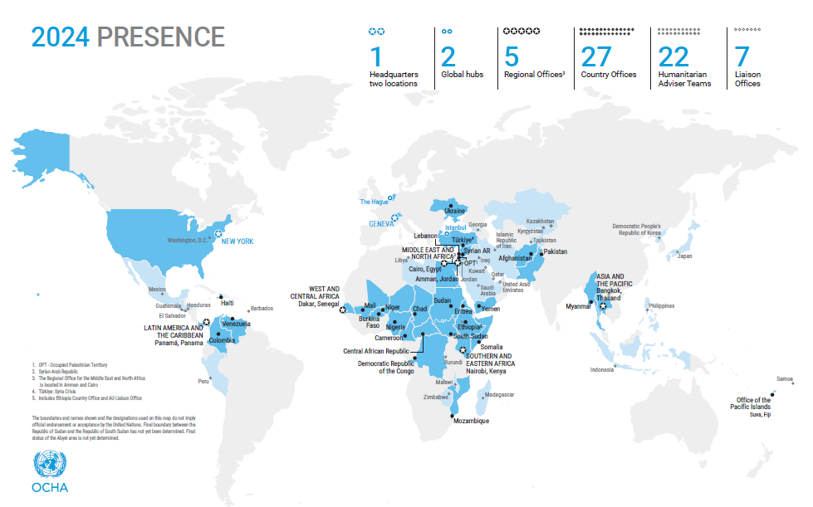
Humanitarian Crisis in the World
Humanitarian Crisis in the World
The United Nations Office for the Coordination of Humanitarian Affairs (OCHA) brings the world together to tackle humanitarian emergencies and save the lives of people caught in crises. This map shows countries affected with the humanitarian crisis in the world currently.
OCHA, 2024

Slide 14
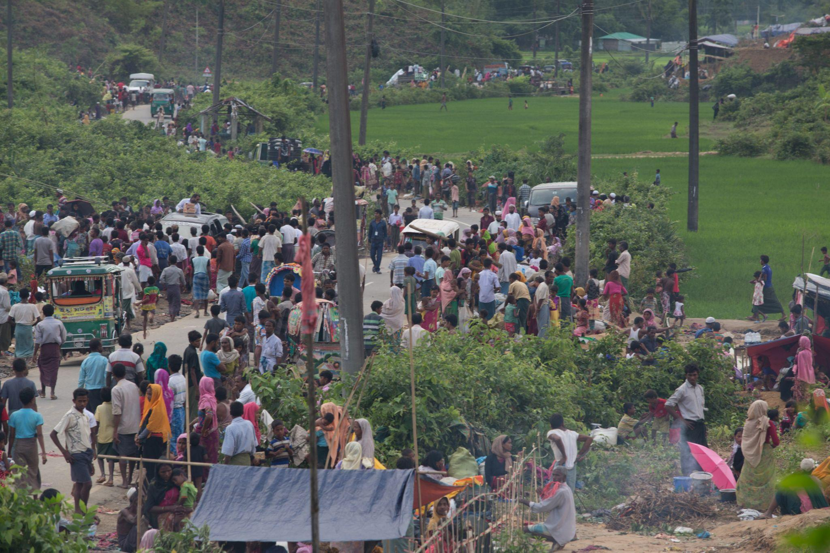
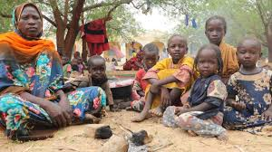
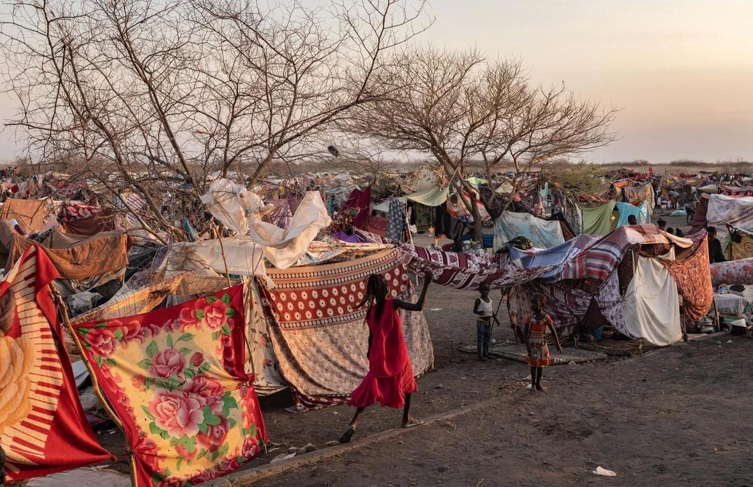
Effects of the Crisis
BRAC, 2017
UN, 2023
UNHCR, 2023
Imaginary Activity: Imagine for 1-2 minutes that you've just arrived at a crowded refugee camp after fleeing your home. What are your biggest concerns? How would you feel about the situation and the people around you?

Slide 15






The Effect of Humanitarian Crises on Communities
Food Insecurity
Economic Loss
Health
WASH
Protection
Vulnerability
Food insecurity and disruptions lead to hunger and malnutrition.
The destruction of infrastructure can lead to long-term financial insecurity.
Physical health issues due to injuries, the lack of access to healthcare services along with mental health issues.
Lack of access to clean water and sanitation facilities increases the risk of waterborne diseases.
Gender-based violence, affecting women and girls' safety and exacerbating gender inequalities.
People become homeless or live in unsafe conditions. Displacement creates identity crisis.

Slide 16
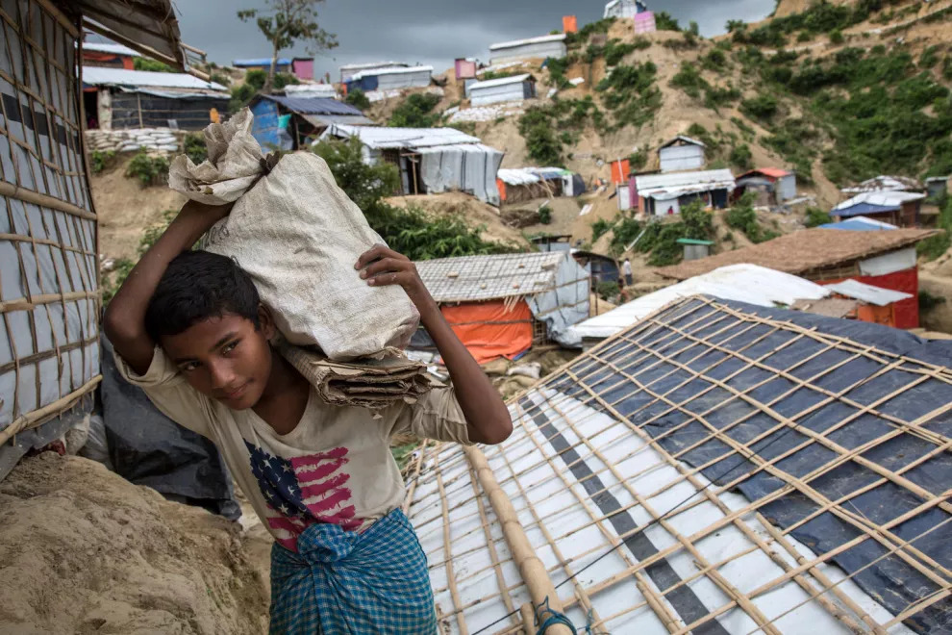
Understanding the effect of Humanitarian crises on children
Crisis exacerbates child protection risks, such as trafficking, child labor, violence, child marriage, family separation, and recruitment and use by armed groups.
Crisis can lead to mental health challenges such as anxiety, depression, and PTSD.
Highest numbers of children whose lives are affected lives in Democratic Republic of Congo, Israel, Palestine, Somalia, Ukraine, and Syria.
Shafiqur Rahman, 2021

Slide 17
Reflection
Multiple Choice Questions
Which of the following best describes a disaster?
What typically causes an emergency?
a) A planned event that enhances community resilience
a) Long-term gradual changes
b) A gradual change in societal norms
b) Multiple simultaneous incidents
c) A sudden and catastrophic event disrupting community functioning
c) A single sudden shock
d) Routine operational procedures
d) A controlled risk management strategy

Slide 18
Reflection
Which factor poses a significant risk to humanitarian relief workers in certain regions?
What is the primary priority in any humanitarian response?
a) Ease of access to affected populations
a) Rebuilding infrastructure
b) Supportive local communities
b) Meeting humanitarian needs and reducing suffering
c) Lack of security risks
c) Allocating blame for the disaster
d) Presence of armed conflict
d) Promoting economic development

Slide 19
Humanitarian Response Principles
Humanitarian Principles
Independence
Impartiality
Voluntary service
Unity
Non-discrimination and inclusion
Universality
Humanity

Slide 20

Humanitarian Standards
1
Communities and people affected by crisis receive assistance appropriate and relevant to their needs.
2
Communities and people affected by crisis can expect that the organizations assisting them are managing resources effectively, efficiently and ethically.
3
Communities and people affected by crisis are not negatively affected and are more prepared, resilient and less at-risk as a result of humanitarian action.
4
Communities and people affected by crisis know their rights and entitlements, have access to information and participate in decisions that affect them.
5
Communities and people affected by crisis have access to safe and responsive mechanisms to handle complaints.

Slide 21
Humanitarian Standards
6
Communities and people affected by crisis receive coordinated, complementary assistance.
7
Communities and people affected by crisis can expect delivery of improved assistance as organizations learn from experience and reflection.
8
Communities and people affected by crisis receive the assistance they require from competent and well-managed staff and volunteers.
9
Communities and people affected by crisis can expect that the organizations assisting them are managing resources effectively and ethically.

Slide 22
Global Policies & Pledges
International Humanitarian Law (IHL)
Sustainable Development Goals (SDGs)
The UN Guiding Principles
The United Nations Charter
The 1951 Convention

Slide 23
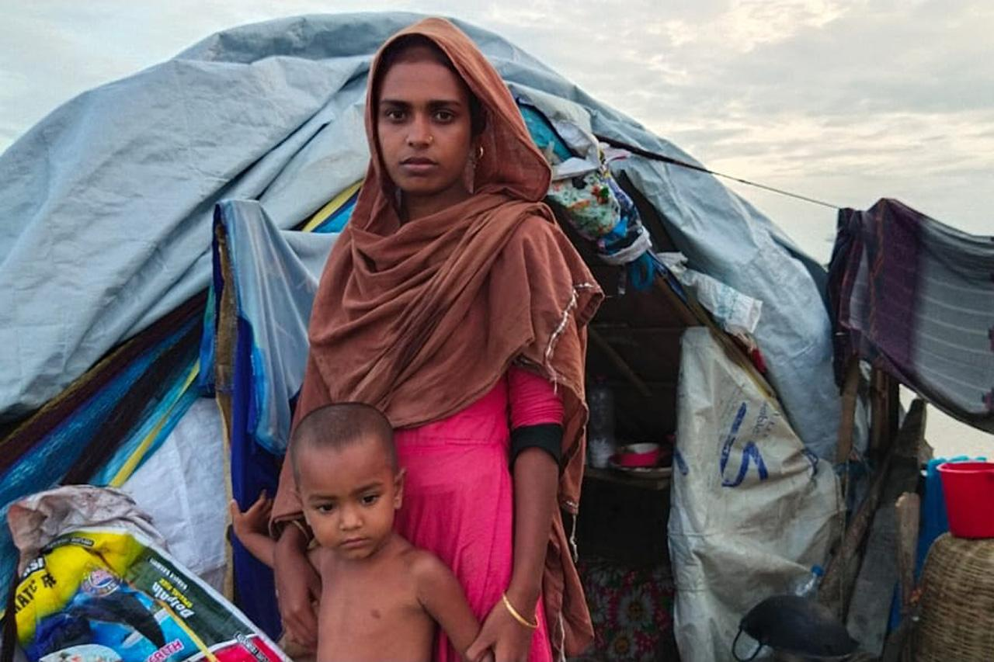
Ethics
Imagine for one-two minutes that you're assigned with a team creating a documentary on a humanitarian crisis. What ethical considerations would you face in telling the story?
BRAC, 2021

Slide 24
Ethics
Do No Harm
Informed Consent
Accountability
Confidentialit
Anonymity
This principle is paramount. Humanitarian action should not inadvertently worsen the situation in affected communities.
People have the right to understand how aid will be used and make informed decisions about participation.
Humanitarian organizations must ensure transparency, effectiveness, and responsiveness to the needs of affected populations.
Researcher-participant confidentiality ensures sensitive information is handled carefully.
Anonymizing implies that the project does not gather personal information or cannot link responses to participants.

Slide 25

United Nations & Associated Agencies
Red Cross & Red Crescent
Humanitarian
Actors
Non-Governmental Organizations
& I-NGO
Community-based Organization
Civil Society Organization
Host Community

Slide 26
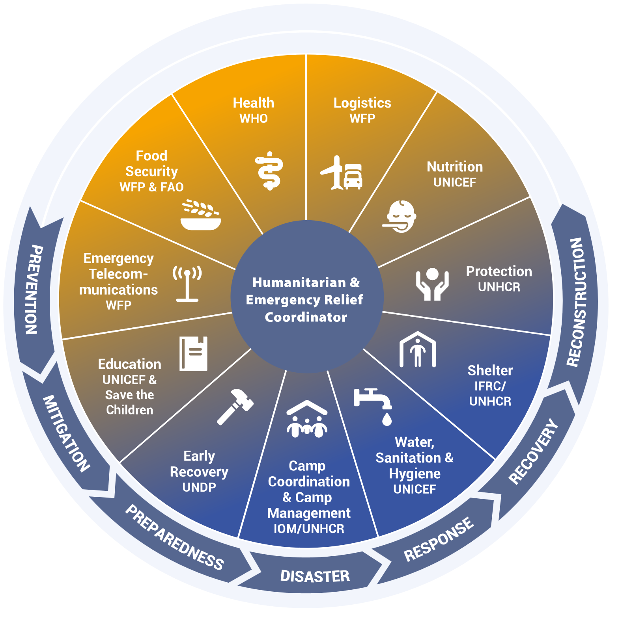
Humanitarian Sectors
The Inter-Sector Coordination Group (ISCG) is the central coordination body for humanitarian agencies serving Rohingya refugees in Cox’s Bazar, Bangladesh. These agencies are organized into 11 thematic Sectors:
Food Security
Shelter
Water, Sanitation & Hygiene
Protection
Health
Livelihoods
Nutrition
Logistics
Education
Camp Coordination
Emergency Telecommunication
Early Recovery
The Cluster Approach (Source: IASC Reference Module for Cluster Coordination at the Country Level)

Slide 27
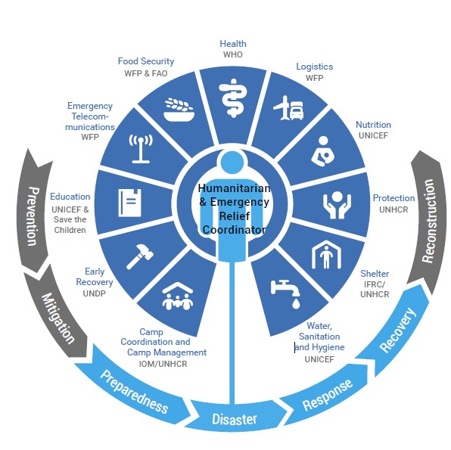
Global National Cluster
Clusters are sectoral coordination groups composed of humanitarian actors engaged in a response. Clusters are shown in the dark blue segments in the diagram here.
At the global level, clusters are responsible for strengthening system-wide preparedness and providing technical capacity to respond to humanitarian emergencies within their respective sectors.
At the country level, clusters ensure that the activities of partners are coordinated and harmonized.
Example: The Education Cluster is co-led by UNICEF and Save the Children at the global level. At the country level, education clusters are usually co-led by UNICEF and Save the Children, but another NGO can also co-lead.
Source: IASC Reference Module for Cluster Coordination at the Country Level
https://emergencymanual.iom.int/cluster-approach

Slide 28

Video
Watching
Watch the video on the humanitarian crisis and action in Cox's Bazar by BRAC and think about the key takeaways.
https://www.youtube.com/watch?v=iVYX1sGanTQ&list=PLDpe9qVztlZpXJfZUdJvYoUDeW_bD9UPO&index=17

Slide 29
Al-Dahash, H., Thayaparan, M., & Kulatunga, U. (2016). Understanding the terminologies : disaster, crisis and emergency. http://researchopen.lsbu.ac.uk/1110/
Alexander, D. (2003). Towards the development of standards in emergency management training and education. Disaster Prevention and Management: An International Journal, 12(2), 113-123.
Alexander, D. (2005b). Towards the development of a standard in emergency planning. Disaster Prevention and Management: An International Journal, 14(2), 158-175.
BRAC.(2021).https://blog.brac.net/a-super-cyclone-flooding-and-a-pandemic-the-year-bangladesh-had-three-humanitarian-crises-at-the-same-time/
BRAC. (2021). BRAC stands by fire victims in the Rohingya refugee camps.
https://bracusa.org/brac-stands-by-fire-victims-rohingya-refugee-camps/
Community Engagement | UNICEF SBC GUIDANCE. (n.d.). https://www.sbcguidance.org/understand/community-engagement
De Lauri, A. (2020). Civil Society. In BRILL eBooks (pp. 28–29). https://doi.org/10.1163/9789004431140_014
References

Slide 30
Fundamental principles: IFRC. Homepage. (n.d.-a).
https://www.ifrc.org/who-we-are/international-red-cross-and-red-crescent-movement/fundamental-principles
Hasan, K. (2017). Standing beside. The Good Feed. https://blog.brac.net/standing-beside-the-rohingyas-the-last-twelve-months-in-coxs-bazar-bangladesh/
Le Cozannet, Goneri & Kervyn, Matthieu & Russo, Simone & Ifejika Speranza, Chinwe & Ferrier, P. & Foumelis, Michael & Lopez, Teodolina & Modaressi, Hormoz. (2020). Space-Based Earth Observations for Disaster Risk Management. Surveys in Geophysics. 41. 10.1007/s10712-020-09586-5.
McEntire, D. (2015). Disaster response and recovery. Hoboken, NJ: John Wiley.
OCHA. (2024). https://www.unocha.org/headquarters
Parater, L. (2018, August 20). At the Heart of the Community: How to work with community-based organizations. UNHCR Innovation. https://www.unhcr.org/innovation/heart-community-work-community-based-organizations/
References

Slide 31
Pauchant, T. C., & Mitroff, I. I. (1992). Transforming the crisis-prone organization. San Francisco: CA: Jossey-Bass Publishers
Project, S. (2011). Humanitarian Charter and Minimum Standards in Humanitarian Response. Practical Action Pub. http://books.google.ie/books?id=DPq6GwAACAAJ&dq=Fundamental+principles:+IFRC&hl=&cd=3&source=gbs_api
Protracted emergencies vs rapid onset. CARE Toolkit. (2022a, August 13). https://www.careemergencytoolkit.org/management/8-communications-and-media/1-role-of-media-and-communications-in-emergencies/protracted-emergencies-vs-rapid-onset/
Rahman, S (2021). Fire destroys Rohingya camp in Bangladesh.
https://www.dw.com/en/fire-destroys-rohingya-shelters-in-bangladesh-refugee-camp/a-56952995
Sphere. (2018). The Sphere Handbook. Sphere Project. http://books.google.ie/books?id=tDOfvAEACAAJ&dq=The+Sphere+Handbook+2018&hl=&cd=6&source=gbs_api
The Unprotected: Overview of the Impact of Humanitarian Crises on Children in 2023 | INEE. (2024, January 31). https://inee.org/resources/unprotected-overview-impact-humanitarian-crises-children-2023
References

Slide 32
UN. (2023). A Sudanese mother and her children take refuge in a town in Chad across the border from Darfur in Sudan.
https://reliefweb.int/report/sudan/explainer-how-darfur-became-humanitarian-calamity-and-catastrophic-human-rights-crisis
UNHCR. (2023). Thousands of South Sudanese refugee returnees wait at the UNHCR transit centre near the Joda border point in Renk, South Sudan, after fleeing the conflict in Sudan. https://www.unhcr.org/uk/news/briefing-notes/unhcr-appeals-safety-civilians-and-aid-1-million-displaced-sudan-crisis.
UNICEF. https://www.unicef.org/adolescence/humanitarian-action
UNISDR. (2009). UNISDR terminology on disaster risk reduction. Geneva: UNISDR. Retrieved 16 March, 2016, from http://www.preventionweb.net/files/7817_UNISDRTerminologyEnglish.pdf
What is a humanitarian emergency?. Humanitarian Coalition. (n.d.). https://www.humanitariancoalition.ca/what-is-a-humanitarian-emergency
World Health Organization. (2002). Disasters and emergencies. Definitions Training Package. WHO/EHA PanAfrican Emergency Training Centre, Addis Ababa. Retrieved August, 10, 2006.
References

